Slide 1
Hebrews 10:1-4, 16-18
Richie Thetford www.thetfordcountry.com

Slide 2
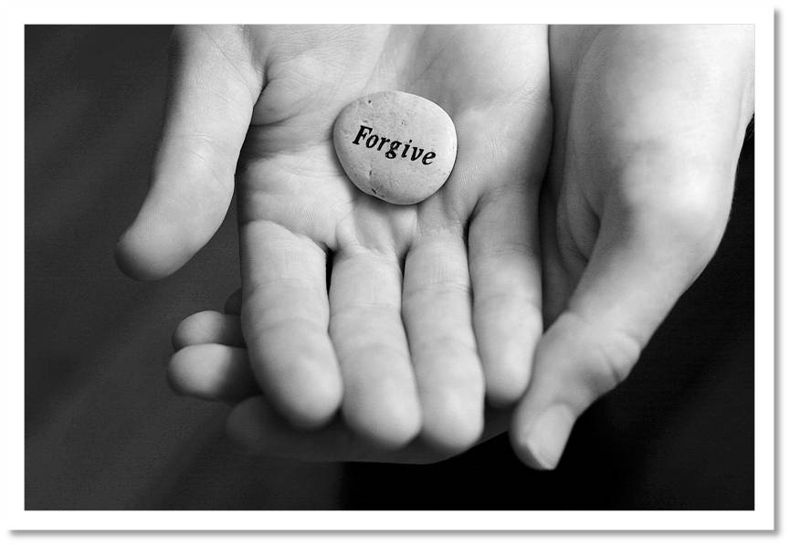
God’s Forgiveness
Is dependent upon our forgiveness
Genesis 50:15-21
Matthew 6:14-15
Matthew 18:23-35
Richie Thetford www.thetfordcountry.com

Slide 3
Respect
Respect the value of the one who needs forgiveness
Romans 5:6-10
Matthew 18:11-13
Richie Thetford www.thetfordcountry.com

Slide 4
Actions
Act as we would want God to act
Ephesians 4:32
Colossians 3:12-13
Richie Thetford www.thetfordcountry.com

Slide 5
Effort
Make every effort to forgive as God forgives
Psalms 103:10-12
Hebrews 10:16-18
Richie Thetford www.thetfordcountry.com

Slide 6
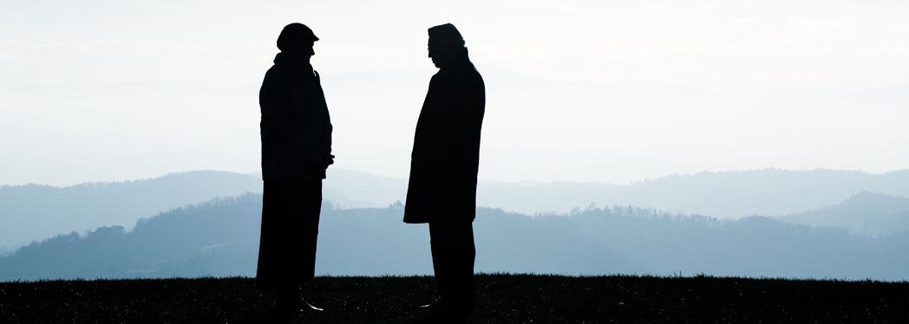
Do we practice forgiveness?
God’s forgiveness depends on our forgiveness of others
Respect the value of those who need forgiveness
Act as God would act
Forgive as God forgives!
Richie Thetford www.thetfordcountry.com

