Slide 1
Practicing Church Discipline
Discipline Defined: “Training that develops self-control, character, efficiency; submission to authority and control; treatment that corrects or punishes”
Richie Thetford www.thetfordcountry.com

Slide 2
God’s Instruction
And you have forgotten the exhortation which speaks to you as to sons: “My son, do not despise the chastening of the Lord, Nor be discouraged when you are rebuked by Him; For whom the Lord loves He chastens, And scourges every son whom He receives. If you endure chastening, God deals with you as with sons; for what son is there whom a father does not chasten? But if you are without chastening, of which all have become partakers, then you are illegitimate and not sons. Furthermore, we have had human fathers who corrected us, and we paid them respect. Shall we not much more readily be in subjection to the Father of spirits and live? For they indeed for a few days chastened us as seemed best to them, but He for our profit, that we may be partakers of His holiness. Now no chastening seems to be joyful for the present, but painful; nevertheless, afterward it yields the peaceable fruit of righteousness to those who have been trained by it.”
Hebrews 12:5-11
Richie Thetford www.thetfordcountry.com

Slide 3
Commanded to Discipline
“Now I urge you, brethren, note those who cause divisions and offenses, contrary to the doctrine which you learned, and avoid them. For those who are such do not serve our Lord Jesus Christ, but their own belly, and by smooth words and flattering speech deceive the hearts of the simple.”
Romans 16:17-18
When does the church get involved in discipline?
Richie Thetford www.thetfordcountry.com

Slide 4
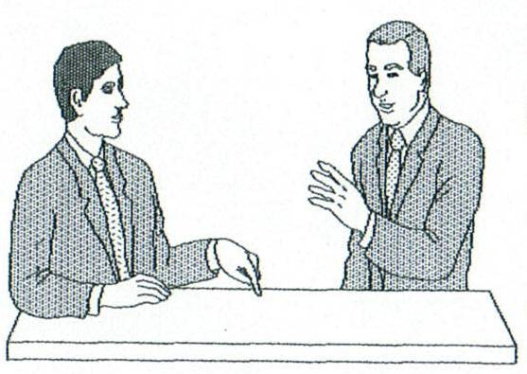
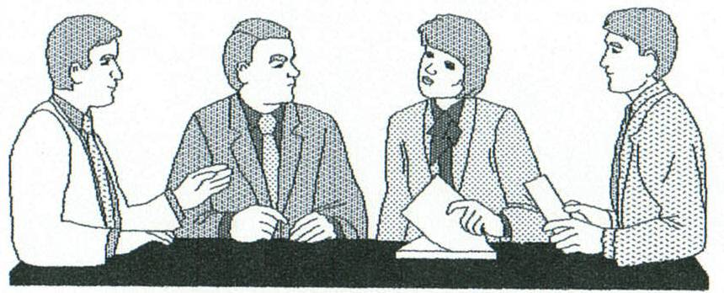
Proper Church Discipline
Matthew 18:15-17
1) 18:15 – You and the trespassing brother
If he hears (repents) you gained your brother
If he does not hear (repent) – take step 2
2) 18:16 – You and one or two others and the trespassing brother
If he hears (repents) you gained your brother
If he does not hear (repent) – take step 3
3) 18:17 – Tell it to the church
If he hears (repents) WE have gained our brother
If he does not hear (repent) – take step 4
4) Let him be as a heathen and a publican
Richie Thetford www.thetfordcountry.com

Slide 5
Paul’s Example of Expediency
Try to get one to repent
When one will not respond – turn over to Satan
Paul’s handling of the situation at Corinth
1 Corinthians 5:1-13
Sin was occurring – it was public
Expediency needed – knew others would be affected (leaven)
“Not to keep company with”
“Reject a divisive man after the first and second admonition, knowing that such a person is warped and sinning, being self-condemned.” Titus 3:10-11
Richie Thetford www.thetfordcountry.com

Slide 6
Be Yoked with Believers
Christians cannot be in fellowship with unbelievers
2 Corinthians 6:14
Ephesians 5:11
“If we say that we have fellowship with Him, and walk in darkness, we lie and do not practice the truth. But if we walk in the light as He is in the light, we have fellowship with one another, and the blood of Jesus Christ His Son cleanses us from all sin.” 1 John 1:6-7
Richie Thetford www.thetfordcountry.com

Slide 7
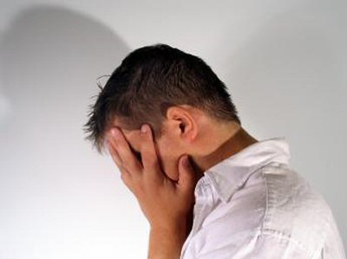
Why is One Handed Over to Satan?
So that their soul might be saved
1 Timothy 1:19-20
1 Corinthians 5:5
So that “he might be ashamed”
“And if anyone does not obey our word in this epistle, note that person and do not keep company with him, that he may be ashamed.” 2 Thessalonians 3:14-15
Richie Thetford www.thetfordcountry.com

Slide 8
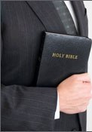
What is Our Responsibility to the “Marked” Christian?
Can’t associate with – in darkness
Continues to “crucify” Jesus
Hebrews 6:4-6
Can’t keep company with
1 Corinthians 5:11
2 Thessalonians 3:14-15
Must withdraw from
2 Thessalonians 3:6
2 John 1:9-11
“Yet count him not as an enemy, but admonish him as a brother.”
2 Thessalonians 3:15
Richie Thetford www.thetfordcountry.com

Slide 9
Whom We Serve is Our Choice!
God gave us freedom of choice
Serve God – or Satan
Matthew 10:32-39
Determine to serve Christ
To “Mark” is for our good and the erring brother
Only effective if we obey the teaching of Jesus
Those who don’t discipline – don’t love
Richie Thetford www.thetfordcountry.com

