Slide 1
Placing Ourselves Under the Mighty Hand of God
1 Peter 5:5-14

Slide 2
Be Clothed with Humility (V5)
Be dressed for the work of a Christian
Colossians 3:12-14
Be clothed with humility
Humility is true – an honest view of who and what we are
If one will humble himself, then he will be exalted
Matthew 23:12

Slide 3
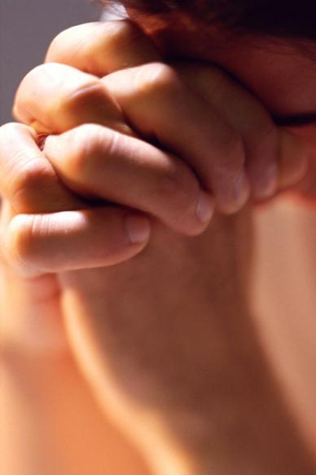
Cast All Your Care Upon Him (V7)
Can’t escape sickness, disappointment, and distress
We can turn our cares over to our Father
Matthew 7:11
Place our life under His mighty hand!
Romans 8:18

Slide 4
Being Sober and Vigilant (V8)
“Be sober, be vigilant; because your adversary the devil walks about like a roaring lion, seeking whom he may devour.”
1 Peter 5:8
Be watchful
To be sober is to be mentally under control at all times
To be vigilant is to be alert; watchful
1 John 3:8-9

Slide 5
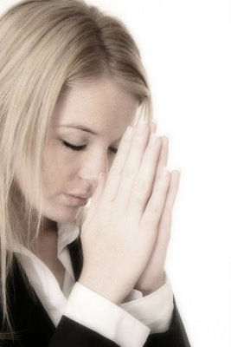
Resist the Devil (V9)
The enemy must be resisted
1 Peter 5:9
Satan seeks to lead us astray
James 4:7

Slide 6
Stand in the Grace of God (V12)
God affords us resources for every need
God of all grace
To stand in His grace means to learn, rely upon and live as one dependent on His grace.
“that the genuineness of your faith, being much more precious than gold that perishes, though it is tested by fire, may be found to praise, honor, and glory at the revelation of Jesus Christ, whom having not seen you love. Though now you do not see Him, yet believing, you rejoice with joy inexpressible and full of glory, receiving the end of your faith--the salvation of your souls.” 1 Peter 1:7-9

Slide 7
CONCLUSION
A promise awaits those who adapt these concepts of God’s Word
1 Peter 5:6
Acts 20:32
SANCTIFIED:
To be set apart for God’s service and made free from sin!

