Slide 1
The Philippian Jailer
Acts 16:16-24
Acts 16:25-30
What must I do to be saved?
Richie Thetford www.thetfordcountry.com

Slide 2
The Jailer and You
In the same situation
James 4:14
Do we not prepare for death?
Hebrews 9:27
Conduct of our life
2 Corinthians 5:10
Continuing in rebellion
Revelation 21:8
Richie Thetford www.thetfordcountry.com

Slide 3
Paul’s Answer
“What must I do?”
Matthew 23:33
Acts 16:31-32
The barrier of sin
Isaiah 59:1-2
Romans 1:16
Jeremiah 10:23
Richie Thetford www.thetfordcountry.com

Slide 4
The “Word of the Lord”
God’s plan
Hebrews 11:6
James 2:19-20
James 2:24
Richie Thetford www.thetfordcountry.com

Slide 5
His Faith Was Not Dead
A living faith
Acts 16:33-34
Ephesians 2:8
Richie Thetford www.thetfordcountry.com

Slide 6
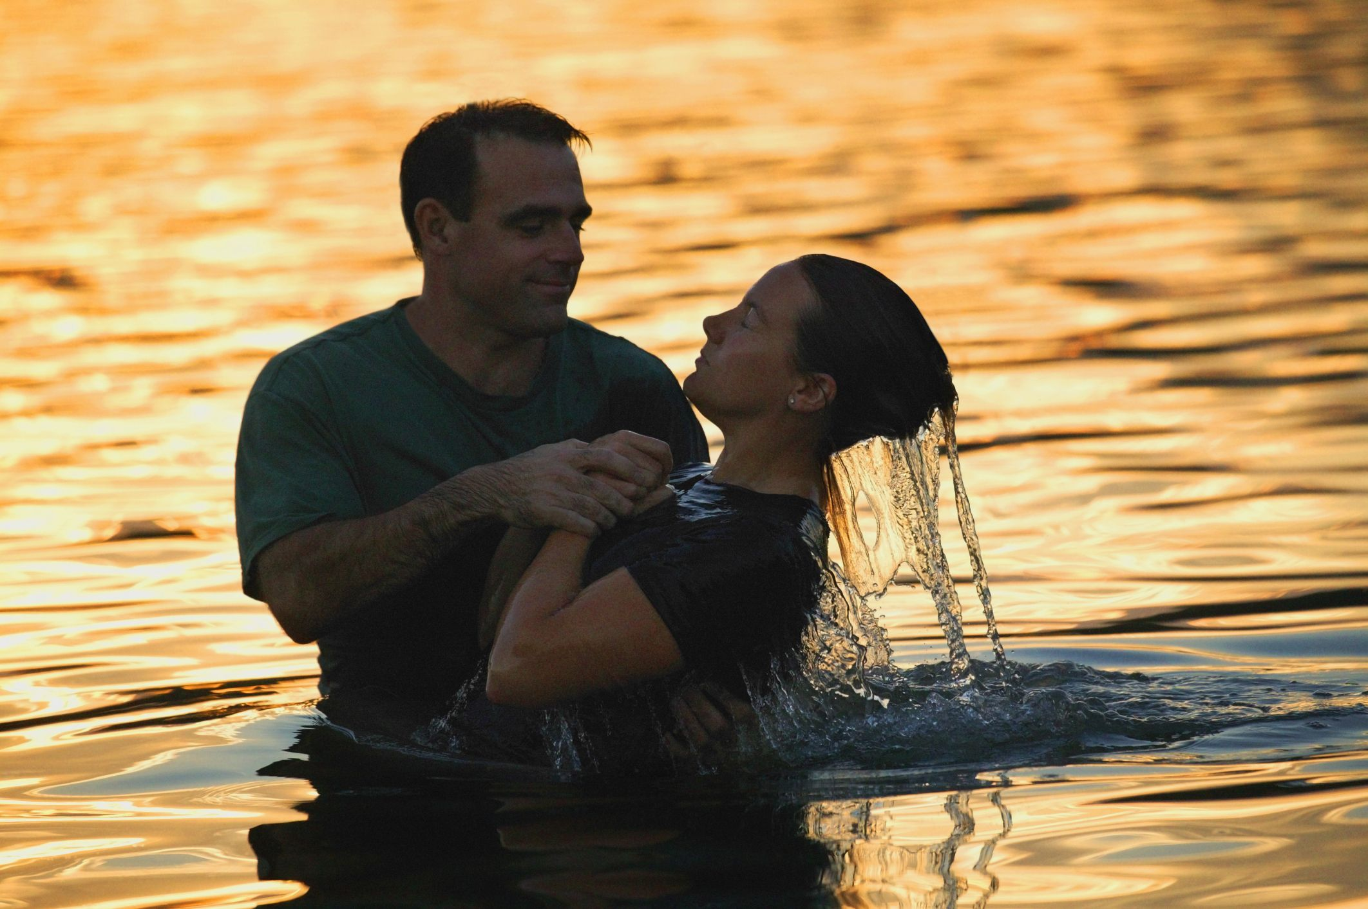
The Jailer Did Not Wait
He obeyed the gospel of Christ
Acts 16:33
John 3:16
Richie Thetford www.thetfordcountry.com

