Slide 1
The Pharisee
&
The Publican
Luke 18:9-14
Richie Thetford www.thetfordcountry.com

Slide 2
Introduction
Humility Needed
Romans 12:3
James 4:6, 10
“a modest or low view of one’s own importance; humbleness”
-- Oxford Dictionary
Richie Thetford www.thetfordcountry.com

Slide 3
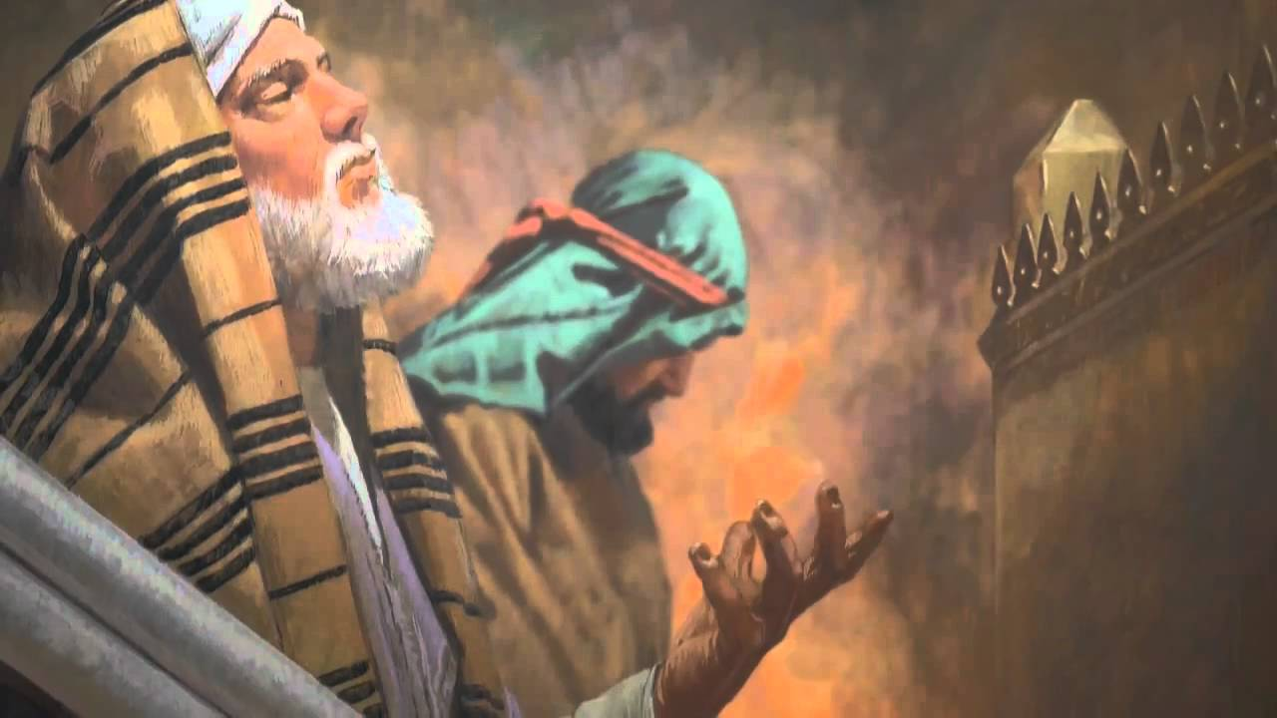
Two Attitudes
The Pharisee
Luke 14:7-11
The Publican
Luke 14:11
Richie Thetford www.thetfordcountry.com

Slide 4
Two Approaches
The Pharisee
Aren’t you proud of me!
The Publican
I am not worthy!
Richie Thetford www.thetfordcountry.com

Slide 5
Two Outcomes
The Pharisee
Rejected by God
The Publican
Accepted and forgiven
Richie Thetford www.thetfordcountry.com

Slide 6
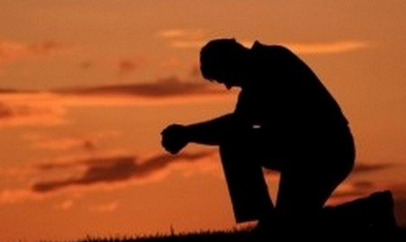
Humbleness in Prayer
“to be bowed down”
Romans 12:10
Proverbs 15:33
Isaiah 29:16; 64:8
Jeremiah 18:4, 6
Romans 9:20-21
Richie Thetford www.thetfordcountry.com

Slide 7
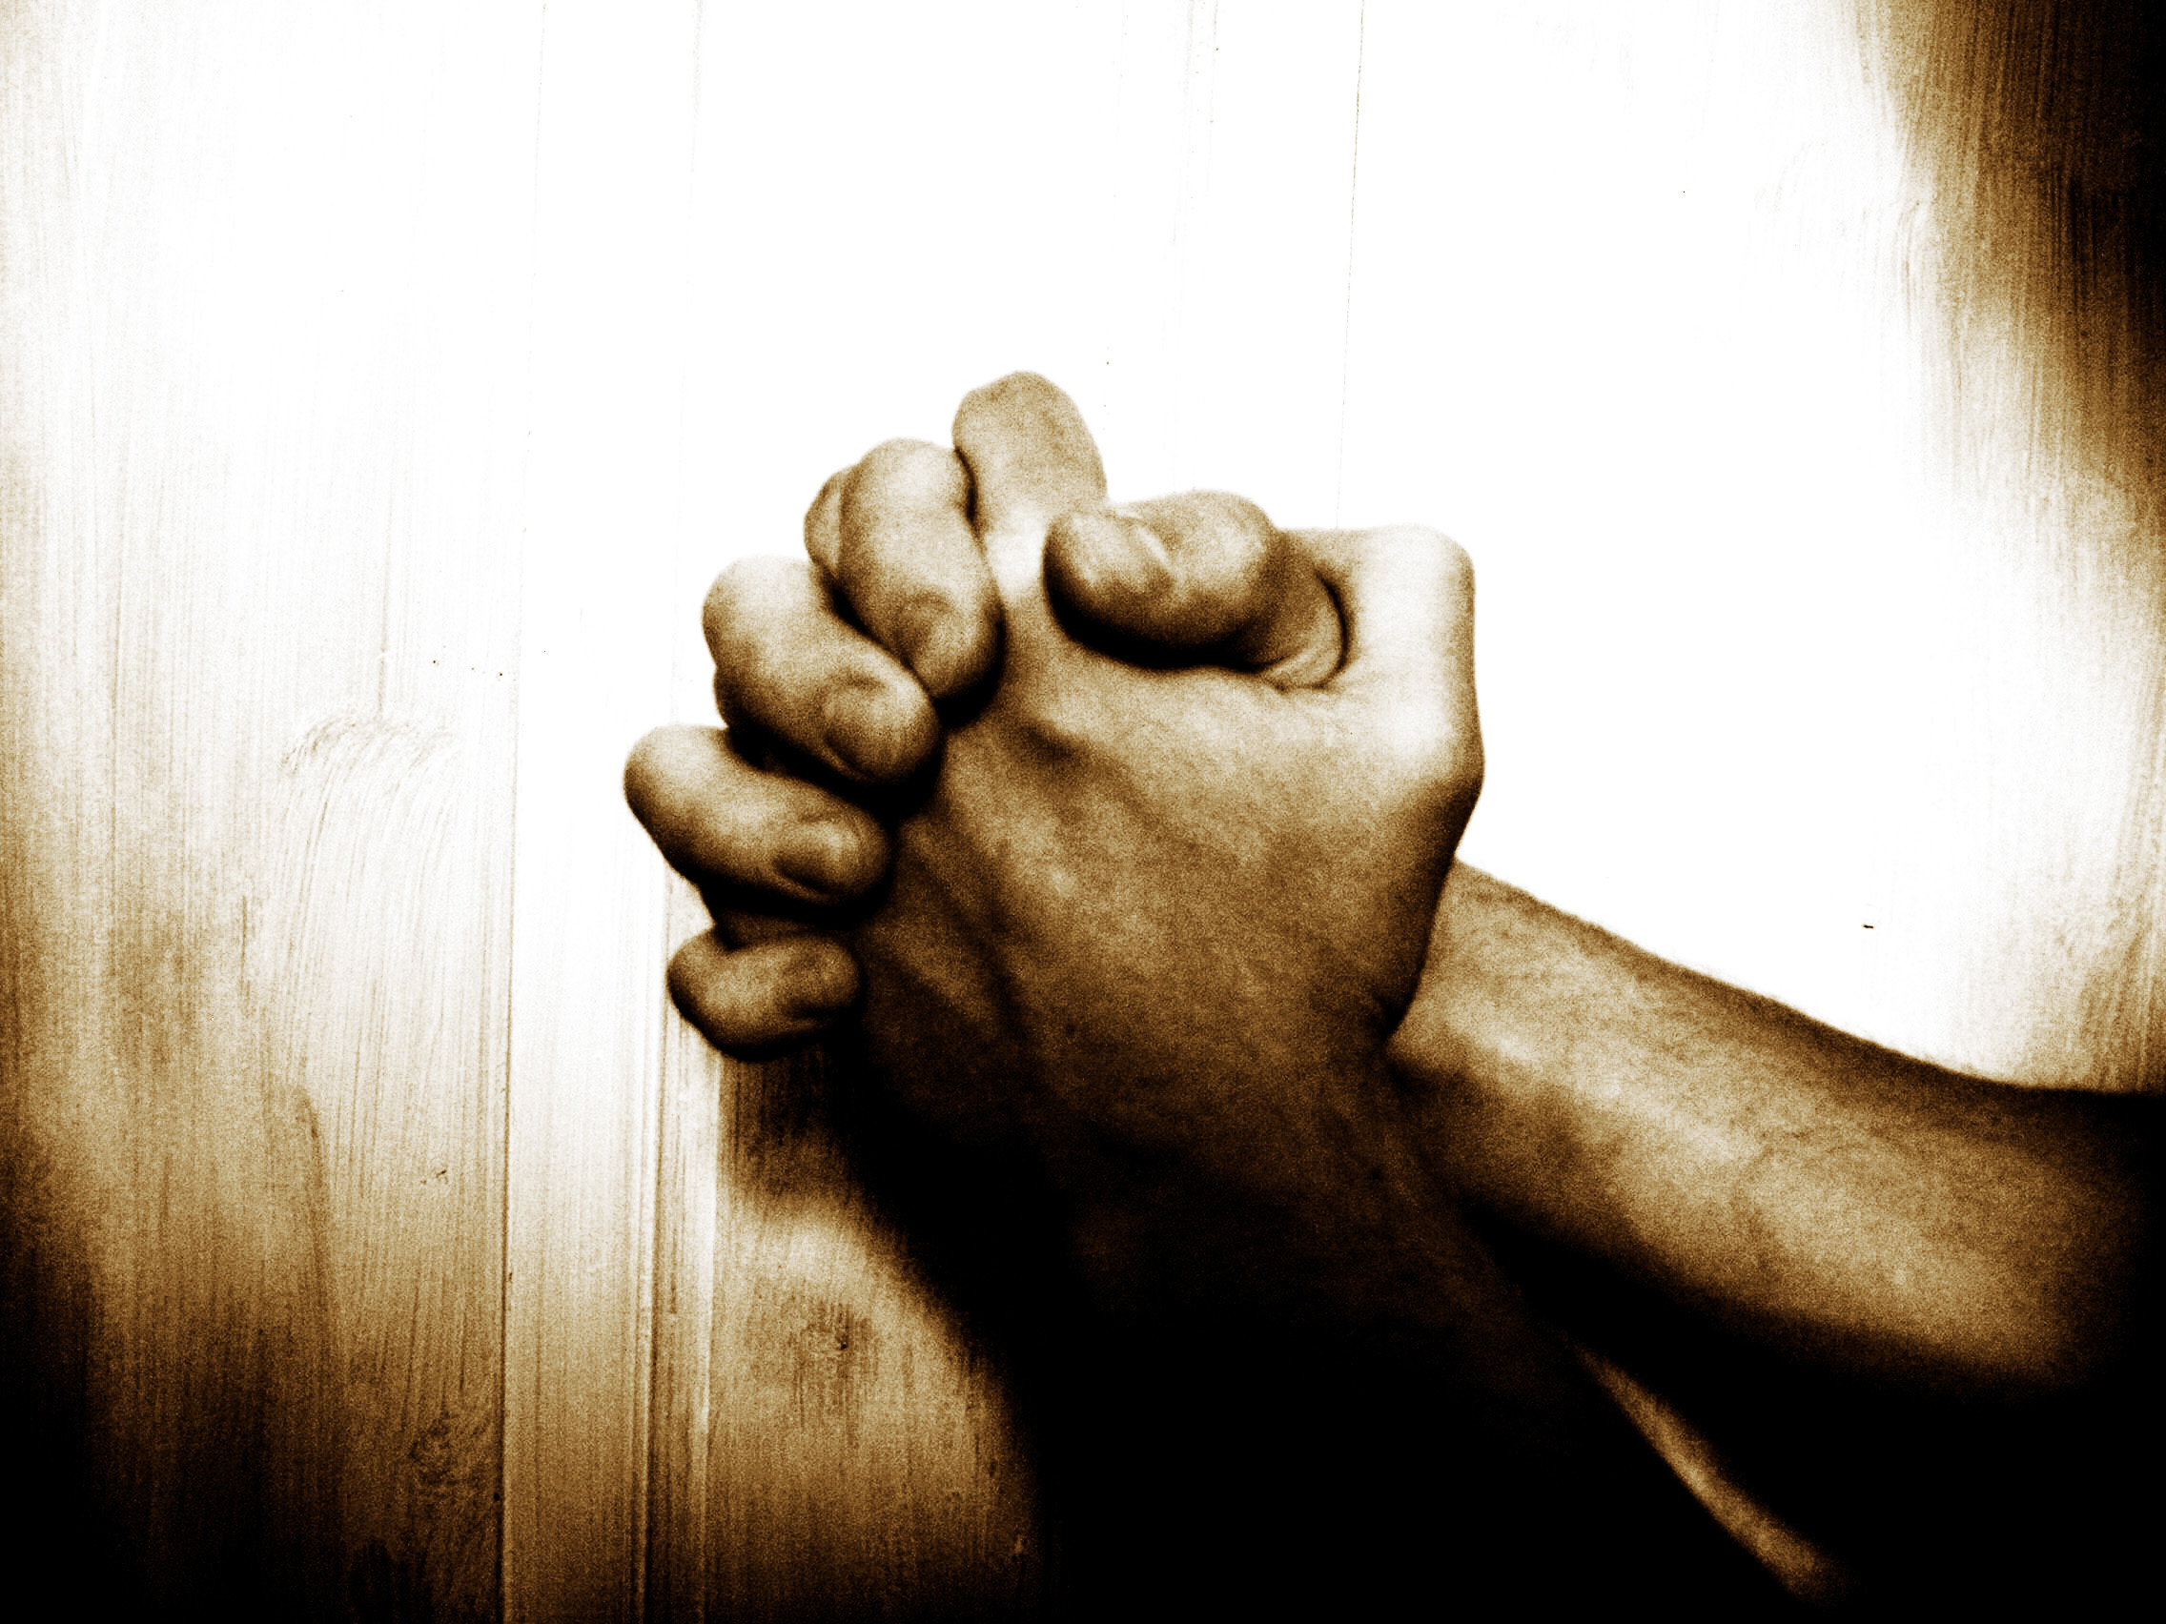
Humbleness in Prayer
How applied to prayer?
Matthew 10:29-30
Matthew 6:7-8
2 Corinthians 10:12
James 4:10
Hebrews 4:12-13
Richie Thetford www.thetfordcountry.com

Slide 8
Humbleness in Prayer
Don’t confuse boldness with haughtiness
Hebrews 10:19-23
Hebrews 4:14-16
1 John 3:19-22
Richie Thetford www.thetfordcountry.com

Slide 9
Conclusion
God wants us to come to Him
God will listen to us
Prayer is a privilege
Are we in the right relationship with our heavenly Father?
Richie Thetford www.thetfordcountry.com

