Slide 1
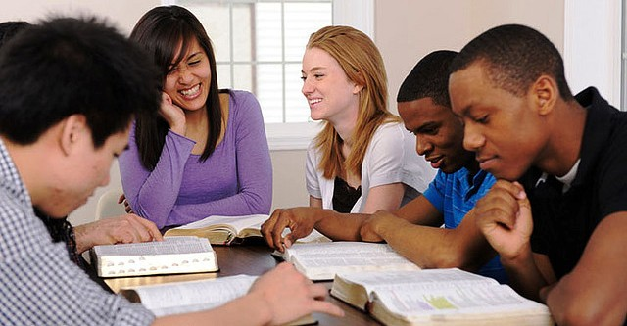
People of Good Reputation
“Therefore, brethren, seek out from among you seven men of good reputation, full of the Holy Spirit and wisdom, whom we may appoint over this business”
Acts 6:3
Richie Thetford www.thetfordcountry.com

Slide 2
Seeking Qualified People for God
A Good name is VERY important!
“A good name is to be chosen rather than great riches, Loving favor rather than silver and gold”
Proverbs 22:1
“A good name is better than precious ointment, And the day of death than the day of one's birth”
Ecclesiastes 7:1
Richie Thetford www.thetfordcountry.com

Slide 3
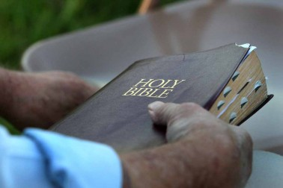
People of Good
R
E
P
U
T
A
T
I
O
N
ighteous
In the ways of God
Matthew 13:43
Matthew 6:33
Richie Thetford www.thetfordcountry.com

Slide 4
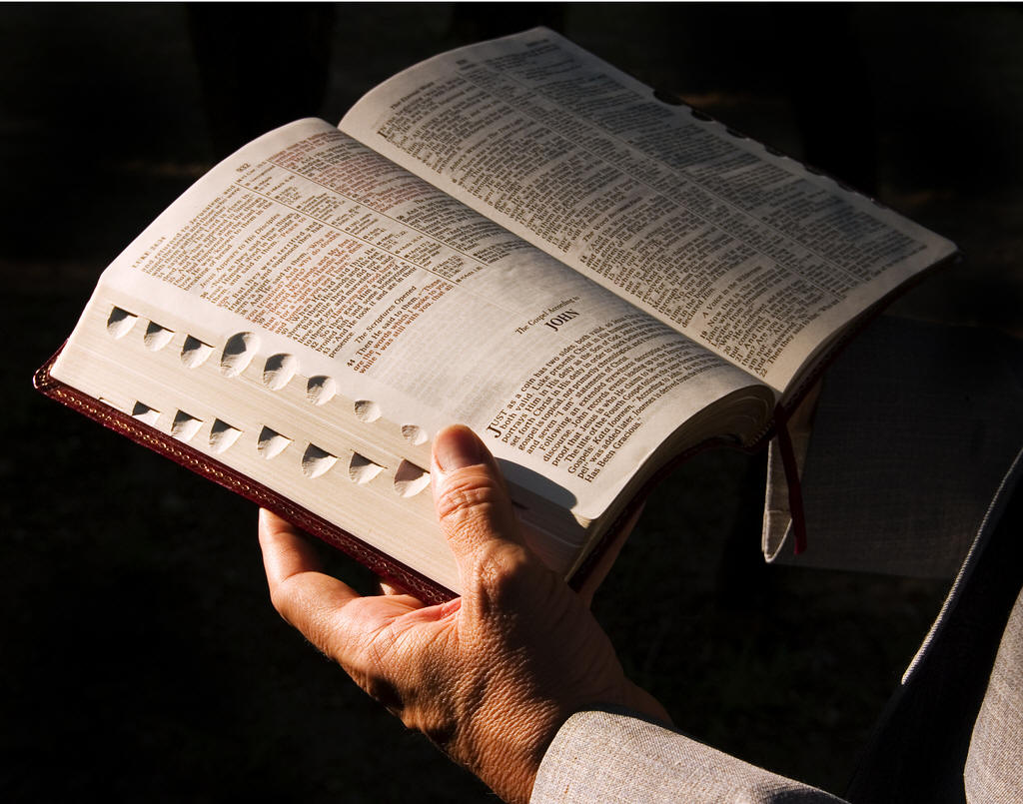
People of Good
R
E
P
U
T
A
T
I
O
N
We should strive to build up rather than to tear down
1 Thessalonians 5:11
dify
Richie Thetford www.thetfordcountry.com

Slide 5
People of Good
R
E
P
U
T
A
T
I
O
N
In spiritual growth
2 Peter 1:5-11
ersevere
Richie Thetford www.thetfordcountry.com

Slide 6
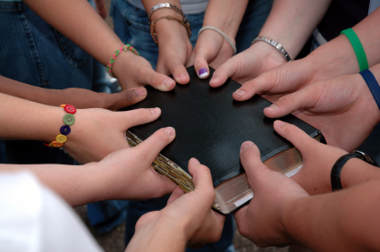
People of Good
R
E
P
U
T
A
T
I
O
N
With brethren in the things of God
Ephesians 4:1-6
nited
Richie Thetford www.thetfordcountry.com

Slide 7
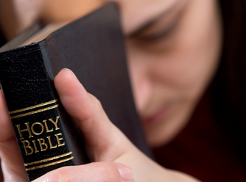
People of Good
R
E
P
U
T
A
T
I
O
N
To develop, to be involved, and to help
Ephesians 4:16
ry
Richie Thetford www.thetfordcountry.com

Slide 8
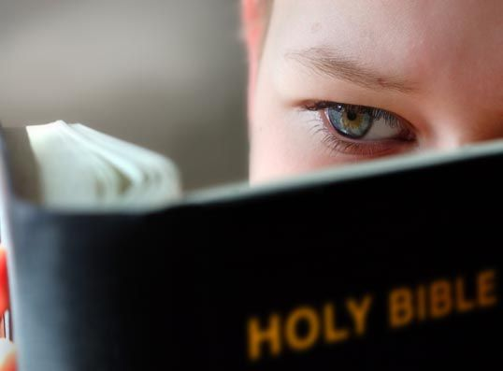
People of Good
R
E
P
U
T
A
T
I
O
N
From situations that can lead to sin
1 Thessalonians 5:21-22
1 Corinthians 15:33
bstain
Richie Thetford www.thetfordcountry.com

Slide 9
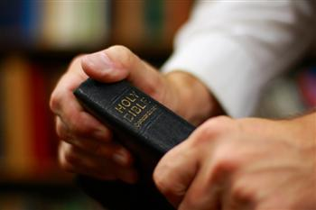
People of Good
R
E
P
U
T
A
T
I
O
N
Watch our tongue
James 3:1-13
ongue
Richie Thetford www.thetfordcountry.com

Slide 10
People of Good
R
E
P
U
T
A
T
I
O
N
Remain pure from sin, always repentant
1 John 1:6-2:2
nnocent
Richie Thetford www.thetfordcountry.com

Slide 11
People of Good
R
E
P
U
T
A
T
I
O
N
Continual submission to God and His commands
1 John 2:3-5
bedient
Richie Thetford www.thetfordcountry.com

Slide 12
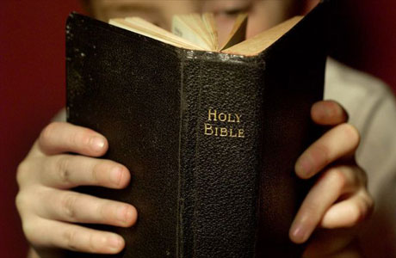
People of Good
R
E
P
U
T
A
T
I
O
N
Be a “NOW” person, not a procrastinator
Hebrews 3:13
ow
Richie Thetford www.thetfordcountry.com

Slide 13
People of Good
R
E
P
U
T
A
T
I
O
N
ighteous
God is looking for individuals that have acquired a “good reputation”
Are we that “special person” God is looking for?
dify
ersevere
nited
ry
bstain
ongue
“A good name is to be chosen rather than great riches, Loving favor rather than silver and gold”
Proverbs 22:1
nnocent
bedient
ow
Richie Thetford www.thetfordcountry.com

