Slide 1
The Parable of the Hidden Treasure
The Preciousness and Value of the Kingdom
Richie Thetford www.thetfordcountry.com

Slide 2
Explanation of the Parable
Hidden Treasure
Details of the Parable
Finds a treasure and hides it
Meaning of the Parable
Describes the value of the kingdom
Richie Thetford www.thetfordcountry.com

Slide 3
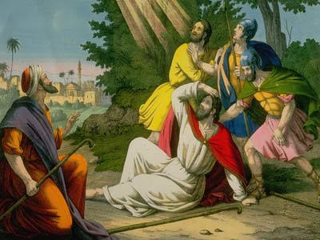
Explanation of the Parable
Hidden Treasure
Apostle Paul as an Example
Discovered the “treasure” unexpectedly
Acts 9:1-2
Acts 26:9-11
Acts 26:19-23
Richie Thetford www.thetfordcountry.com

Slide 4
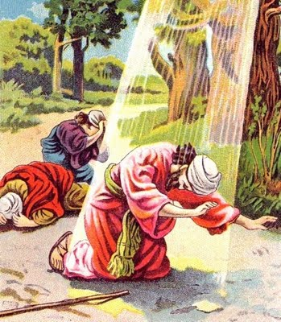
Explanation of the Parable
Hidden Treasure
Apostle Paul as an Example
Estimation of what he found
Philippians 3:4-11
2 Corinthians 4:7
Colossians 2:1-2
Richie Thetford www.thetfordcountry.com

Slide 5
Kingdom of Exceeding Value
Hidden Treasure
Refuge from powers of darkness
Colossians 1:13
Ephesians 2:1-3
Romans 6:17-18
1 Corinthians 10:13
Richie Thetford www.thetfordcountry.com

Slide 6
Kingdom of Exceeding Value
Hidden Treasure
Domain of righteousness, Peace, Joy
Romans 14:17
Philippians 3:8-9
Philippians 4:6-7
Philippians 4:4
Philippians 2:17-18
Richie Thetford www.thetfordcountry.com

Slide 7
Kingdom of Exceeding Value
Hidden Treasure
Unshakeable kingdom
Hebrews 12:25-29
Daniel 2:44
2 Peter 1:10-11
Richie Thetford www.thetfordcountry.com

Slide 8
Kingdom of Exceeding Value
Hidden Treasure
Destined for Glory
1 Corinthians 15:21-26
Matthew 13:41-43
Revelation 21:1-5
Revelation 21:9-12
Revelation 21:22-27
Richie Thetford www.thetfordcountry.com

Slide 9
What is the value of the Kingdom?
Hidden Treasure
Stephen
Acts 7
Early Christians
Acts 8:1-4
Apostle Paul
2 Timothy 3:10-11; 4:6-8, 16-18
Loved ones who died in Christ
Revelation 7:9-17
Richie Thetford www.thetfordcountry.com

Slide 10
What is the value of the Kingdom?
Hidden Treasure
Our Lord Jesus
Philippians 2:5-8
“It is worth it all!”
Our response to the gospel, and how we live our lives as Christians, demonstrate our true estimation of the “treasure” of the kingdom of heaven!
Richie Thetford www.thetfordcountry.com

