Slide 1

Overcoming Sin
Romans 3:23
Romans 6:1-2
Richie Thetford www.thetfordcountry.com

Slide 2
Using Our Bible
Psalms 119:11
Proverbs 4:23
Proverbs 23:7
Proverbs 16:6
John 17:17
Psalms 37:31
1 John 2:1
Ezekiel 3:16-21
Matthew 4:1-11
1 Timothy 4:13
2 Timothy 2:15
Richie Thetford www.thetfordcountry.com

Slide 3
Pray Often
Matthew 6:13
Luke 21:36
Ephesians 6:13, 18
1 Thessalonians 5:17
Colossians 4:2
Luke 18:1
Richie Thetford www.thetfordcountry.com

Slide 4
Regular
Self-Examination
Deuteronomy 11:16
Psalms 39:1
1 Corinthians 11:28
2 Corinthians 13:5
James 1:22-25
Richie Thetford www.thetfordcountry.com

Slide 5
Reverent
Fear of God
Exodus 20:20
Proverbs 3:7
Ecclesiastes 12:13
Hebrews 10:31
2Corinthians 5:11
Richie Thetford www.thetfordcountry.com

Slide 6
God Always
Sees Us
Psalms 139:7-12
Proverbs 15:3
Richie Thetford www.thetfordcountry.com

Slide 7
This May Be
Our Last Day
James 5:7-9
Richie Thetford www.thetfordcountry.com

Slide 8
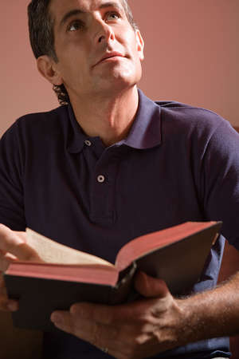
Overcoming Sin
“Takes a genuine effort on our part”
Heaven waits for those who overcome sin!
Richie Thetford www.thetfordcountry.com

