Slide 1
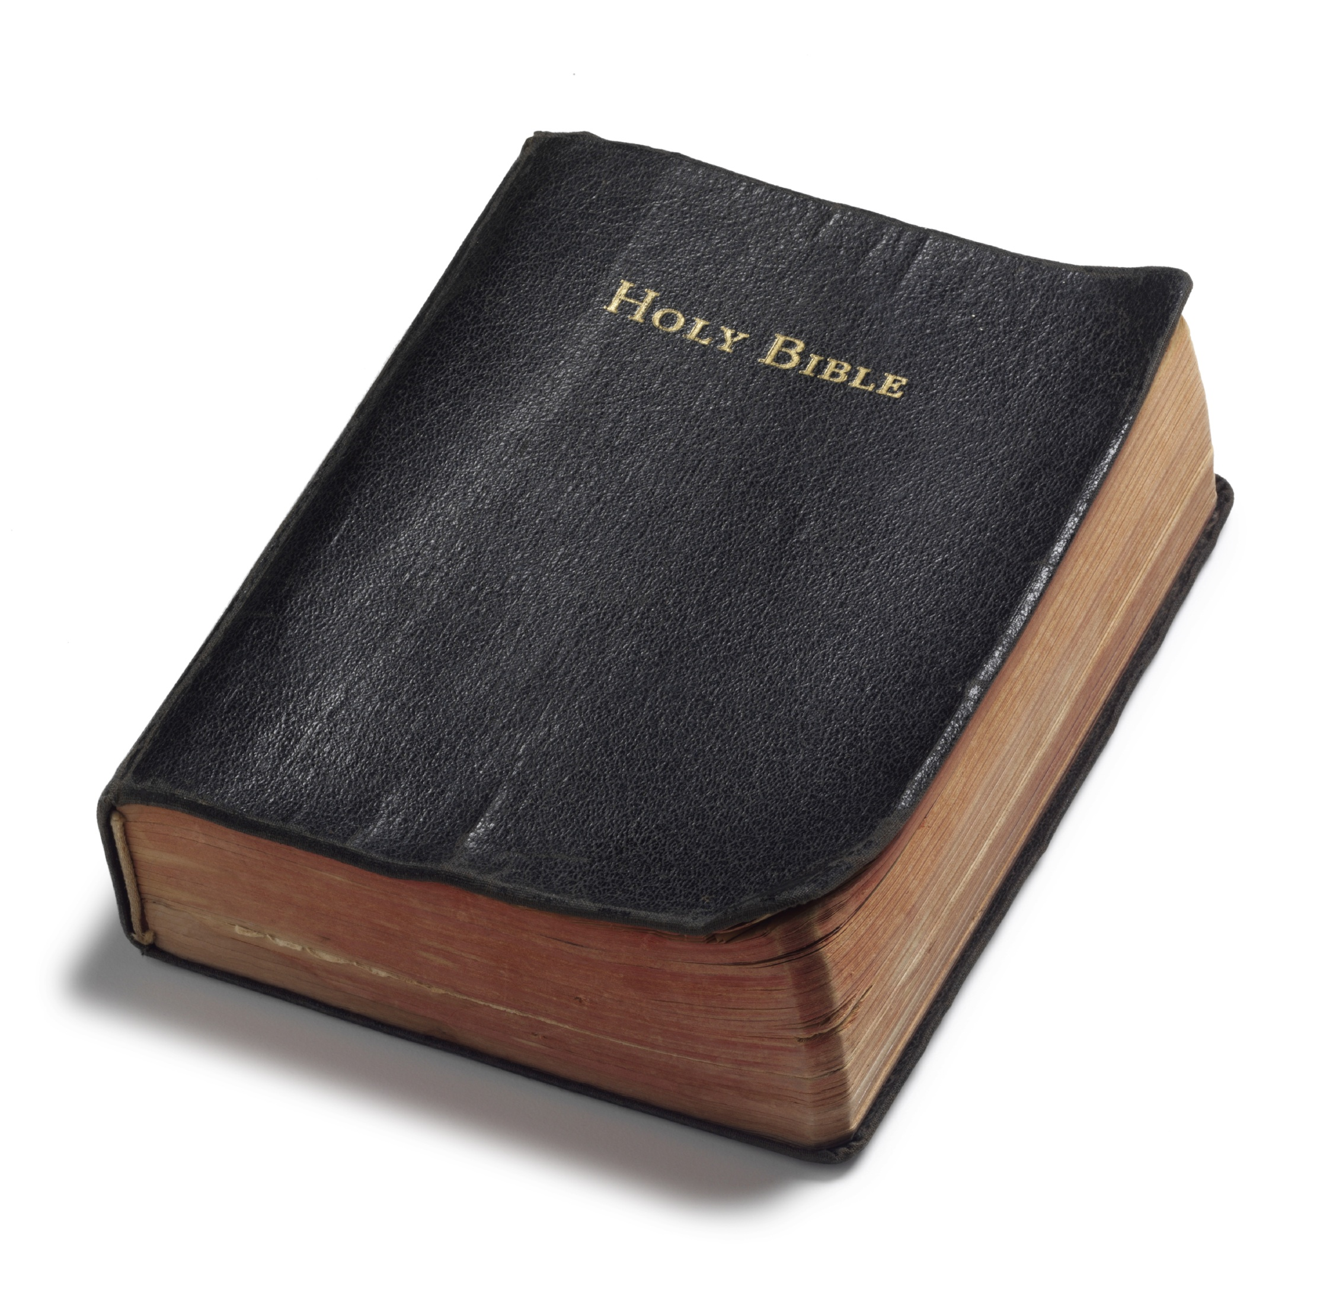
Out With The
In With The
Hebrews 9:15
OLD
NEW
OLD
NEW
Richie Thetford www.thetfordcountry.com

Slide 2
“And for this reason He is the Mediator of the new covenant, by means of death, for the redemption of the transgressions under the first covenant, that those who are called may receive the promise of the eternal inheritance.”
Hebrews 9:15
“testament” or “covenant”
“a solemn disposition, or contract”
Richie Thetford www.thetfordcountry.com

Slide 3
Out With the OLD
Old law has been abolished
Romans 15:4
Several New Testament scriptures prove it has been abolished
Ephesians 2:15-16
Colossians 2:14
Galatians 5:1-4
Romans 7:1-6
Richie Thetford www.thetfordcountry.com

Slide 4
Out With the OLD
Moses pointed to the coming of Christ
Deuteronomy 18:15
Peter Emphasized this
Acts 3:22-23
It was faulty
Hebrews 8:7-8
Richie Thetford www.thetfordcountry.com

Slide 5
Out With the OLD
Christ connects the “new covenant” with His blood
1 Corinthians 11:25
Exodus 24:7-8
Luke 22:20
Matthew 26:28
The Shed Blood
Hebrews 9:11-28
Richie Thetford www.thetfordcountry.com

Slide 6
Out With the OLD
The Mediator
Romans 6:3-5
“Inheritance” and “will”
Without shedding of blood – no forgiveness
Richie Thetford www.thetfordcountry.com

Slide 7
Out With the OLD
Relationship to Jeremiah
Jeremiah 31:31-34
Relationship to Ezekiel
Ezekiel 36:26-28
Richie Thetford www.thetfordcountry.com

Slide 8
Out With the OLD
Paul’s contrast of the Old and New
2 Corinthians 3:5-12
The glory of the New Covenant is focused in Christ and shines forth from Him
Richie Thetford www.thetfordcountry.com

Slide 9
Conclusion
All today are under the New Covenant
Can’t do things based upon what individuals were commanded to do under the Old Law
Galatians 5:3
Richie Thetford www.thetfordcountry.com

Slide 10
Conclusion
Only those that come in contact with the blood of Christ will be saved
Must die to our old ways, be buried with Christ, and arise to walk anew!
Romans 6:3-8
Richie Thetford www.thetfordcountry.com

