Slide 1
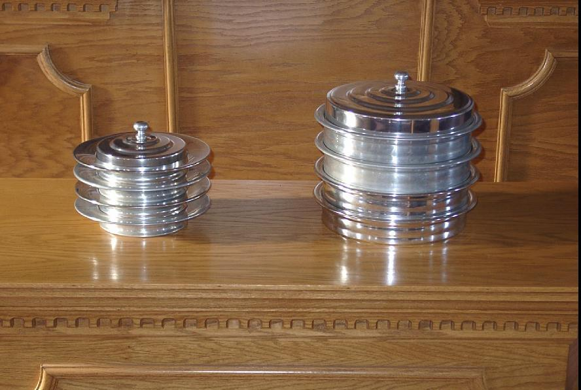
1 Corinthians 11:17-34
Our Worship
and
The Lord's Supper
Proper Observance Yields
SPIRITUAL BLESSINGS
Improper Observance will result in GREAT CONDEMNATION

Slide 2

Our Worship and The Lord's Supper
Origin of
Observance
Instituted on the night Jesus was betrayed
  Matthew 26:26-29 (Mark 14:22-25; Luke 22:19-20)
For generations this Passover feast commemorated God’s deliverance of Israel from Egyptian captivity
  Exodus 12:21-27
  Christ gave it a NEW meaning

Slide 3
Our Worship and The Lord's Supper
Emblems of
Observance
Unleaven Bread
  Baked from unfermented dough (without yeast)
  Passover called “feast of unleavened bread”
    Matthew 26:17; 16:6; 1 Corinthians 5:6-8
Fruit of the Vine
  Grape juice (greek word vine is “ampelos”)
    Matt 26:29; Jam 3:12; Rev 14:18; Eph 1:7

Slide 4
Our Worship and The Lord's Supper
Day of
Observance
Observed on the first day of the week
  Christ was raised on the first day
  Early church assembled on the first day
  Disciples came together to “break bread”
  the first day
    Acts 2:42; Acts 20:7

Slide 5
Our Worship and The Lord's Supper
Frequency of
Observance
Which first day did the N.T. church observe the Lord’s Supper?
  How many week’s are there in a year?
  How many week’s have a first day?
In the O.T. they were to keep the Sabbath day holy -- which one?

Slide 6
Our Worship and The Lord's Supper
Purpose of
Observance
A MEMORIAL
  Reminds us of the death of Jesus Christ
    1 Corinthians 11:23-25
  Without Jesus’ death – no forgiveness of sins
  Without Jesus’ resurrection – no hope
  One who forgets His death – will also forget
  to live for Him

Slide 7
Our Worship and The Lord's Supper
Purpose of
Observance
A COMMUNION
  An expression of our union with Christ and
  with one another
    1 Corinthians 10:16-17
  Communion means partnership, joint participation
    Observing the Lord’s Supper is an outward expression
    of our unity as Christians

Slide 8
Our Worship and The Lord's Supper
Purpose of
Observance
A PROCLAMATION
  Through observance we proclaim the Lord’s
  death until He comes
    1 Corinthians 11:26
  Ensure that we exhibit the proper attitude
    1 Corinthians 11:27-30
  Must be observed with reverence

Slide 9
PROPER
MINDSET
Our Worship and The Lord's Supper
Look BACKWARD and remember the death of Christ
Look INWARD and examine our self
Look OUTWARD to those lost in sin and proclaim
our faith in the Lord’s sacrifice
Look FORWARD in anticipation of His return
Lord’s Supper – observed in God’s kingdom by His children

