Slide 1
We must have a concern for lost souls
Our Responsibility
Toward Lost Souls
Richard Thetford www.thetfordcountry.com

Slide 2
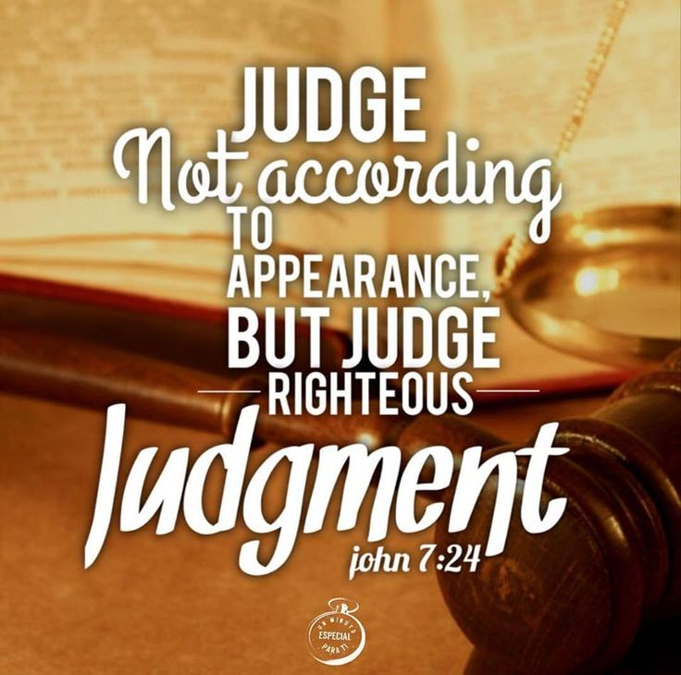
Who Are the Lost?
God decides who are lost
He has given us information
Man makes judgments
John 7:24
Richard Thetford www.thetfordcountry.com

Slide 3
Who Are the Lost?
Those who are lost:
2 Corinthians 4:3
Those without the gospel
Romans 10:14-15
John 8:24
Those without faith in the gospel
Romans 10:17
Richard Thetford www.thetfordcountry.com

Slide 4
Who Are the Lost?
Those who are lost:
Luke 13:3
Those without repentance
2 Corinthians 7:9-10
Mark 16:16
Those who reject baptism
Richard Thetford www.thetfordcountry.com

Slide 5
Who Are the Lost?
Those who are lost:
Acts 2:47
Those outside the Lord’s church
Galatians 1:13-14
Sincere conviction are not enough
Acts 26:9-11
1 Timothy 1:13
Acts 22:16
Richard Thetford www.thetfordcountry.com

Slide 6
Who Are the Lost?
Those who are lost:
Revelation 3:14-16, 19
Lukewarm and indifferent church members
Those who fall away
Hebrews 3:12
Hebrews 10:29-30
James 5:19-20
Richard Thetford www.thetfordcountry.com

Slide 7
What Can We Do to Save the Lost?
Always set the right example
Romans 2:21-24
Galatians 2:20
2 Corinthians 3:2
Show interest in lost souls
Learn the Bible to be able to teach
Hebrews 5:12
2 Peter 3:18
Richard Thetford www.thetfordcountry.com

Slide 8
Why Be Concerned about Lost Souls?
Because the Lord was concerned
Luke 19:10
Romans 5:8
Because of the value of souls
Matthew 10:28
Because of our own souls
By helping others, we save ourselves
Richard Thetford www.thetfordcountry.com

Slide 9
All we can do is try to save others – but we must try
Our Responsibility
Matthew 10:14
Toward Lost Souls
Richard Thetford www.thetfordcountry.com

