Slide 1
Our “good” can be god’s “wrong”
Matthew 7:21-23
Colossians 3:17
Luke 6:46
1 Corinthians 4:6
Richie Thetford www.thetfordcountry.com
Notes:
NOTE:
To change the image on this slide, select the picture and delete it. Then click the Pictures icon in the placeholder to insert your own image.

Slide 2
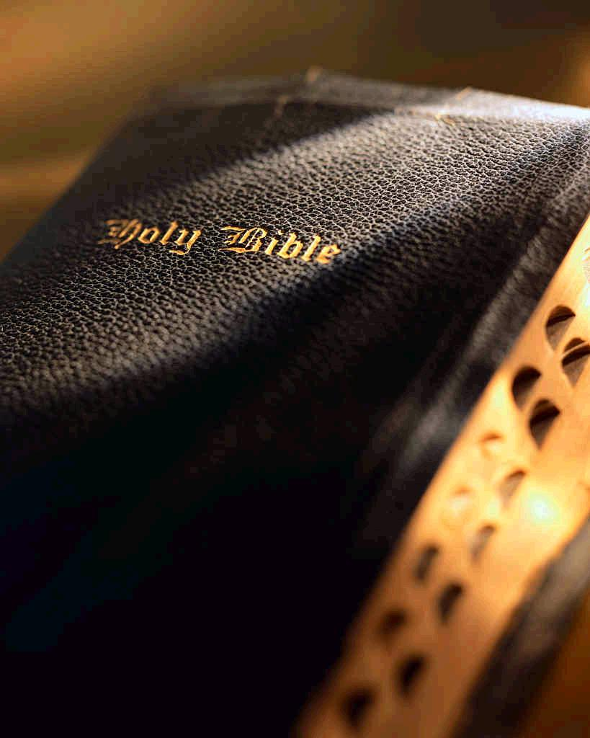
Bible Examples
Transporting the Ark of the Covenant (2 Samuel 6)
History with the Philistines (1 Samuel 4-6:1)
Ark sent back to Israel (1 Samuel 6:2-7:2)
God’s directions for transport
Numbers 4:1-15; 3:27-31; Exodus 25:10-14
King David tried to return the Ark
2 Samuel 6:1-11
David accepts responsibility for the loss
1 Chronicles 15:12-15
Richie Thetford www.thetfordcountry.com

Slide 3
Bible Examples
Nadab and Abihu burning incense unto God
Leviticus 10:1-2
Leviticus 6:12-13
They offered a “strange” fire
Man cannot change God’s word
Richie Thetford www.thetfordcountry.com

Slide 4
Bible Examples
Ananias and Sapphira offering money to God
Acts 5:1-11
Community of early Christians
Acts 2:44-45; 4:34-37
They desired to give a service unto God
The consequence of doing good in a wrong way
Richie Thetford www.thetfordcountry.com

Slide 5
Bible Examples
Many people claim to do good works
Matthew 7:21-23
Understand the eternal principle that is shown here
Richie Thetford www.thetfordcountry.com

Slide 6
Bible Examples
The modern religious world
Evangelize - but not according to God’s way
Change the mission of the church
Singing with mechanical instruments
Ephesians 5:19
Colossians 3:16-17
Change the command for baptism
Richie Thetford www.thetfordcountry.com

Slide 7
Conclusion
Not enough just to do godly acts
Acts must be according to God’s authority
Matthew 7:21-23
1 Peter 4:11
Matthew 15:8-9
Luke 6:46
2 Corinthians 5:7
Richie Thetford www.thetfordcountry.com

