Slide 1


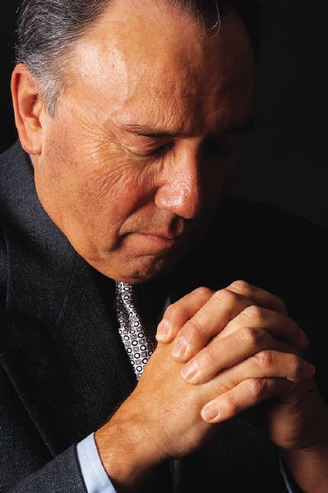
James 4:4
Matthew 22:37
OUR
D
I
V
I
D
E
D
Love of the World
Love of GOD
Luke 9:57-62
Colossians 3:17
AFFECTIONS
Richie Thetford www.thetfordcountry.com

Slide 2
Divided Affections: Trying to please the Lord as much as possible while we try to please the Lord as little as possible.
“No one can serve two masters; for either he will hate the one and love the other, or else he will be loyal to the one and despise the other. You cannot serve God and mammon”
--- Matthew 6:24
Richie Thetford www.thetfordcountry.com

Slide 3

How Can We Have
Turning our attention to money
and possessions
  Luke 17:32-33
  Matthew 19:16-22
Turning our attention to pleasures of the world
  2 Timothy 4:9-11
  Ezekiel 20:15-16
  Jeremiah 14:10
  Romans 12:1-2
  Romans 8:5-10
A
F
F
E
C
T
I
O
N
S
GOD
Divided
World
Richie Thetford www.thetfordcountry.com

Slide 4
How Can We Have
Not accepting the gospel on
Christ’s terms
  Luke 9:61
    “I think” we need an instrument in worship
    “I don’t think” it is necessary to be baptized
    “I think” the church needs to get involved in social things
    “I think” it is alright to attend only when I want to
A
F
F
E
C
T
I
O
N
S
GOD
Divided
World
Richie Thetford www.thetfordcountry.com

Slide 5
How Can We Have
CONCLUSION
A
F
F
E
C
T
I
O
N
S
Do we love the Lord and focus
on Him?
  It is possible to divide our affections and become unfit for the kingdom
Where are our affections?
  Set on Christ?
  Set on something else?
GOD
Divided
World
Matthew 6:33
Colossians 3:2
Richie Thetford www.thetfordcountry.com

Slide 6
How Can We Have
A
F
F
E
C
T
I
O
N
S
GOD
Your talk talks
and
your walk talks
but
your walk talks
more than
your talk talks
Divided
World
Richie Thetford www.thetfordcountry.com

