Slide 1

Our Christian Influence
Matthew 5:13-16
Richie Thetford www.thetfordcountry.com

Slide 2

Our Christian Influence….
Should reflect good, not evil
  Hebrews 5:14
  Matthew 5:48
  1 Peter 1:15-16
  Ephesians 4:26-27
  Revelation 2:14
Richie Thetford www.thetfordcountry.com

Slide 3

Our Christian Influence….
Is shown through our example of words/actions
  Titus 3:8
  James 3:17
  Acts 9:36
  Titus 2:7-8
  1 Timothy 4:12
Richie Thetford www.thetfordcountry.com

Slide 4

Our Christian Influence….
Can be seen through our associations
  Exodus 23:2
  Ephesians 5:6-13
  1 John 1:3-7
Should be obvious to all
  1 Peter 2:9
  Philippians 2:14-15
Richie Thetford www.thetfordcountry.com

Slide 5

Our Christian Influence….
Will affect our salvation
  Matthew 5:13
  Galatians 5:9
  Galatians 6:7
  Revelation 14:13
  Matthew 13:43
Richie Thetford www.thetfordcountry.com

Slide 6
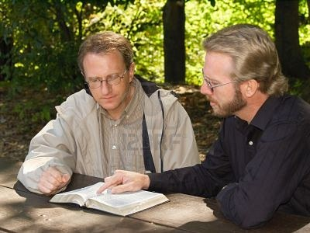
Our Christian Influence….
Should reflect good, not evil
Shown through our example of words/actions
Can be seen through our associations
Should be obvious to all
Will affect our salvation
Richie Thetford www.thetfordcountry.com

