Slide 1
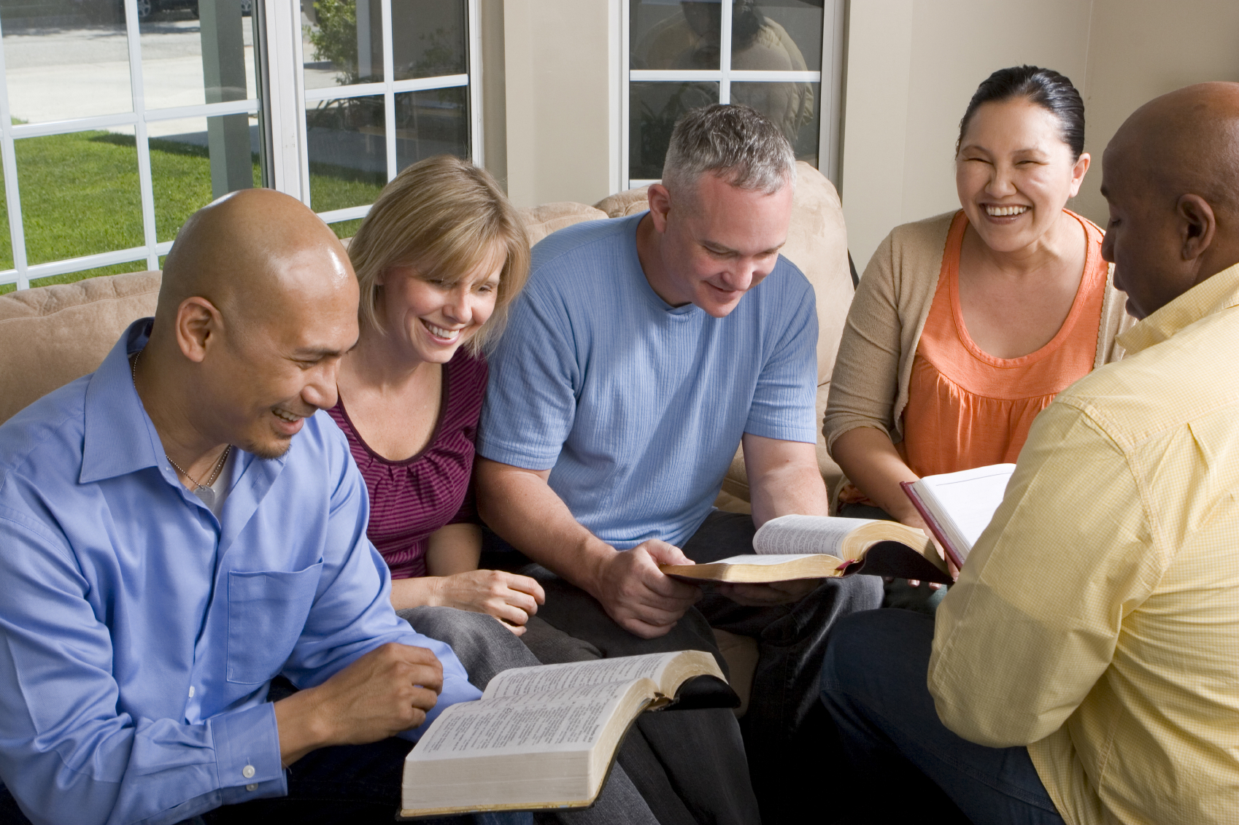
Our Christian Conduct
Philippians 1:27-28
Richie Thetford www.thetfordcountry.com

Slide 2
Manner of Life
Behave as a citizen
Philippians 3:20
Live worthy of the gospel
Richie Thetford www.thetfordcountry.com

Slide 3
Stand Firm
Be immovable
1 Corinthians 15:58
Stand for the truth
Luke 17:10
Stand for righteousness
Matthew 5:29-30
Colossians 1:22-23
Richie Thetford www.thetfordcountry.com

Slide 4
Striving Side by Side
For the spiritual prize
1 Corinthians 9:24-25
Constantly going forward
Philippians 3:7-8, 12-14
Stay committed to the end
2 Timothy 4:6-8
Richie Thetford www.thetfordcountry.com

Slide 5
Not Frightened
Kingdom of God -- unshakable
1 Peter 1:4
Can’t be destroyed
Ephesians 6:11-13
2 Kings 6:16-17
Richie Thetford www.thetfordcountry.com

Slide 6
Conclusion
Christians are called to live lives worthy of the gospel.
We must stand firm, strive valiantly, and not be frightened by our opponent.
What then shall we say to these things? If God is for us, who can be against us?
Romans 8:31
Richie Thetford www.thetfordcountry.com

