Slide 1

Opposing God
Richie Thetford www.thetfordcountry.com

Slide 2
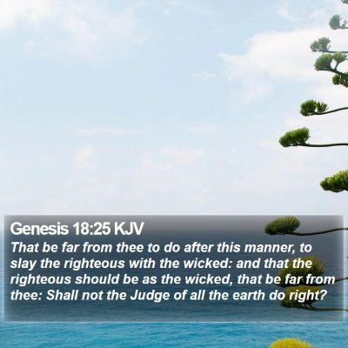
Abraham
God’s plan was to destroy Sodom and Gomorrah
Genesis 18:23-33
Abraham opposed what God was going to do
Isaiah 45:21
God heard Abraham
God knew Lot was there
2 Peter 2:7
Richie Thetford www.thetfordcountry.com

Slide 3

Moses
God’s plan was to save Israel out of Egyptian captivity
Exodus 3:1-4:17
Moses opposed God’s selection of him
God answered Moses’ objections
God knew all these things about Moses
“Nothing will ever be attempted if all possible objections must be first overcome”
- Samuel Johnson
Richie Thetford www.thetfordcountry.com

Slide 4
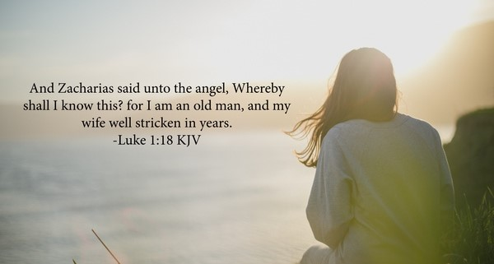
Zacharias
God’s plan was for Zacharias and Elizabeth to have John so he could prepare the way for Jesus
Luke 1:5-25; 57-80
God revealed this to Zacharias
God brought John into the world
God knew Zacharias’ doubts
Richie Thetford www.thetfordcountry.com

Slide 5

Saul of Tarsus
God’s plan was for the church to grow
Acts 9
Saul was opposed to God’s plan
John 16:2
Acts 23:1
Philippians 3:5
Saul was NOT doing God’s will
God knew Saul’s heart
Richie Thetford www.thetfordcountry.com

Slide 6
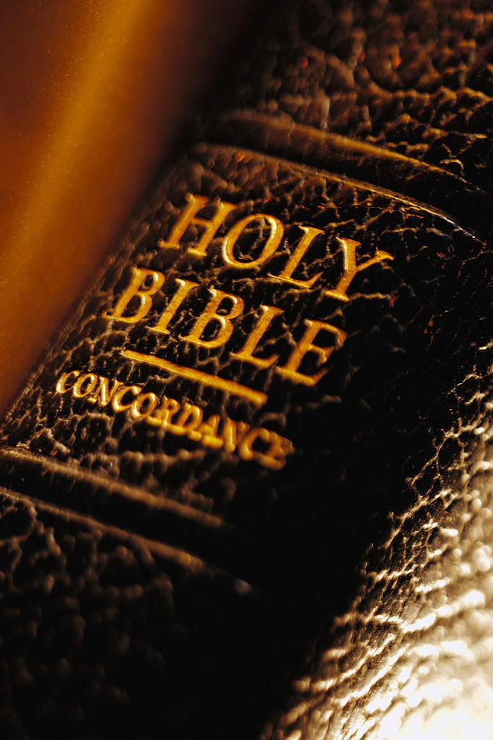
Conclusion
The very best of God’s creation had flaws
God will be respected in the hearts of good men
Philippians 3:13-14
Man’s lack of trust in God doesn’t change His will
God’s purposes are always fulfilled
1 Timothy 1:12-13
Richie Thetford www.thetfordcountry.com

Slide 7

Conclusion
Man is NOT wiser than God
1 Corinthians 1:25
God knows how to save the righteous
2 Peter 2:9
God knows the heart of men
1 Samuel 16:7
God WILL help us
Richie Thetford www.thetfordcountry.com

