Slide 1

Open Minds
Acts 17:10-12
Richie Thetford www.thetfordcountry.com

Slide 2

They Kept Open Minds
“Received the Word”
  John 6:45
  Matthew 13:14-15
“With all readiness of mind”
  2 Corinthians 8:12
  Luke 8:15
  John 7:17
Richie Thetford www.thetfordcountry.com

Slide 3
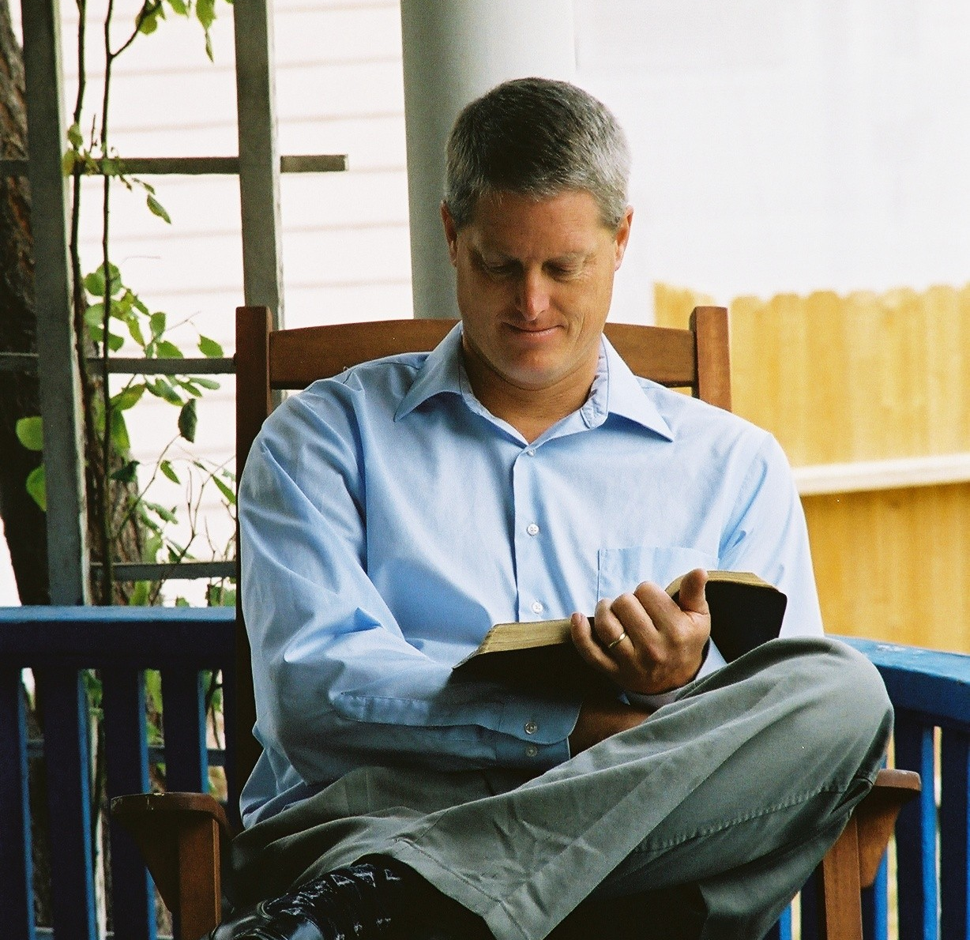
They Kept Open Bibles
“Examining the Scriptures”
  1 Thessalonians 5:21
“Whether these things
were so”
  Romans 10:17
Richie Thetford www.thetfordcountry.com

Slide 4
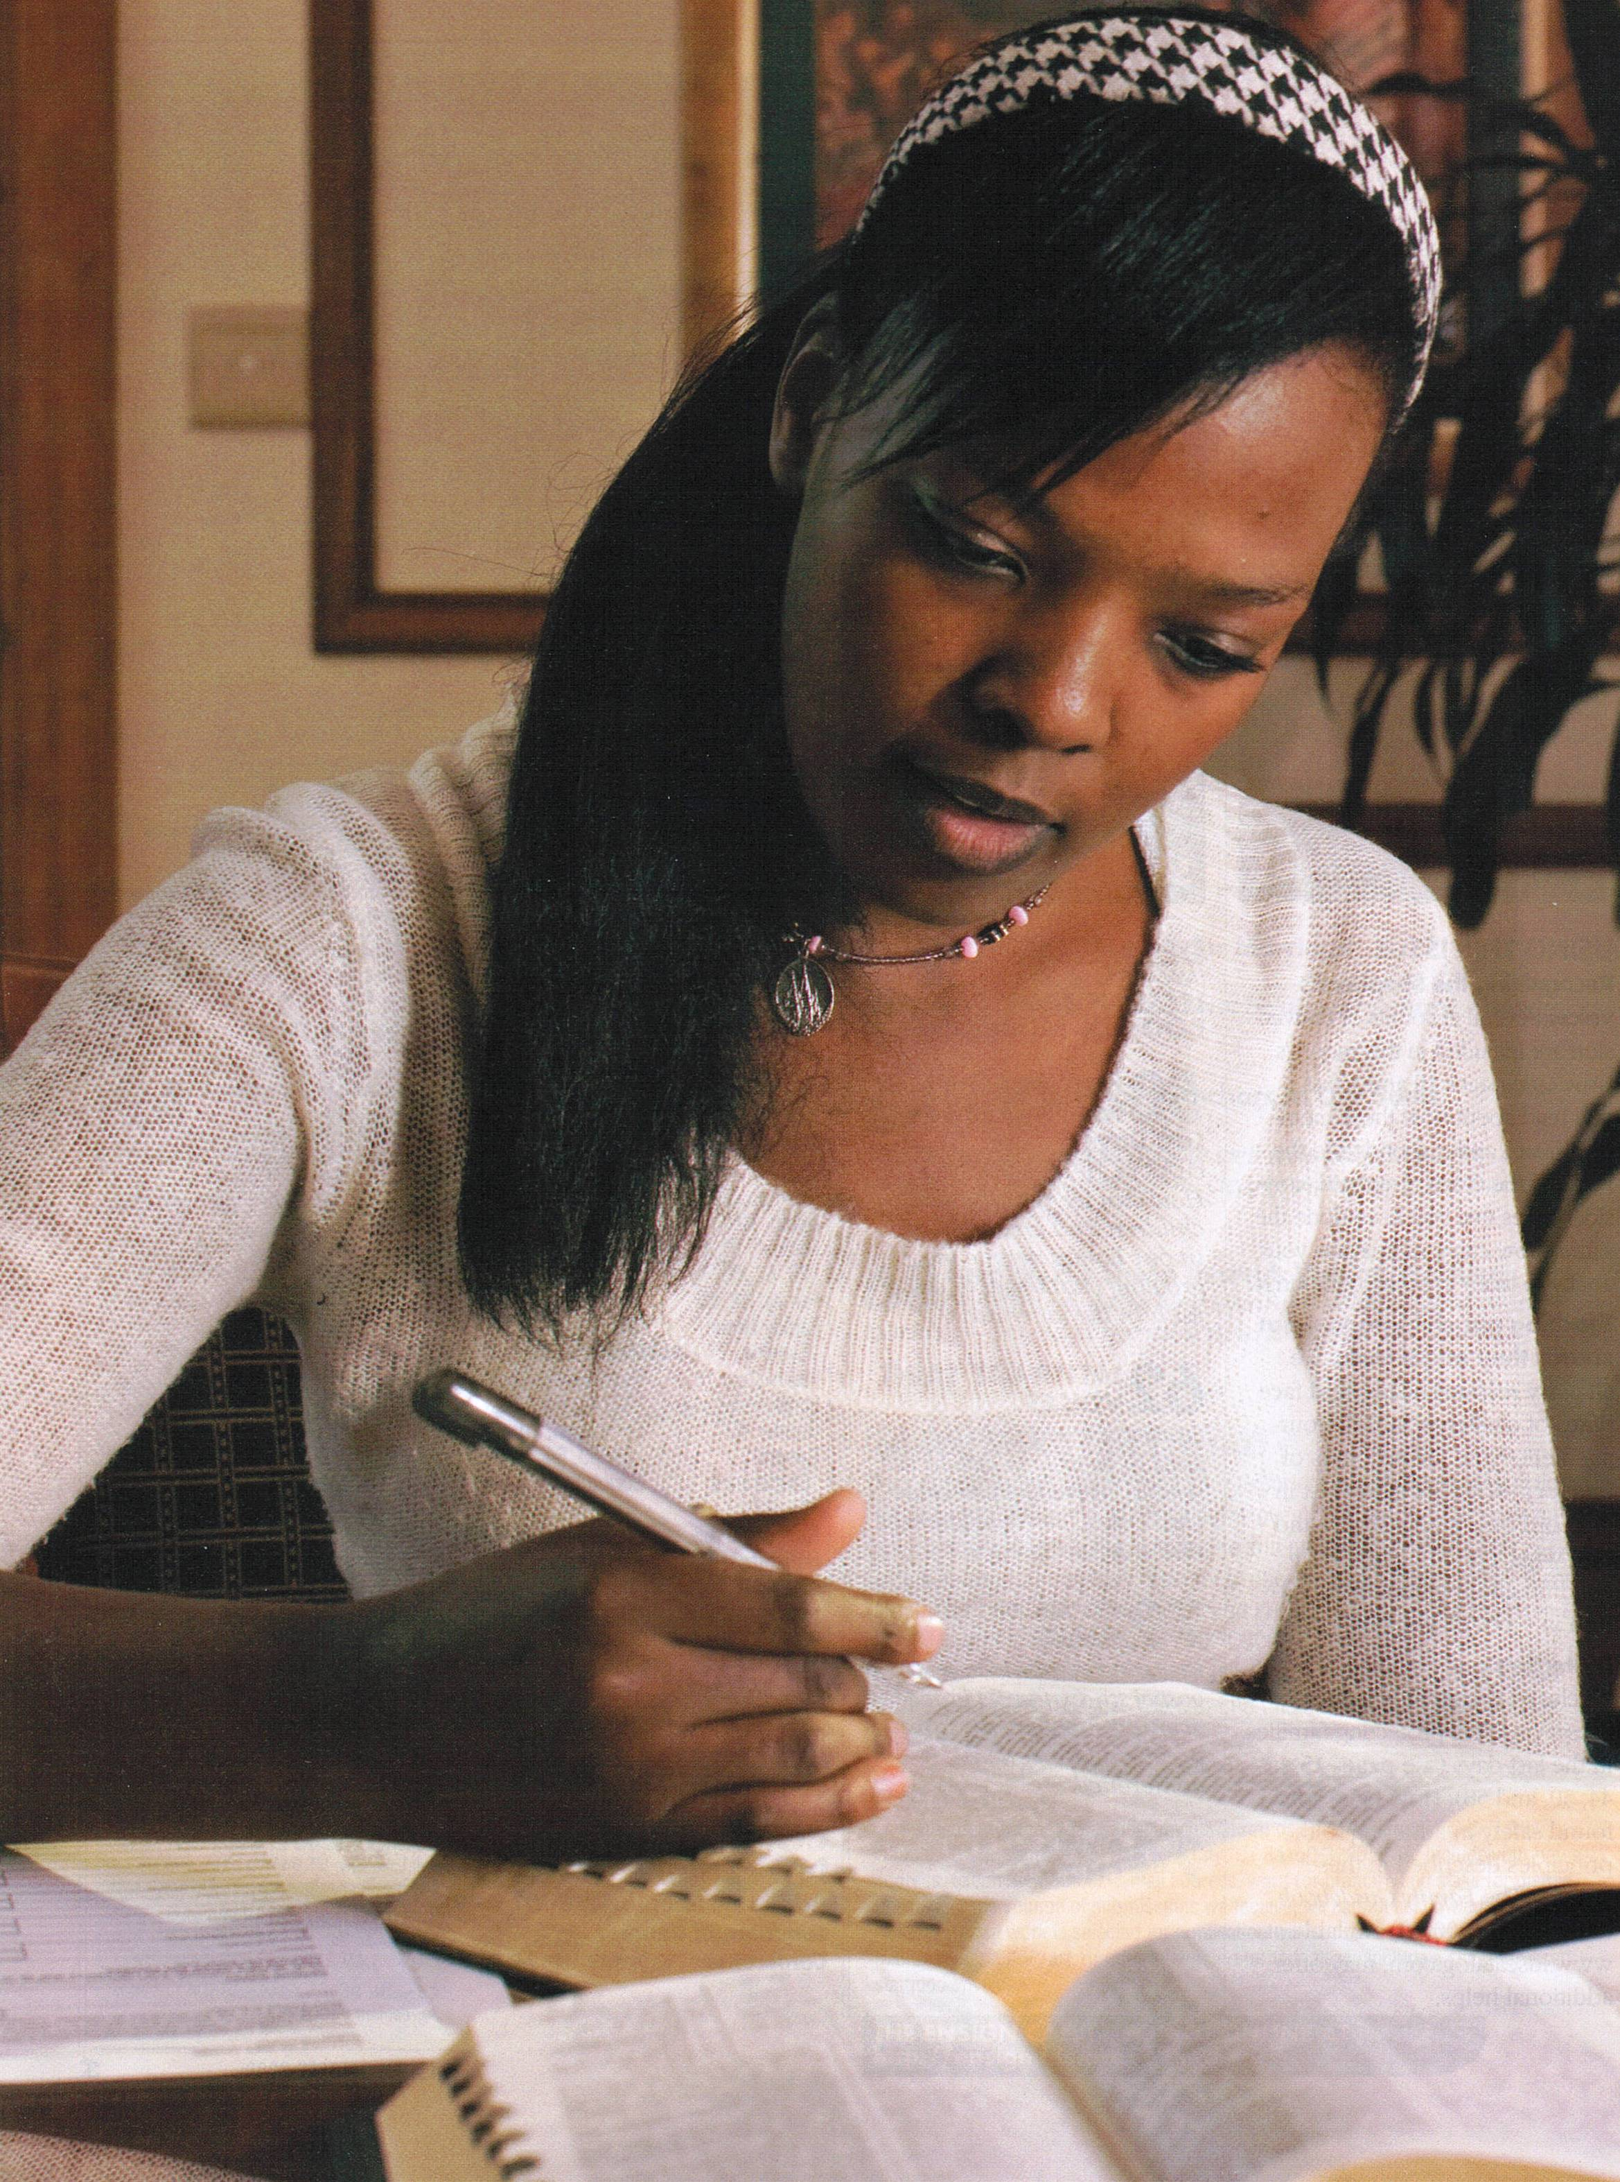
They Kept Open Schedules
Examined Scriptures “daily”
  Ephesians 5:16
  Acts 2:41, 46
  1 Peter 2:1-3
“No time for God? What fools we are, to clutter up our lives with common things and leave without heart’s gate the Lord of life
and life itself --- Our God!”
--- Norman Trott
Richie Thetford www.thetfordcountry.com

Slide 5
Open Minds
Jude 3
1 John 4:1
Richie Thetford www.thetfordcountry.com

