Slide 1
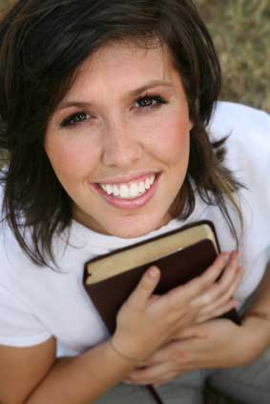
The Oneness of God
“And you shall know the truth, and the truth shall make you free.”
John 8:32
Richard Thetford www.thetfordcountry.com

Slide 2
The Oneness of God
The World
God
Many churches
  ?
Reconciled out of church
  ?
Many ways
  ?
One church
  Acts 20:28
Reconciled in the church
  Ephesians 2:16
One way
  John 14:6
Richard Thetford www.thetfordcountry.com

Slide 3
The Oneness of God
The World
God
Many bodies
  ?
Many spirits
  ?
Many baptisms
  ?
One body
  Ephesians 4:4
One spirit
  Ephesians 4:4
One baptism
  Ephesians 4:5
Richard Thetford www.thetfordcountry.com

Slide 4
The Oneness of God
The World
God
Many names
  ?
Many faiths
  ?
Many folds
  ?
One name
  Romans 16:16
One faith
  Ephesians 4:4
One fold
  John 10:16
Richard Thetford www.thetfordcountry.com

Slide 5
The Oneness of God
The World
God
Many places to build
  ?
Many vines
  ?
Many brides
  ?
One place to build
  Matthew 7:24
One vine
  John 15:1-6
One bride
  Ephesians 5:23
Richard Thetford www.thetfordcountry.com

Slide 6
Conclusion
God has told us and shown us the “ONE” true way to be pleasing to Him
Richard Thetford www.thetfordcountry.com

