Slide 1
Observations of discipleship
RomANS 10:17; 1:16
Let the nonbeliever know:
There is a God who loves him or her
Who has sent Jesus as a manifestation of that love
Let the true searcher know:
Those who are true disciples of Christ
Who can thus lead him or her to Christ
Richie Thetford www.thetfordcountry.com

Slide 2
unity
The value of unity of believers
John 17:20-23
Unity is an “observation” to the world
John 3:16; Ephesians 2:13-16
Thus – the importance of unity
1 Corinthians 1:10; Romans 16:17-18
Ephesians 4:1-3; Philippians 2:2-4
Richie Thetford www.thetfordcountry.com

Slide 3
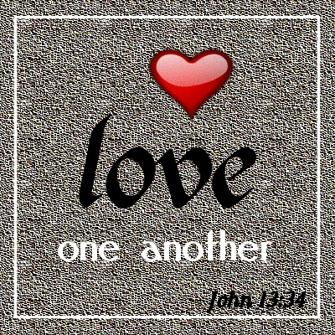
Love
The value of love for one another
John 13:34-35
Love is an “observation” of the world
John 15:12-13; Ephesians 5:1-2
Thus – the importance of love
1 Thessalonians 4:9-10; Colossians 3:14
Unity and Love – Divine Observations
Richie Thetford www.thetfordcountry.com

Slide 4
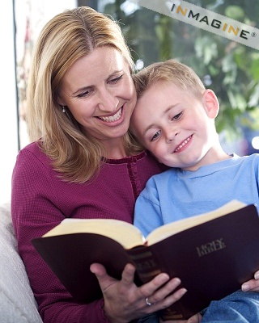
Hope
The value of hope
1 Peter 3:15
Hope is an “observation” of the world
Romans 5:1-5; 1 Peter 1:3-4
Thus – the importance of hope
1 Peter 1:13; 1 Peter 3:15
Richie Thetford www.thetfordcountry.com

Slide 5
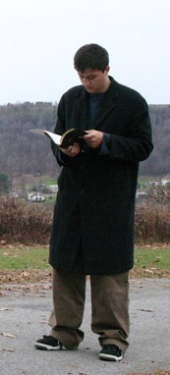
Good works
The value of good works
Matthew 5:16; 1 Peter 2:12
Good works are an “observation” of the world
1 Peter 3:1-2
Thus – the importance of good works
Titus 3:1, 8, 14
Richie Thetford www.thetfordcountry.com

Slide 6
Observations of discipleship
CONCLUSION
We can see how people can be led to christ
Our unity can convince people of God’s love for them
Our love can direct them to true disciples of Christ
Our hope can prompt them to ask questions about our faith
Our good works can encourage them to glorify God
Richie Thetford www.thetfordcountry.com

