Slide 1
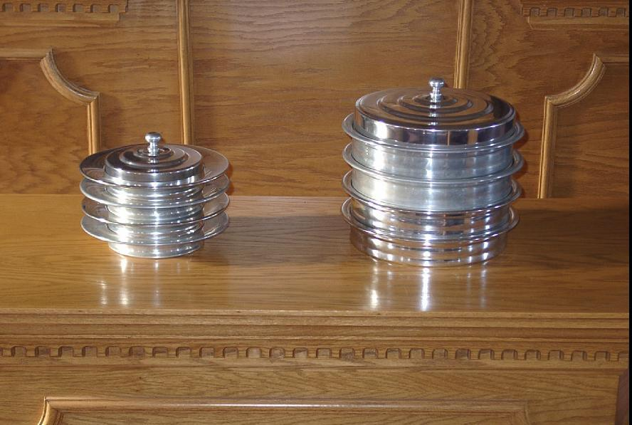
Observance of the
Lord’s Supper
1 Corinthians 11:23-26
Acts 20:7
Richie Thetford www.thetfordcountry.com

Slide 2
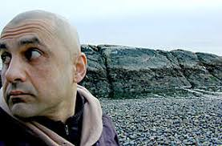
Look Backward
Lord’s Supper is a memorial
  Luke 22:19-20
Remembering Jesus’ death
  1 Corinthians 11:26
Richie Thetford www.thetfordcountry.com

Slide 3

Look Inward
Lord’s Supper is a self-examination
  1 Corinthians 11:28
Think of the need of Jesus’ death
  Isaiah 59:2
  Romans 5:10
  Ephesians 1:7
Richie Thetford www.thetfordcountry.com

Slide 4
Look Inward
Think about the church
  Ephesians 5:25
  Acts 20:28
Think about our unity
  1 Corinthians 10:16-17
  John 17:17-23
Richie Thetford www.thetfordcountry.com

Slide 5
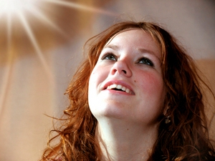
Look Upward
Worship of God and His Son
  John 3:16
Because of love
  John 15:13
  Romans 5:8
Richie Thetford www.thetfordcountry.com

Slide 6
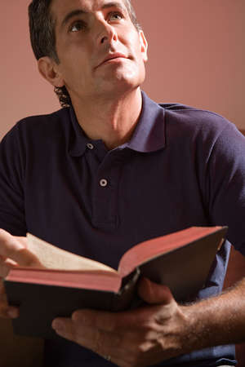
Look Upward
The perfect sacrifice
  2 Corinthians 5:21
  1 John 3:5
The perfect mediator
  1 Timothy 2:5
  Romans 8:27
  1 John 2:1-2
Richie Thetford www.thetfordcountry.com

Slide 7

Look Forward
“until He comes”
  1 Corinthians 11:26
  Acts 1:10-11
  John 14:1-3
  1 Thessalonians 4:13-18
Richie Thetford www.thetfordcountry.com

Slide 8
Observance of the
Lord’s Supper
Look backward
Look inward
Look upward
Look forward
Richie Thetford www.thetfordcountry.com

