Slide 1
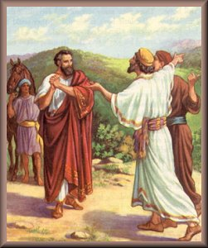
The Nobleman’s Son Healed
John 4:43-54
Richie Thetford www.thetfordcountry.com

Slide 2
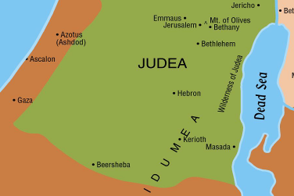
John 4:43-44
The Nobleman’s Son Healed
Jesus leaves Judea
Judea was His home
Born in Bethlehem
Seat of Jewish worship and government
“His own people” rejected Jesus
John 1:11; 5:43; 12:37
Matthew 13:57
Richie Thetford www.thetfordcountry.com

Slide 3
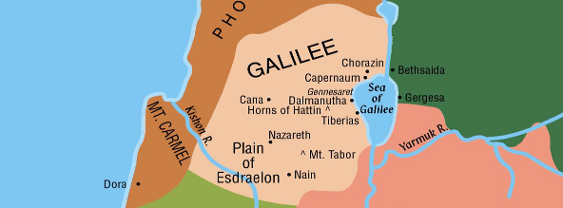
John 4:45
The Nobleman’s Son Healed
Galileans Received Him
Judeans see the same thing?
Did not accept His miracles
Some Galilean’s faith will fall
Richie Thetford www.thetfordcountry.com

Slide 4
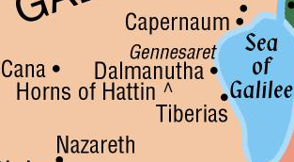
John 4:46-47
The Nobleman’s Son Healed
Returns to Cana
Some ready to receive Him
Nobleman found his location
Reluctant to leave his son
Expected that Jesus MUST make the trip to Capernaum
“come down and heal his son”
Nobleman: “an officer of a King”
Richie Thetford www.thetfordcountry.com

Slide 5
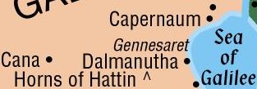
John 4:48
The Nobleman’s Son Healed
Signs: “deeper truth than what meets the eye”
Wonders: “draws attention to the physical side”
His son is at the point of death
He had some faith
His was a faith that believed on outward signs
Fledging faith – testimony of others
Satisfying faith – personal investigation
“unless you people see signs and wonders, you will by no means believe”
Richie Thetford www.thetfordcountry.com

Slide 6
John 4:49-51
The Nobleman’s Son Healed
Nobleman had one option – Jesus
Heard that Jesus could perform miracles
Felt the presence of Jesus was required to perform the miracle
Jesus announced
“Go your way; your son lives.”
Nobleman gained confidence
Richie Thetford www.thetfordcountry.com

Slide 7
John 4:52-53
The Nobleman’s Son Healed
Second day since Jesus said the boy was healed
Growth is evident in the faith of the Nobleman
First believed in the power of Jesus’ presence
Then believed in the power of Jesus’ word
Boy healed at the exact moment that the command by Jesus was given
Richie Thetford www.thetfordcountry.com

Slide 8
Some Traits of the Nobleman
He did not let position, pride, or effort prevent him from coming to seek Jesus
He stood the test of his faith
He became a witness for the Lord!
His whole household believed
Richie Thetford www.thetfordcountry.com

Slide 9
APPLICATION
Christ is the one we should desire
Faith grows when we turn to Jesus
Know that Jesus can provide
A weak faith is rebuked
Don’t limit what we think Christ can do
A sincere faith is rewarded
Nobleman had a growing faith – rewarded by the healing of his son
A sincere faith is contagious!
It spread in the Nobleman’s family – can spread in ours
Gain faith by: Study, Attendance, Participation
Richie Thetford www.thetfordcountry.com

