Slide 1

The new life!
Colossians 3:1-4
Becoming a Christian is the beginning of a new life!
Richard Thetford www.thetfordcountry.com

Slide 2
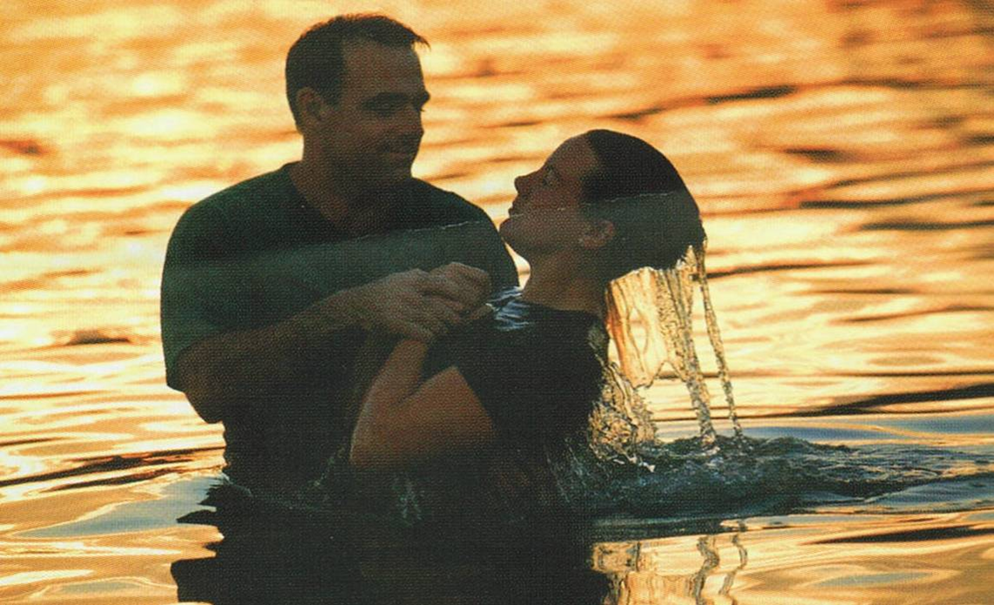
The reality of the new life
Christians have been
“raised with Christ”
Baptism is a representation of the death, burial, and
resurrection of Christ
  Colossians 2:12-13
  Romans 6:3-4
Richard Thetford www.thetfordcountry.com

Slide 3
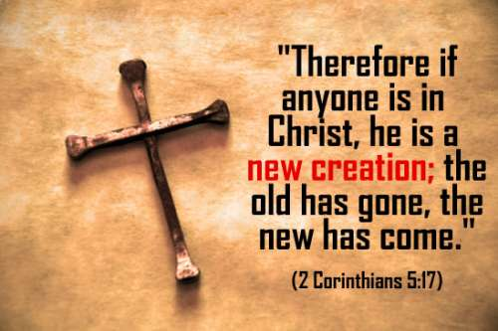
The reality of the new life
Those baptized into Christ enjoy a “newness of life”
  2 Corinthians 5:17
  Ephesians 2:1, 5-6
Richard Thetford www.thetfordcountry.com

Slide 4

The responsibilities of the new life
We have new goals
  Colossians 3:1
  Matthew 6:33
  Romans 2:6-7
Richard Thetford www.thetfordcountry.com

Slide 5

The responsibilities of the new life
We have new thoughts
  Colossians 3:2
  Matthew 6:19-21
  2 Corinthians 4:17-18
  Philippians 4:8
Richard Thetford www.thetfordcountry.com

Slide 6
The responsibilities of the new life
We have new habits
  The Christian is to get rid of things (3:5-9)
  The Christian is to obtain things (3:12)
  The Christian is to conduct themselves properly (3:13-16)
Richard Thetford www.thetfordcountry.com

Slide 7

The responsibilities of the new life
The new authority is to be respected
  Colossians 3:17
  1 Peter 3:15
Richard Thetford www.thetfordcountry.com

Slide 8
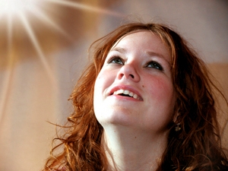
Reasons for the new life
Because we possess a new hope
  Colossians 3:3-4
  Colossians 2:12
  1 Peter 5:4
Richard Thetford www.thetfordcountry.com

Slide 9

Reasons for the new life
Hope of eternal life affects our life here
  1 Peter 1:3, 8; 1 John 2:28; 1 Peter 1:13-15;
  1 John 3:2-3; 1 Peter 1:17; 2 Peter 1:10-11;
  Colossians 3:5-6; 1 Peter 1:18-19;
  Philippians 3:18-21
Richard Thetford www.thetfordcountry.com

Slide 10
The new life!
Conclusion
The hope of eternal life means that the Christian must daily “put off” the old man and “put on” the new!
Live like people who have the hope of heaven!
Richard Thetford www.thetfordcountry.com

