Slide 1
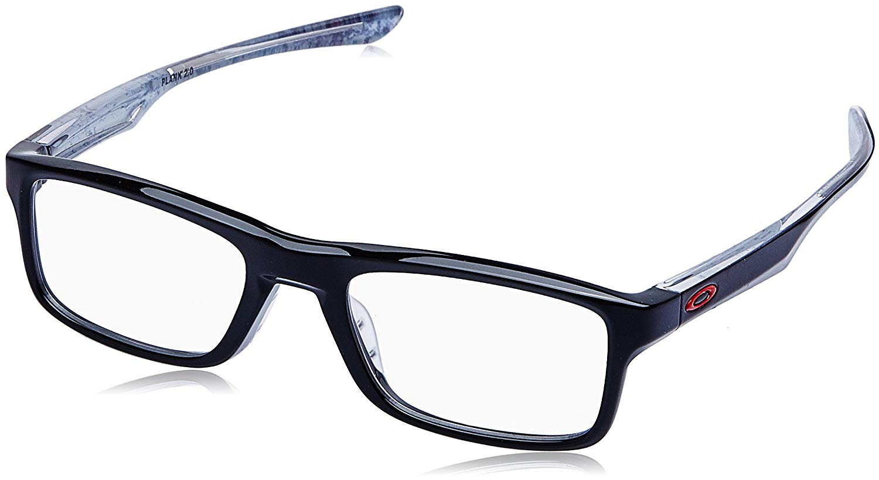
Nearsightedness
For he who lacks these things is shortsighted,
even to blindness, and has forgotten that he
was cleansed from his old sins.
2 Peter 1:9
Richie Thetford www.thetfordcountry.com

Slide 2
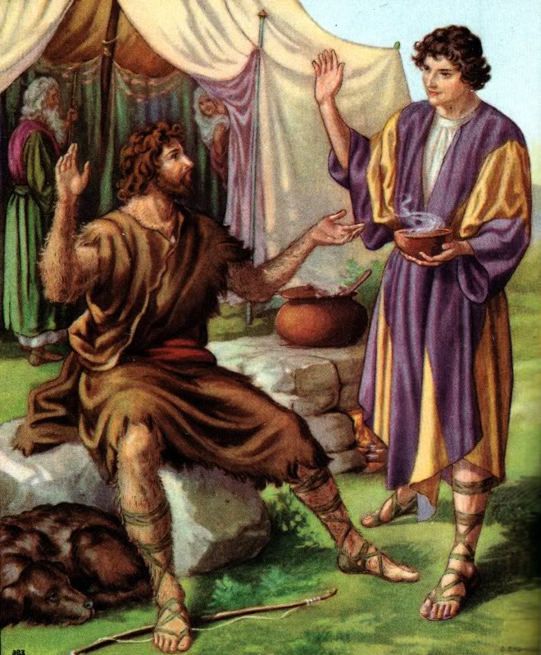
Old Testament Examples of Nearsightedness
Esau selling his birthright
  Genesis 25:27-34
Trespass of Achan
  Joshua 6:17-18
Disobedience of Saul
  1 Samuel 15:22-28
“To obey is better than sacrifice”
Richie Thetford www.thetfordcountry.com

Slide 3

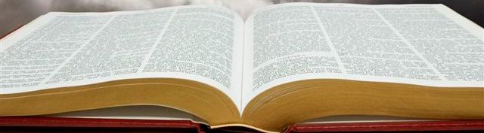
New Testament Examples of Nearsightedness
Ananias and Sapphira
  Acts 4:34-37
Simon the Sorcerer
  Acts 8:9-13
Richie Thetford www.thetfordcountry.com

Slide 4

Nearsighted
Examples of Today
Failing to study the Bible
  2 Timothy 2:15
  Hebrews 5:12-14
Neglecting the assembly
  Hebrews 10:25-29
Failing to contribute
  1 Corinthians 16:1-2
  2 Corinthians 9:6-8
Richie Thetford www.thetfordcountry.com

Slide 5
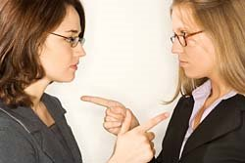
Nearsighted
Examples of Today
Seeing fault in others only
  Matthew 7:1-5
Returning evil for evil
  Romans 12:17-21
  Matthew 6:14-15
Thinking too much of ourselves
  Romans 12:3
Richie Thetford www.thetfordcountry.com

Slide 6

Nearsighted
Examples of Today
Having our interests centered
on worldly things
  1 John 2:15-17
Backsliding
  1 Timothy 4:1
  2 Peter 2:20-21
Richie Thetford www.thetfordcountry.com

Slide 7
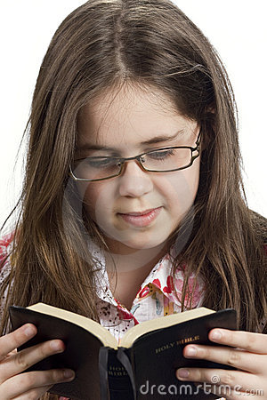
Remedy for
Nearsightedness
1 Peter 1:5-10
Virtue “moral excellence; goodness of character”
Knowledge “state of knowing; awareness”
Self-Control “control of our emotions, desires”
Perseverance “persistence; steadfastness”
Godliness “devoted to God; devout”
Brotherly Kindness “friendly; kind; loyal”
Love “strong affection or attachment to someone”
Richie Thetford www.thetfordcountry.com

