Slide 1
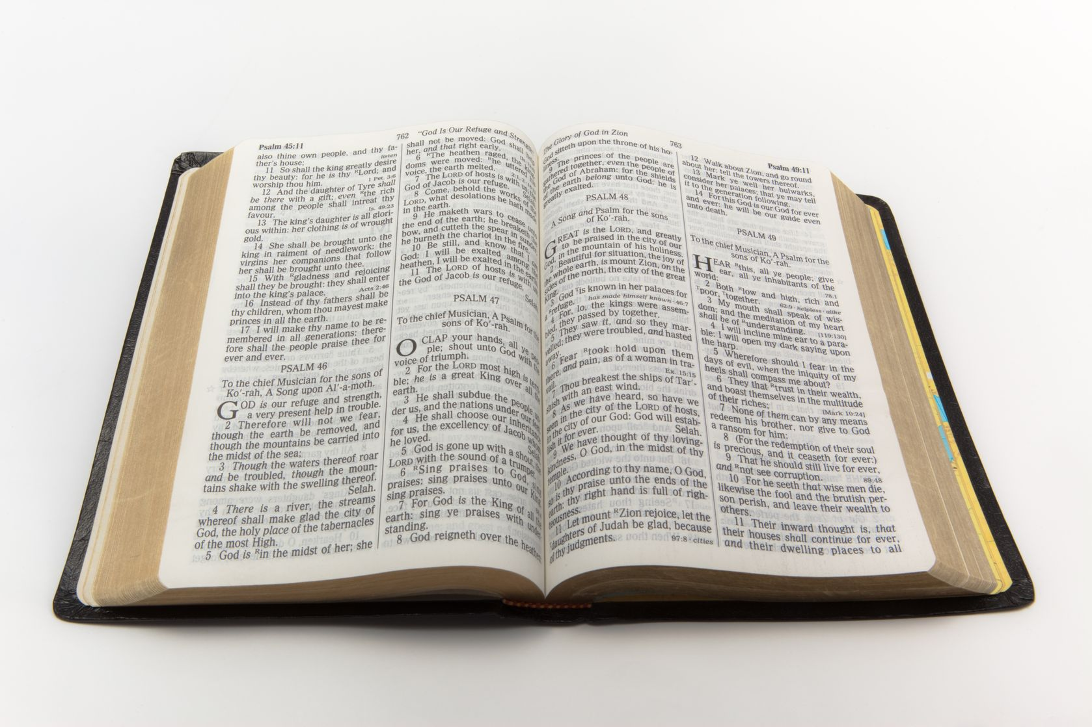
My Word Has No Place in You
John 8:21-37
John 1:11-12
Acts 13:46
Richie Thetford www.thetfordcountry.com

Slide 2
Why Should It Have A Place?
“My Word has no place in you”
Jesus’ authority
Matthew 28:18
Hear Jesus
Matthew 17:5
Acts 3:22-23
“Lord, to whom shall we go?” (John 6:68)
Richie Thetford www.thetfordcountry.com

Slide 3
Why Should It Have A Place?
“My Word has no place in you”
Jesus’ words are life
John 6:63
James 1:18-21
Romans 1:16; 6:23
John 3:18
He who rejects Me, and does not receive My words, has that which judges him – the word that I have spoken will judge him in the last day (John 12:48)
Richie Thetford www.thetfordcountry.com

Slide 4
What Place Should the Word Have?
“My Word has no place in you”
Within our heart
Colossians 3:16
John 15:7; Luke 8:15
Respect
Proverbs 13:13
Richie Thetford www.thetfordcountry.com

Slide 5
What Place Should the Word Have?
“My Word has no place in you”
Place of love
Psalms 119:97
2 Thessalonians 2:10
Authority
Matthew 15:9
Richie Thetford www.thetfordcountry.com

Slide 6
Why Doesn’t the Word Have a Place?
“My Word has no place in you”
Rejected
2 Timothy 3:1-5
1 John 2:15-17
Matthew 13:22
2 Peter 2:9-15
Matthew 12:30
Richie Thetford www.thetfordcountry.com

Slide 7
The Condition of Those That Reject?
“My Word has no place in you”
Deeper in sin
James 4:17
No longer seek Christ’s Words
Hebrews 3:8-9
Hebrews 3:15; 12-14
2 Timothy 4:1-4
2 Thessalonians 1:8
Richie Thetford www.thetfordcountry.com

Slide 8
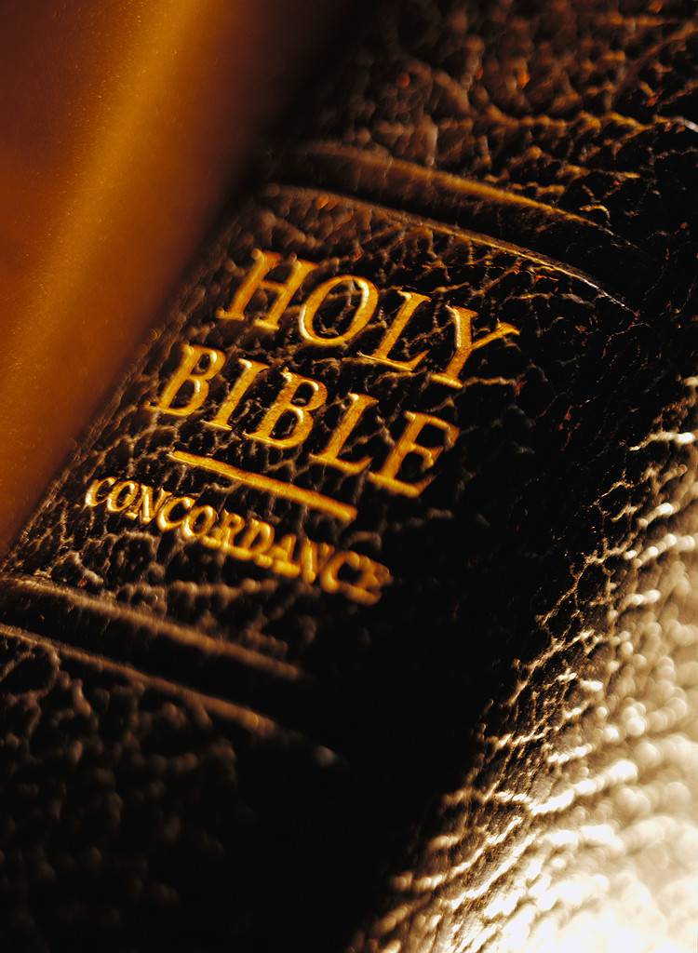
Christ’s Word to Us Today
“My Word has no place in you”
Alien Sinner
John 8:24; Acts 17:30; Mark 16:16; Acts 2:38
Erring
1 John 1:8-10; Acts 8:22
Faithful Christian
Titus 2:11-13; 2 Peter 3:18; Revelation 2:10; John 8:32
Richie Thetford www.thetfordcountry.com

Slide 9
Richie Thetford www.thetfordcountry.com

