Slide 1

My Mother Loved Me
Recall your mother’s love for you
and also God’s love for you
Richard Thetford www.thetfordcountry.com

Slide 2

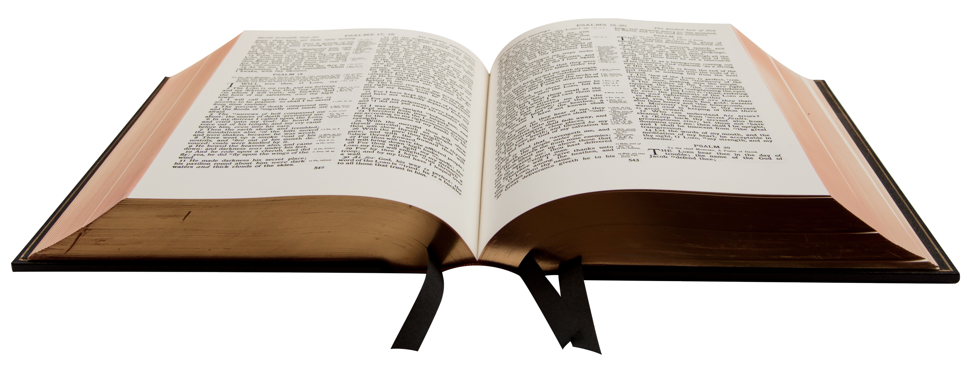
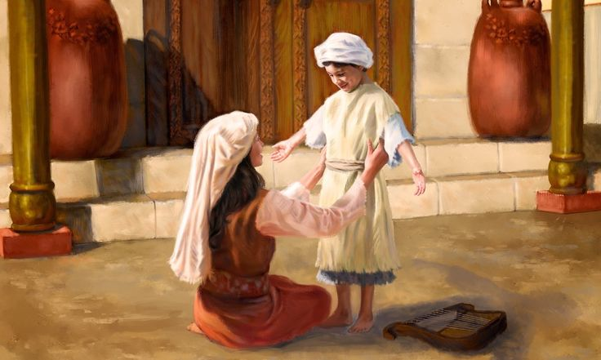
The Example of Hannah
A great example of a good mother
  1 Samuel 2:19
Hannah loved Samuel

Slide 3
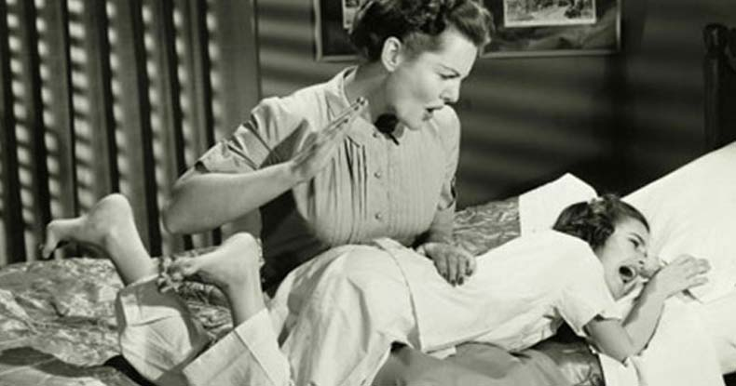
Disciplined Me
Disciplined me when I did wrong
  Proverbs 13:24
  Proverbs 29:15

Slide 4

Cared for Me
Knew exactly what to do
  Psalms 35:13-14
  Matthew 4:24

Slide 5
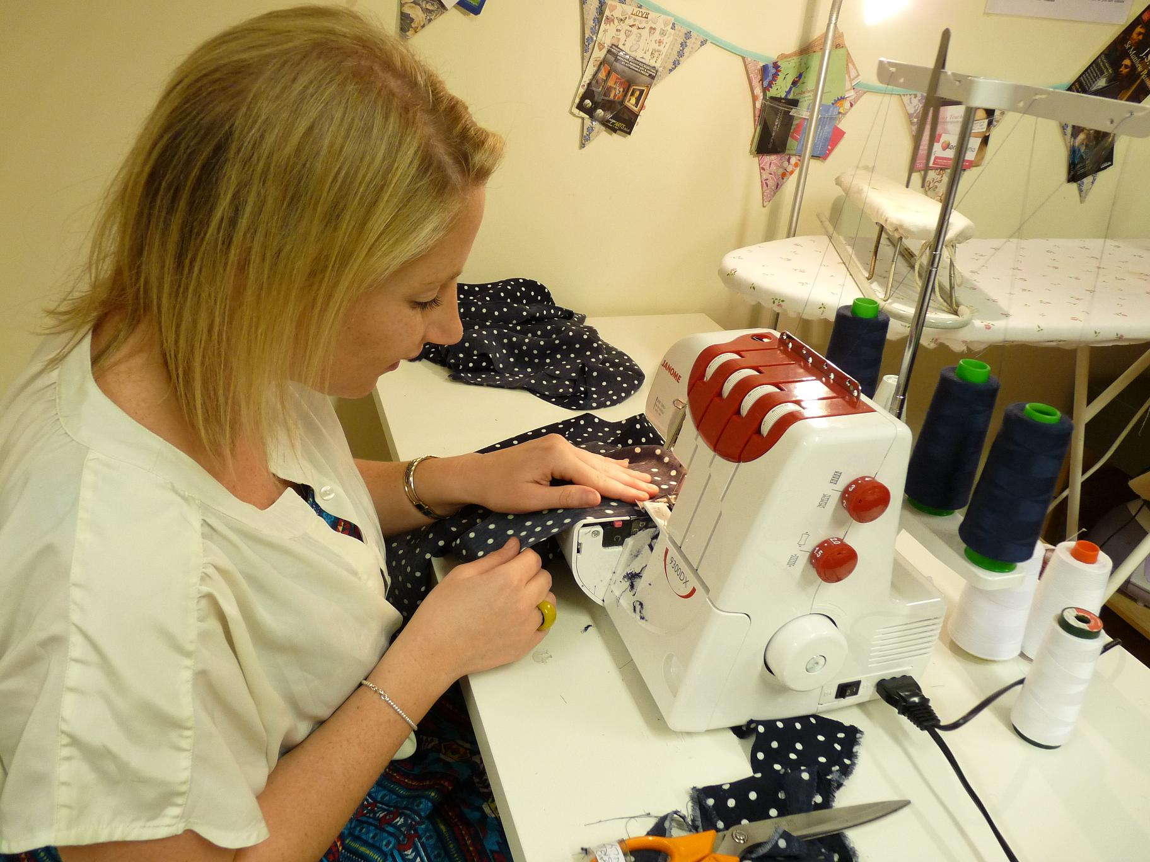
Fed and Clothed Me
Always made sure I had what I needed
  Matthew 5:44-48
  Romans 5:7-8

Slide 6

Taught Me God’s Word
Godliness and righteousness was a priority
  Psalms 22:10
  2 Timothy 1:3-5

Slide 7
Conclusion
I know my mother loved me because…..
  She disciplined me when I was wrong
  She cared for me when I was sick
  She fed me and clothed me even when I rebelled
  She taught me about God’s word
Her love was demonstrated
through action based on
God’s teaching

