Slide 1
My life, my faith, my hope
Job 12-14

Slide 2
My life
Job had wisdom
God is great
Job wanted to end his suffering
Acts 17:24-28
Colossians 1:16-17
Our lives are in God’s hands – do we have anything to fear?

Slide 3
My life
What About Suicide?
Life is in God’s hands
Job 12:10
Job 14:5
Psalms 139:16
Psalms 31:15

Slide 4
My life
What About Suicide?
No incident of a godly person committing suicide
Saul rebelled – 1 Samuel 31:3-5
Zimri was a rebel – 1 Kings 16:8-20
Judas betrayed Jesus – Matthew 27:4-5
Samson’s death (Martyrdom) – Judges 16:23f

Slide 5
My life
What About Suicide?
Sixth commandment forbids murder
Exodus 20:13
Man made in the image of God
“To run away from trouble is a form of cowardice.” and “while it is true that the suicide braves death, he does it not for some noble object but to escape some ill.”
--- Aristotle
2 Timothy 4:6-8

Slide 6
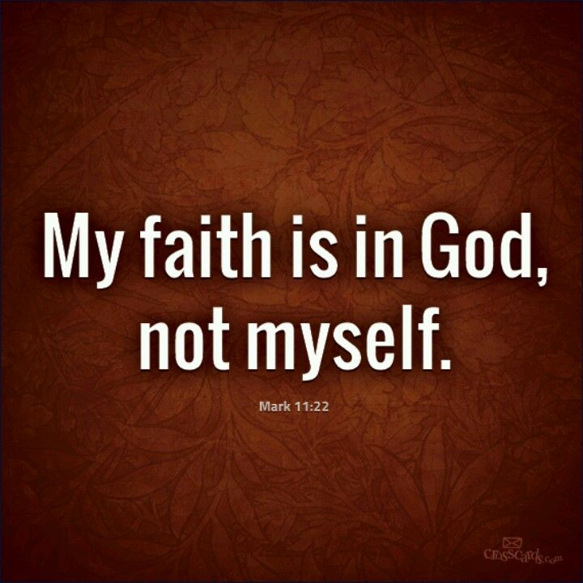
My faith
Job sees his creator as judge
“I desire to reason with God” (13:3)
As we help others….
Job 13:15
What GREAT faith Job had in his God!

Slide 7
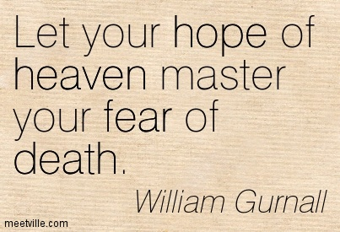
My Hope
Man is born to die
Job 14:2, 10-12, 5-6
Must rest our hope on God!
John 11:25-26
1 Corinthians 15
2 Timothy 1:9-10
Keep the FAITH as long as we long for the HOPE of heaven!

