Slide 1

Mothers Pleasing to God
Reflecting on the importance of mothers

Slide 2

Honor Father and Mother
Honor – to obey them while we are young and to provide for them when they’re old
Honor our mothers every day of the year!

Slide 3
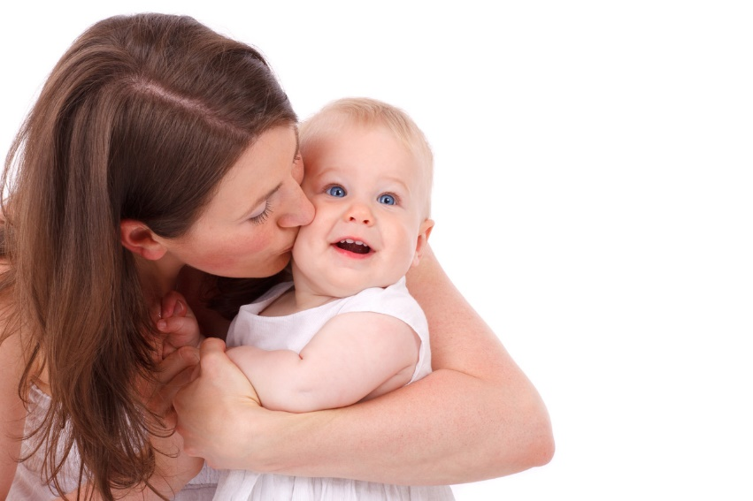
Reflecting on Mothers
Celebrating Life
Life began with God
  Genesis 2:7
Man was made in the image of God
  Genesis 1:26-27
Life is a gift from God

Slide 4

Reflecting on Mothers
Celebrating Life
Process of procreation
  Genesis 3:20
  1 Timothy 2:15
We celebrate life through our mothers
  John 10:10
  John 3:16

Slide 5
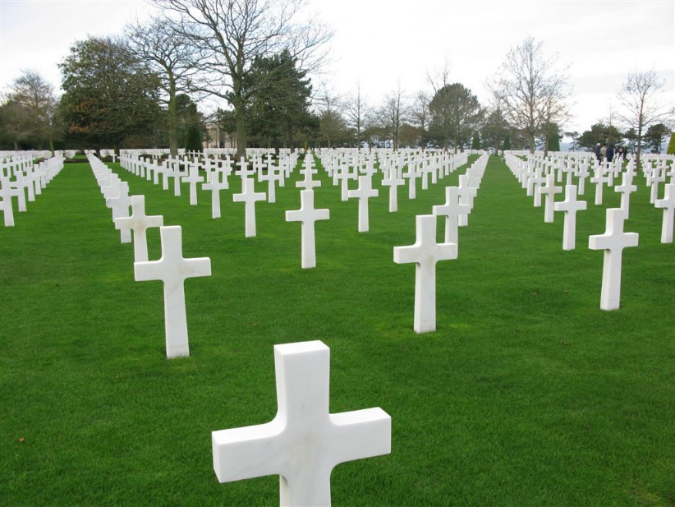
Reflecting on Mothers
Remembering Death
All are appointed to die
  Hebrews 9:27
God told Adam:
  Genesis 3:19
Godly mothers raised us with the end in sight
  Psalms 90:10,12; Ecclesiastes 7:2-4

Slide 6

Reflecting on Mothers
Reinforcing Holiness
Examples of good mothers
  Sarah (Genesis 17:15-16)
  Hannah (1 Samuel 1-2)
  Elizabeth (Luke 1:6)
  Mary
Good mothers are desperately needed

Slide 7
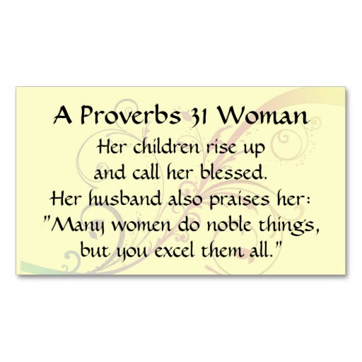
Reflecting on Mothers
Reinforcing Holiness
Godly mother described for us in scripture
  Proverbs 31:10-31
    Is industrious
    Is charitable
    Takes care of her husband and children
  Paul instructs: (Titus 2:4-5)

Slide 8
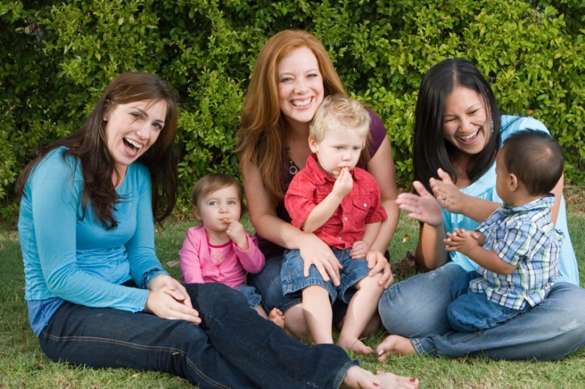
Conclusion
We need mothers to help us:
  Celebrate life
  Remember death
  Reinforce holiness
Let us honor our mothers and live with these principles in mind

