Slide 1
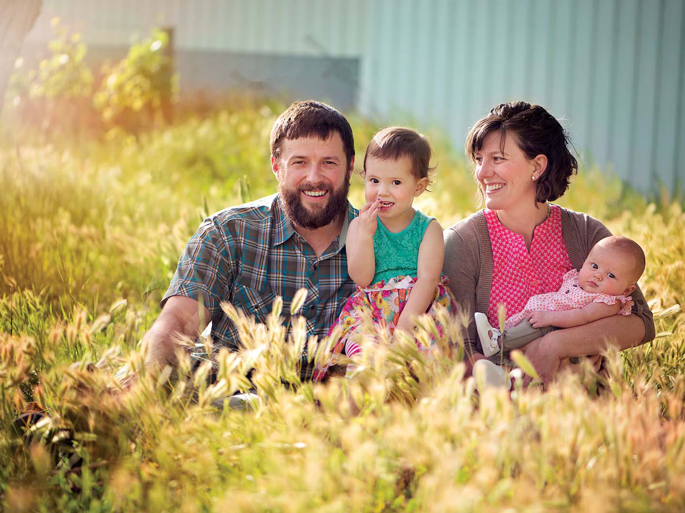
Mothers
The Heart of the Family
Richie Thetford www.thetfordcountry.com

Slide 2

Managers of the Home
God’s order
  1 Timothy 5:14-15
Keeping the home
Domestic manager
  Proverbs 31:21
  Proverbs 31:15-16
  Proverbs 31:18, 24
  Proverbs 31:23, 25
Richie Thetford www.thetfordcountry.com

Slide 3

Models of Obedience
Examples of submissiveness
  James 4:7
  Galatians 2:20
  1 Peter 3:1, 5
  Titus 2:4-5
Seen in Mary
  Luke 1:38
Richie Thetford www.thetfordcountry.com

Slide 4

Teachers of Good Things
Reflects God’s plan
  Proverbs 1:8, 6:20, 31:1
  Matthew 7:5
Timothy’s mother and
grandmother
  2 Timothy 1:5
  2 Timothy 3:15
Richie Thetford www.thetfordcountry.com

Slide 5

Helpers of the Helpless
Agents of grace and mercy
  Proverbs 15:20
  Proverbs 10:1
Mothers care for us
Richie Thetford www.thetfordcountry.com

Slide 6
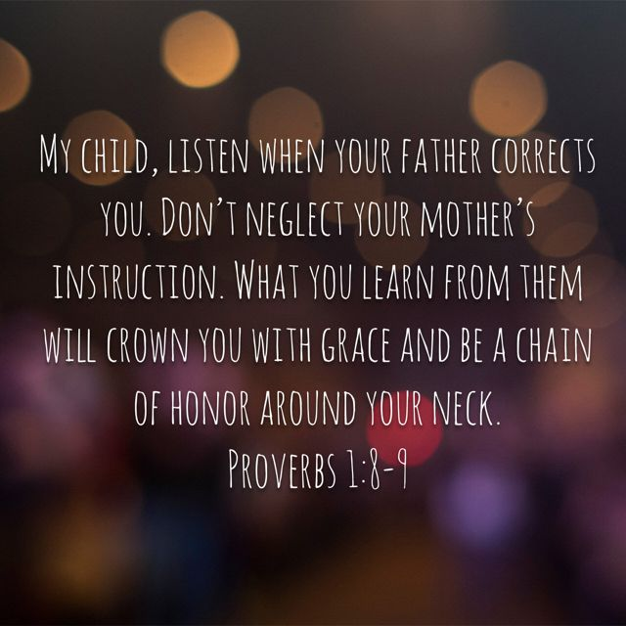
Encouragers of the Fainthearted
The law of mother
  Proverbs 1:8-9
  Proverbs 14:1
“Builds” her house
  A source of encouragement
The example of Hannah
  1 Samuel 1:2-10
Richie Thetford www.thetfordcountry.com

Slide 7

Respected and Honored
Rooted in the Old Testament
Sprouts in the New Testament
  Leviticus 19:3
  Proverbs 23:25
  Ephesians 6:2
The disrespectful child
  Proverbs 19:26; 20:20
  2 Timothy 3:2
Richie Thetford www.thetfordcountry.com

Slide 8


Respected and Honored
Be thankful for our mother
  Proverbs 31:28
Expressed in deeds
  1 John 3:18
Richie Thetford www.thetfordcountry.com

Slide 9
Mothers
Ezekiel 16:44
The Heart of the Family
Richie Thetford www.thetfordcountry.com

