Slide 1
s
“For the love of money is the root of all evil….” (KJV)
1 Timothy 6:10
s
Money and the Christian
Richie Thetford www.thetfordcountry.com

Slide 2
Money and Our Spirituality
Money – a gauge of our spirituality
Galatians 6:6-10
Sharing with those who teach
God won’t be mocked
Galatians 6:8
Jesus’ teaching
Matthew 6:19-21
Richie Thetford www.thetfordcountry.com

Slide 3
Sowing to the Flesh
Not to sow for things of the flesh
1 Timothy 6:17-19
2 Corinthians 9:6-7
Is temporary and corruptible
The rich man’s fleshly approach
Luke 12:16-21
Richie Thetford www.thetfordcountry.com

Slide 4
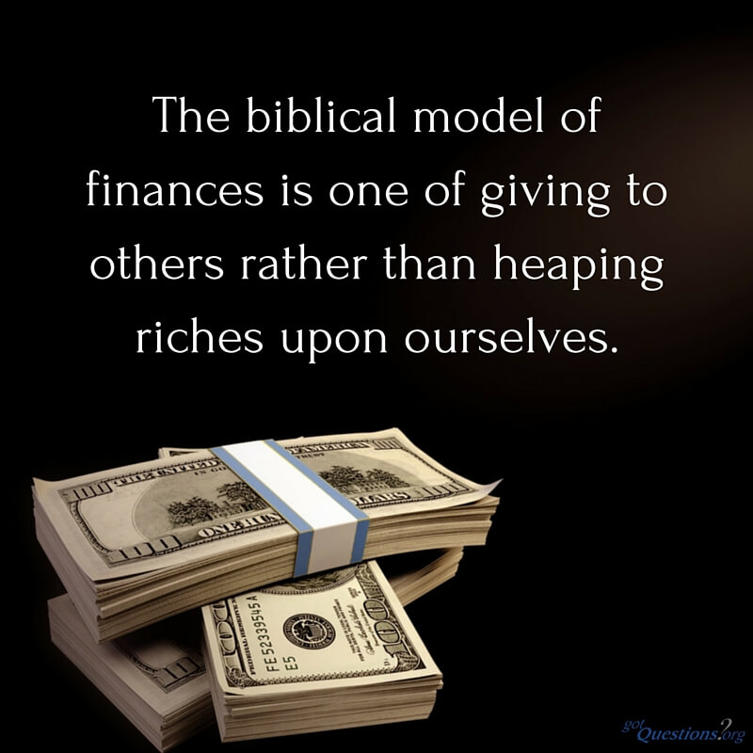
Sowing to the Spirit
Doing things to assist the Holy Spirit
Relieving those suffering
Helping the poor
Our investment will mirror what we hope to reap
The long-term is ETERNAL
Richie Thetford www.thetfordcountry.com

Slide 5
Money – A Measure of Our Lives
A means to get what we need, want, and value
Used for self-gratification – that is our reward
Used for the Spirit’s work – heaven is our reward
We can’t spend most of our time and money on fleshly, earthly matters and then harvest a spiritual crop!
Richie Thetford www.thetfordcountry.com

Slide 6
Examine spending habits
See where our priorities lie
Truly, each one of us will
“reap what we sow”
Richie Thetford www.thetfordcountry.com

