Slide 1
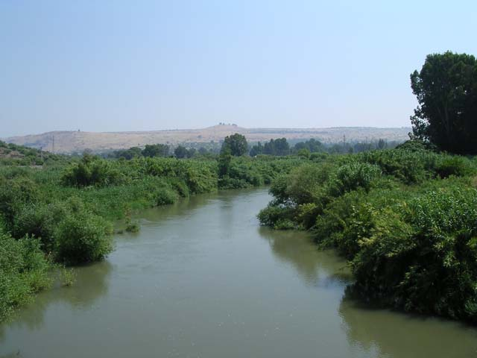
The Mistakes of Naaman
2 Kings 5:1-14
“For whatever things were written before were written for our learning, that we through the patience and comfort of the Scriptures might have hope.” Romans 15:4
Richard Thetford www.thetfordcountry.com

Slide 2
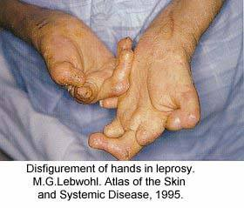
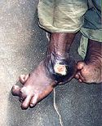
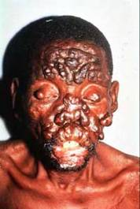
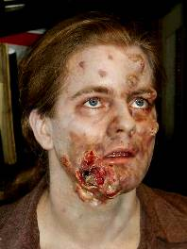
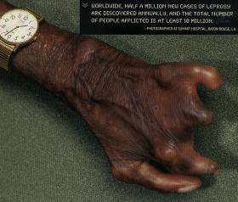
The Mistakes of Naaman
Naaman needed help
A leper (v1)
People today are sinners
Romans 3:23; 6:23
Richard Thetford www.thetfordcountry.com

Slide 3
The Mistakes of Naaman
Naaman needed help
A leper (v1)
People today are sinners
Romans 3:23; 6:23
Naaman went to the wrong man for help
The king (v6)
People today go to various individuals
John 14:6
Richard Thetford www.thetfordcountry.com

Slide 4
The Mistakes of Naaman
Naaman’s cleansing was conditional
Wash in the Jordan (v10)
People today must obey Christ
Hebrews 5:9; Matthew 7:21
Naaman became angry
Didn’t accept the instructions (v11)
People today unwilling to accept the truth
Acts 22:16; Ephesians 1:22-23
Richard Thetford www.thetfordcountry.com

Slide 5
The Mistakes of Naaman
Naaman wanted his way
“I thought” (v11)
People today want it “their way”
James 2:24; Matthew 16:18; Ephesians 5:23; John 9:4; 1 Corinthians 15:58
Naaman wanted to substitute
Other rivers (v12)
People today want to substitute
2 Timothy 3:16-17; Matthew 15:13
Richard Thetford www.thetfordcountry.com

Slide 6
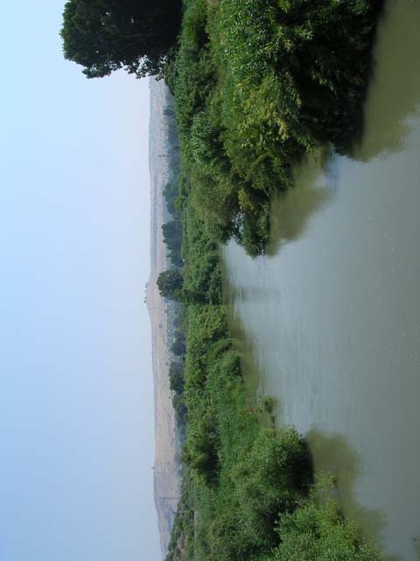
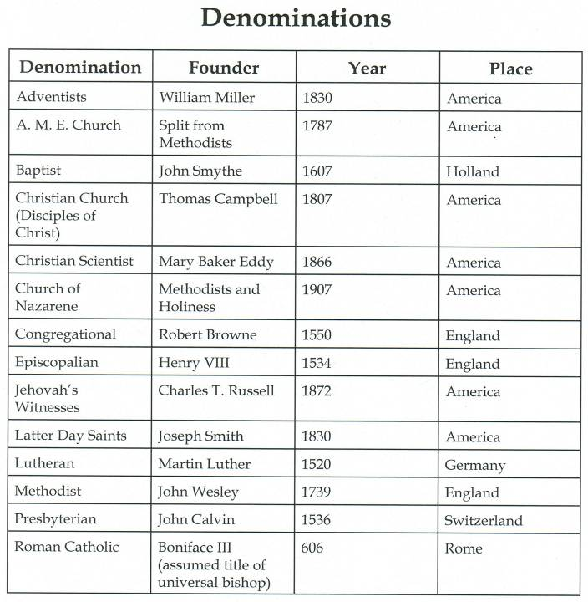
“I will build My church”
Matthew 16:18
The Mistakes of Naaman

Slide 7
The Mistakes of Naaman
Naaman blessed at obedience
Dipped 7 times (v14)
People today must obey God’s will to be saved
Hear (Romans 10:17)
Believe (John 8:24)
Repent (Luke 13:3; Acts 17:30)
Confess (Romans 10:10)
Be Baptized (Mark 16:16; Acts 2:38; 1 Peter 3:21)
Like Naaman, we must follow God’s plan!
Richard Thetford www.thetfordcountry.com

