Slide 1

2 Kings 13:14-19
Richard Thetford thetfordcountry.com

Slide 2

Opportunity of victory over sin
Everyone sins
  Romans 3:23
God’s battle tactics against Satan
  Hear: John 5:24
  Believe: Hebrews 11:6
  Repent: Acts 17:30
  Confess: Romans 10:9-10
  Baptism: Acts 2:38; 22:16
  Live Faithfully: 1 John 1:5-7
Richard Thetford thetfordcountry.com

Slide 3

Opportunity of victory over temptation
Everyone must deal with it
  1 Corinthians 10:12-13
Must endure it
  James 1:2-3
He knows how to
deliver the godly
  2 Peter 2:9
Richard Thetford thetfordcountry.com

Slide 4
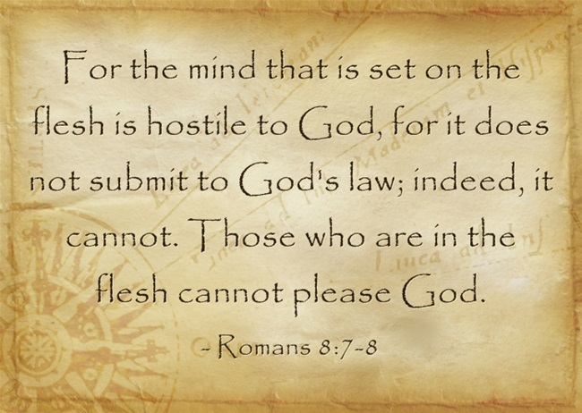
Opportunity of victory over a sinful life
Struggles will continue
  Romans 7:22-23
Our “victory” is in Jesus!
  Romans 7:24-25
Must be a determined effort
  Romans 8:1-14
A half-hearted commitment will make the ultimate
victory harder to achieve for ourselves and others
BELIEVE – without doubt or hesitancy
Richard Thetford thetfordcountry.com

