Slide 1
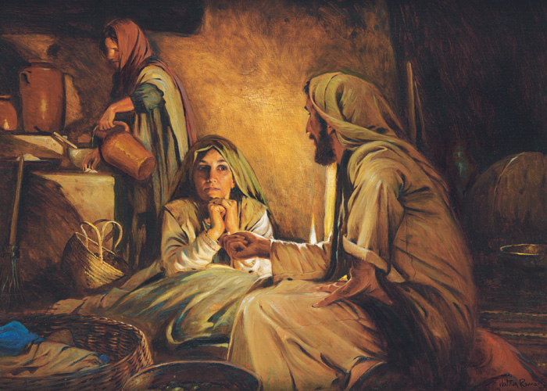
Mary and martha
“a Contrast”
“Martha, Martha, you are worried and troubled about many things.”
Luke 10:41
Richie Thetford www.thetfordcountry.com

Slide 2
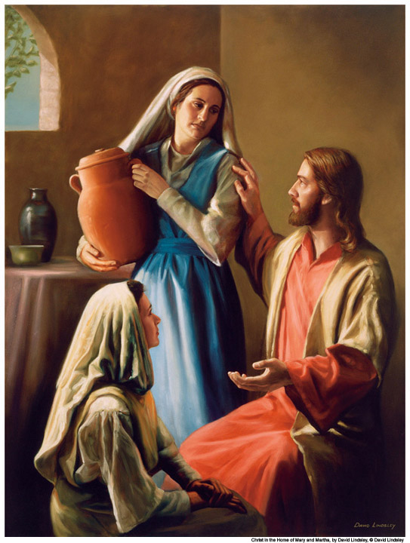
Sisters who are different
Martha – a perfect hostess
Mary – interested in conversation
Love and devotion to Jesus
Mark 14:3-9
John 12:1-8
Richie Thetford www.thetfordcountry.com

Slide 3
Another contrast
Between Martha and Mary
Luke 10:38-42
Martha “distracted with much serving”
Mary sits at the feet of Jesus
Richie Thetford www.thetfordcountry.com

Slide 4
Martha, not a bad person
A woman of dedication
Can be counted on when needed
A commendable woman
Under different circumstances serving may have been the best thing
Richie Thetford www.thetfordcountry.com

Slide 5
Maintain a balanced life
Balance is needed
Recognize we are human
Setting priorities
Confronted with choices
What is good and what is BEST
Richie Thetford www.thetfordcountry.com

Slide 6
WHAT IS GOOD AND BEST
Examine our life below the superficial level of outward appearances
Martha caught up in the performance trap
Setting expectations that can’t be met
Richie Thetford www.thetfordcountry.com

Slide 7
Conclusion
What about our life?
Filled with purpose and peace?
Stressed and frayed?
Jesus’ words ring true for us today
Matthew 11:28
Look at the example of Mary and Martha and learn to give our BEST not just the good!
Richie Thetford www.thetfordcountry.com

