Slide 1
Richie Thetford www.thetfordcountry.com

Slide 2
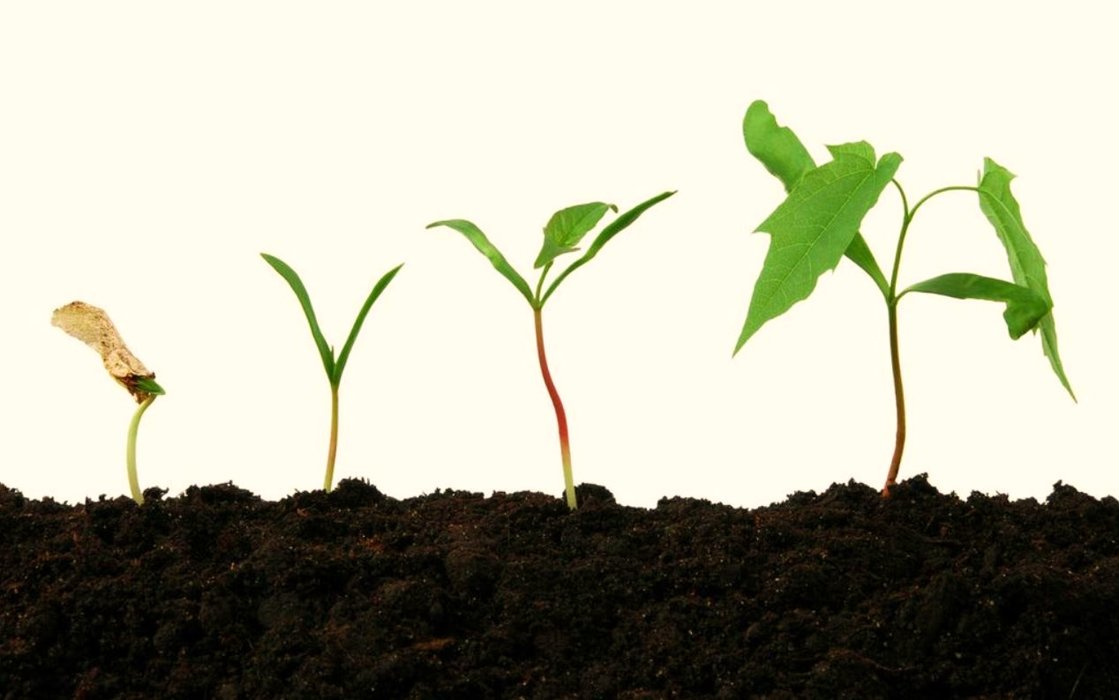
The Marks of Maturity
The growth process
1 Corinthians 14:26
Ephesians 4:11-14
Richie Thetford www.thetfordcountry.com

Slide 3
The Marks of Maturity
The Hebrew Marks
Hebrews 5:11-6:3
James 3:1
1 Corinthians 3:1-3
Philippians 1:9-10
Richie Thetford www.thetfordcountry.com

Slide 4
The Marks of Maturity
The Mark of Humility
Colossians 1:28
2 Timothy 3:16-17
Richie Thetford www.thetfordcountry.com

Slide 5
The Marks of Maturity
The Mark of Tongue Control
James 3:2
James 4:11
1 Peter 3:10
Ephesians 4:25
James 3:10
Matthew 12:36
Philippians 2:14
1 Corinthians 10:10
Richie Thetford www.thetfordcountry.com

Slide 6
The Marks of Maturity
The Mark of Love
1 John 4:17-21
John 13:35
Matthew 5:43-48
Richie Thetford www.thetfordcountry.com

Slide 7
The Marks of Maturity
The Mark of Steadfastness
James 1:2-4
James 1:12-15
Richie Thetford www.thetfordcountry.com

Slide 8
Perfection is only gained through maturity
and maturity is only gained when we strive to be perfect!
Richie Thetford www.thetfordcountry.com

