Slide 1
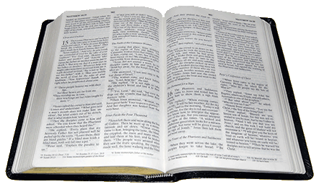
Many Members
In One Body
Romans 12:3-5
Richard Thetford www.thetfordcountry.com
Notes:
When listing all project collaborators, either use commas or bullets

Slide 2
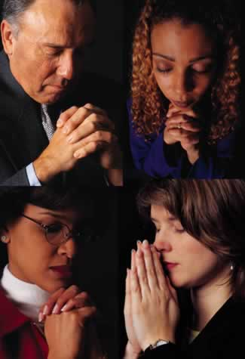
Introduction
Christians work together
  Acts 2:42
  Acts 14:23
  Acts 20:28
  Philippians 1:1
The “body” of Christ
  Ephesians 1:22-23
Members of one another
  Romans 12:5
  Ephesians 4:25
Richard Thetford www.thetfordcountry.com
Notes:
What is the name of your colony song?
Write lyrics to the song and, if you are feeling creative, use a computer program or instruments to create the music that goes along with it!
To insert an audio file, click on Recording -> Audio -> Audio on My PC and choose your file

Slide 3

The Church, the Body of Christ
Three important passages
  Romans 12:3-8
  1 Corinthians 12:4-31
  Ephesians 4:1-16
A personal responsibility
  Work and growth – Ephesians 4:16
  Unity – Ephesians 4:3
  Purity – Ephesians 5:27
  Reputation – Philippians 2:15
Not a matter of private choice
  1 Corinthians 12:18, 14-17, 21-23
Richard Thetford www.thetfordcountry.com
Notes:
What is the name of your colony song?
Write lyrics to the song and, if you are feeling creative, use a computer program or instruments to create the music that goes along with it!
To insert an audio file, click on Recording -> Audio -> Audio on My PC and choose your file

Slide 4
Other Descriptions of the Church
The Christian is:
  A branch in the vine
    John 15:1-8; Colossians 1:10
  A laborer in the vineyard
    Matthew 20:1-16; 1 Corinthians 3:9; 15:58
  A citizen in the kingdom
    Matthew 16:18-19; John 3:5
  A child in the family
    John 1:12; 1 Timothy 3:15
  A soldier in the army
    Ephesians 6:10-17; 2 Timothy 2:3
  A vessel in the house
    2 Timothy 2:20-21
Richard Thetford www.thetfordcountry.com
Notes:
What is the name of your colony song?
Write lyrics to the song and, if you are feeling creative, use a computer program or instruments to create the music that goes along with it!
To insert an audio file, click on Recording -> Audio -> Audio on My PC and choose your file

Slide 5
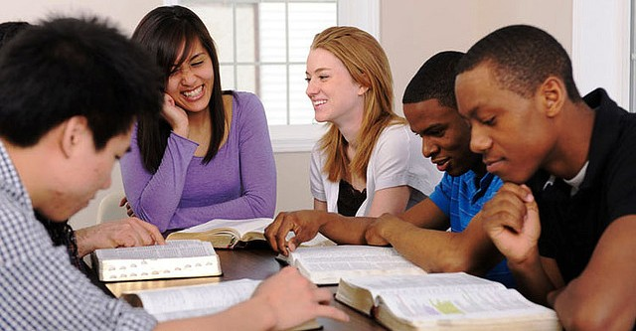
The Problem of Being Passive
The church is a sphere of activity
  Acts 9:26
Biblically – no such thing as a
“passive member”
Faith without works is dead
  James 2:14-26
Richard Thetford www.thetfordcountry.com
Notes:
What is the name of your colony song?
Write lyrics to the song and, if you are feeling creative, use a computer program or instruments to create the music that goes along with it!
To insert an audio file, click on Recording -> Audio -> Audio on My PC and choose your file

Slide 6
Conclusion
Being part of a local church:
  Encouragement to do right
  Friendship and companionship
  Knowledge gained from others
  Benevolent help when we are in physical need
  Prayers offered for us
  Comfort in sorrow, help in troubled times
Make a renewed commitment!
  1 Corinthians 12:25; 15:58
“The happy people are those who are producing something; the bored people are those who are
consuming much and producing nothing” (W. R. Inge)
Richard Thetford www.thetfordcountry.com
Notes:
What is the name of your colony song?
Write lyrics to the song and, if you are feeling creative, use a computer program or instruments to create the music that goes along with it!
To insert an audio file, click on Recording -> Audio -> Audio on My PC and choose your file

