Slide 1
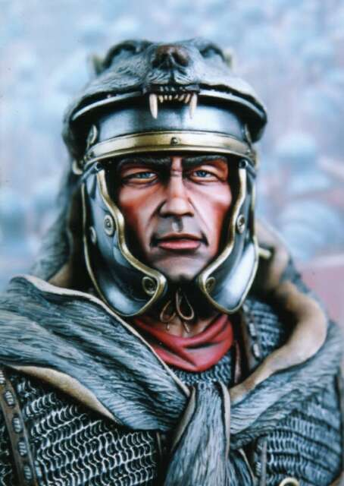

The Man With Such Great Faith!
Luke 7:1-10
Richard Thetford www.thetfordcountry.com

Slide 2
Centurion
Captain of 100 men in the Roman Army
One of four centurions in the New Testament
  At the cross (Matthew 27:54)
  Cornelius (Acts 10:1-2, 22)
  Julius (Acts 27:1, 42-43)
All seem to be men of noble qualities
Richard Thetford www.thetfordcountry.com

Slide 3
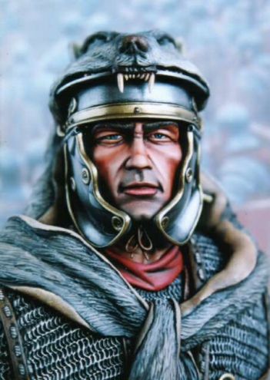
Every man is really 3 men:
  The man his enemies think he is
  The man his friends think he is
  The man he thinks he is
A fourth man:
  The man he REALLY is
Richard Thetford www.thetfordcountry.com

Slide 4
What the
Neighbors Thought
Based upon what they had seen
They approved of him
What would our neighbors say about us?
  In matters what others think (1 Peter 2:11-12)
  We are to be lights (Philippians 2:15)
  We are to be a good neighbor (Matthew 5:16)
Richard Thetford www.thetfordcountry.com

Slide 5
What He Thought
Based on the examination of his heart
  A sincere self estimate
  He knew himself better than they
    Great humility (Matthew 23:12; 1 Corinthians 2:11)
    He was judging himself by a higher standard
    (2 Corinthians 10:12)
A thorough examination will profit all of us
  2 Corinthians 13:5; 1 Corinthians 11:28
Richard Thetford www.thetfordcountry.com

Slide 6
What Jesus
Knew About Him
The Lord “marveled”
This man’s “great” faith (v9)
  Some have “little” faith (Matthew 8:26)
  Some have “dead” faith (James 2:17)
What about our faith?
  Would the Lord marvel at how great it is?
    Hebrews 11:6; 10:39
Richard Thetford www.thetfordcountry.com

Slide 7
Each estimate of the centurion was true from each person’s viewpoint
However – it is the Lord’s approval that counts
that is who we REALLY are!
Richard Thetford www.thetfordcountry.com

