Slide 1
The Making of a Strong Church
Ephesians 6:11-12
Therefore, since we are receiving a kingdom which cannot be shaken, let us have grace,
by which we may serve God acceptably
with reverence and godly fear.
Hebrews 12:28
Richard Thetford www.thetfordcountry.com

Slide 2
We are shown the way of strength
Proverbs 10:29 The way of the LORD is strength for the upright, But destruction will come to the workers of iniquity.
Philippians 4:13 I can do all things through Christ who strengthens me.
“If every member of this church were just like me, what kind of a church would this church be?”
Richard Thetford www.thetfordcountry.com

Slide 3
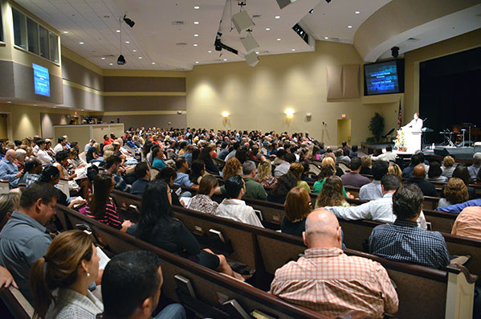
Things That Are Not Necessary
To have a large number of members
To have wealth and a beautiful building
To have programs and entertainment
Richard Thetford www.thetfordcountry.com

Slide 4

Things That Are Necessary
Loyalty to God and His word
  John 15:7
  Hebrews 3:13-14
  1 Corinthians 15:58
  Mark 12:30
  Psalms 119:11
  2 Timothy 3:16-17
  1 Peter 4:11
Richard Thetford www.thetfordcountry.com

Slide 5

Things That Are Necessary
Members converted to Christ
  Luke 6:46
  Matthew 7:21
  Luke 9:62
  Revelation 3:14-16
  Romans 12:1-2
Richard Thetford www.thetfordcountry.com

Slide 6
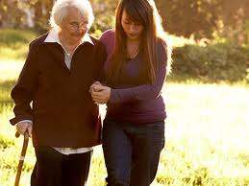
Things That Are Necessary
Members who do good
  1 Peter 2:11
  1 Thessalonians 5:21-22
  1 John 2:15-17
  Ephesians 2:10
Richard Thetford www.thetfordcountry.com

Slide 7

Things That Are Necessary
Members who are “unsatisfied”
  Philippians 3:13-14
  Hebrews 6:1
Richard Thetford www.thetfordcountry.com

Slide 8

Conclusion
Don’t lose sight of the future
For the church to be strong – the members must be strong
Strive to live and develop in the church
Richard Thetford www.thetfordcountry.com

Slide 9
Conclusion
“that we should no longer be children, tossed to and fro and carried about with every wind of doctrine, by the trickery of men, in the cunning craftiness of deceitful plotting, but, speaking the truth in love, may grow up in all things into Him who is the head--Christ--from whom the whole body, joined and knit together by what every joint supplies, according to the effective working by which every part does its share, causes growth of the body for the edifying of itself in love.
Ephesians 4:14-16
Richard Thetford www.thetfordcountry.com

