Slide 1
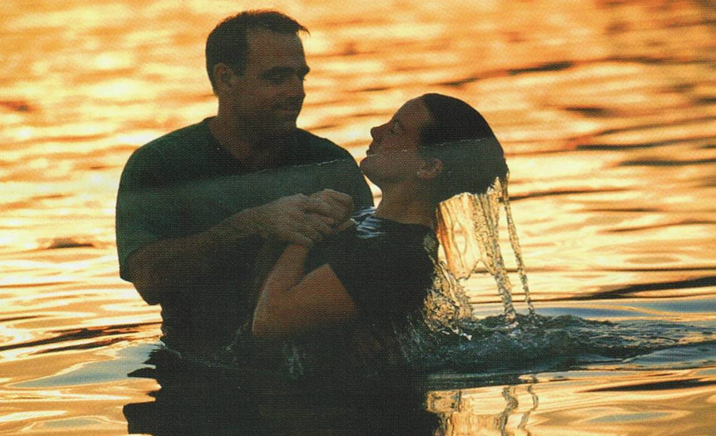
The Making of a Christian
Richie Thetford www.thetfordcountry.com

Slide 2
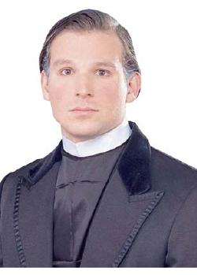
Who Is Not a Christian?
Not all “good people”
Morality is the obligation of a Christian but that does not make them a Christian
Cornelius
Nicodemus
Not all “religious people”
Some heathens are religious
Acts 17:22-23
Richie Thetford www.thetfordcountry.com

Slide 3
The Making of a Christian
One born twice
John 3:3-5
Begotten by the Spirit
1 Peter 1:23
James 1:18
1 Corinthians 4:15
When born again, we can enter the kingdom
Richie Thetford www.thetfordcountry.com

Slide 4
The Making of a Christian
Wears a new name
Isaiah 62:2
Acts 11:26
There is no salvation in any other name
“Nor is there salvation in any other, for there is no other name under heaven given among men by which we must be saved.” (Acts 4:12)
Richie Thetford www.thetfordcountry.com

Slide 5
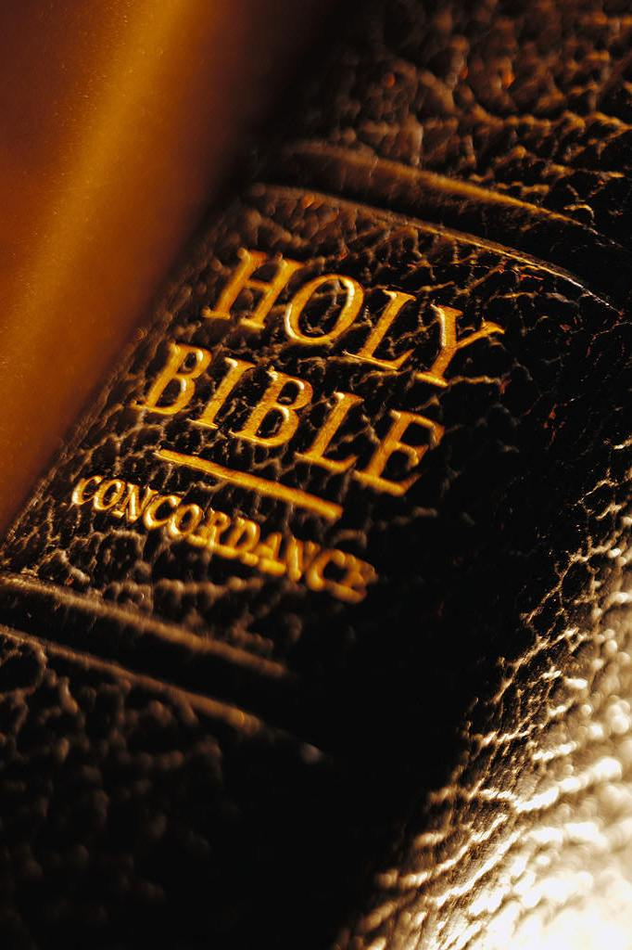
The Making of a Christian
“Christian” used 3 times
First in Antioch
Acts 11:26
Paul preaching to Agrippa
Acts 26:28
Preached the death, burial and resurrection of Jesus
Acts 16:31; 17:30; Romans 10:9-10; 6:3-5
Richie Thetford www.thetfordcountry.com

Slide 6
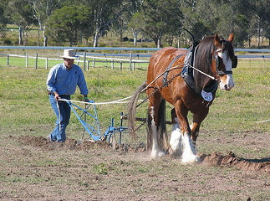
The Making of a Christian
“Christian” used 3 times
In suffering
1 Peter 4:16; 2 Timothy 3:12
It costs something to be a Christian
Matthew 10:32-38
Luke 9:62
Philippians 2:9-11
Richie Thetford www.thetfordcountry.com

Slide 7
Are You a Bible Christian?
WHY KEEP JESUS WAITING?
Richie Thetford www.thetfordcountry.com

