Slide 1


Lot’s Wife
Richard Thetford ww.thetfordcountry.com

Slide 2
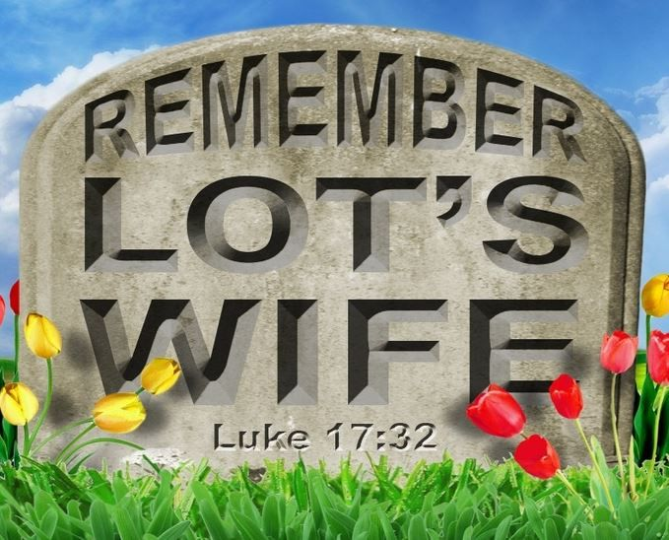
Instructions Given
To Lot
  Genesis 19:13
  Genesis 19:15
  Genesis 19:17
Disobedience
  Genesis 19:26
Richard Thetford www.thetfordcountry.com

Slide 3

Was the Wife of a Righteous Man
Lot was just and righteous
  2 Peter 2:7-8
An individual responsibility
  Galatians 6:5
She had the responsibility
of obedience – as did Lot
Richard Thetford www.thetfordcountry.com

Slide 4

Was Warned of the Danger
The warning issued
  Genesis 19:17
We are warned today
  Hebrews 2:1-3
  Acts 3:22-23
Richard Thetford www.thetfordcountry.com

Slide 5

Made Some Effort to Be Saved
Departed from Sodom
  Genesis 19:16-17
We must start and finish
  Luke 9:62
Richard Thetford www.thetfordcountry.com

Slide 6
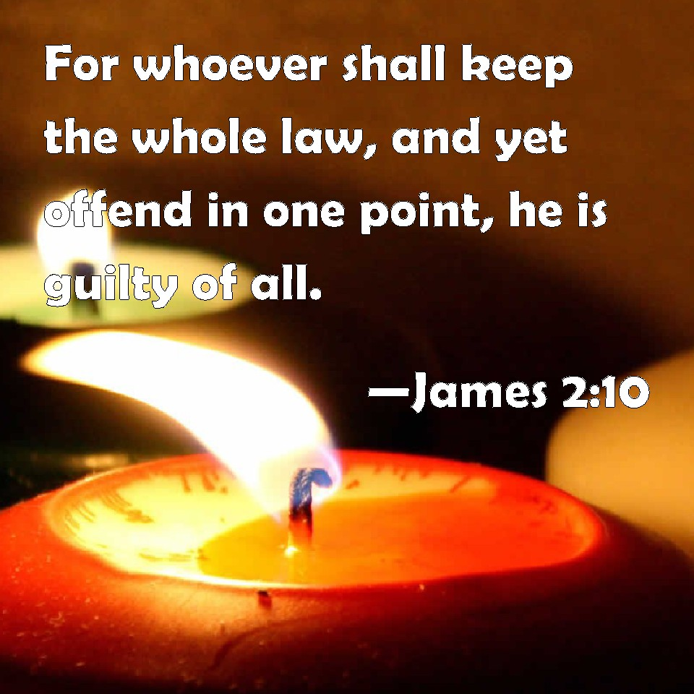
Committed One Sin
We read of one sin committed
  Genesis 19:26
One sin will also destroy us
  James 2:10
  Isaiah 55:8-9
Richard Thetford www.thetfordcountry.com

Slide 7
Lot’s Wife – Let Us Remember!
“Keep your heart with all diligence, For out of it spring the issues of life.”
Proverbs 4:23
Richard Thetford www.thetfordcountry.com

