Slide 1
Lost Religious People
Religious: but religiously wrong
Richard Thetford www.thetfordcountry.com

Slide 2
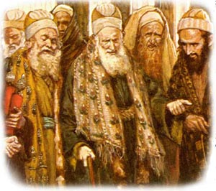
Pharisees
Very religious sect of people
Children of hell
Matthew 23:15
They say and do not do
Matthew 23:3
Works done to be seen of men
Matthew 23:5
Kingdom of God shut
Matthew 23:13
Richard Thetford www.thetfordcountry.com

Slide 3
Pharisees
Very religious sect of people
Prayers are for false showing
Matthew 23:14
Omitted what was important
Matthew 23:23
Strained at gnats
Matthew 23:24
Hypocrites
Matthew 23:28
Richard Thetford www.thetfordcountry.com

Slide 4
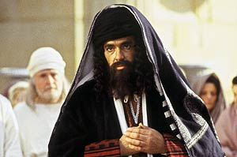
Another Pharisee
Prayed, fasted, gave tithes
Luke 18:9-14
He was lost
Trusted in himself (v9)
Exalted himself (v14)
“Trust in the LORD with all your heart, and lean not on your own understanding”
Proverbs 3:5
Richard Thetford www.thetfordcountry.com

Slide 5
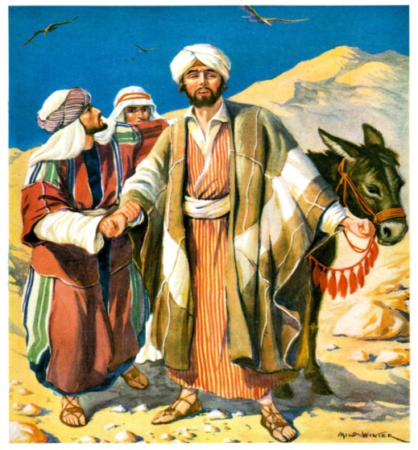
Saul of Tarsus
Religious man – but not saved
Acts 22:10-16
Confidence in the flesh does not save
Philippians 3:4-7
Had to respond to Ananias’ words
Acts 22:16
He was lost as long as he continued to try to keep the law of Moses
Richard Thetford www.thetfordcountry.com

Slide 6
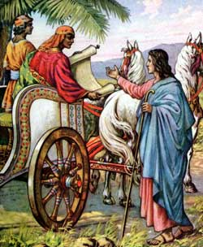
The Eunuch
Religious – he went to worship
Men can worship unacceptably
Matthew 15:9
Read the scriptures (v28)
He was lost
Not obeyed the gospel plan of salvation
Zeal without knowledge is unacceptable
Romans 10:1-3
Richard Thetford www.thetfordcountry.com

Slide 7
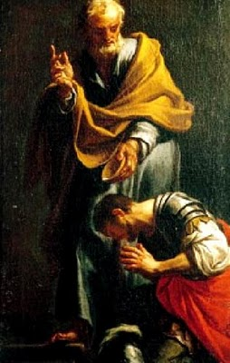
Cornelius
Devout, feared God, gave alms, prayed
Acts 10
Still was NOT saved – UNTIL baptized (v48)
We must hear the word and respond to it
James 1:22-23
Richard Thetford www.thetfordcountry.com

Slide 8
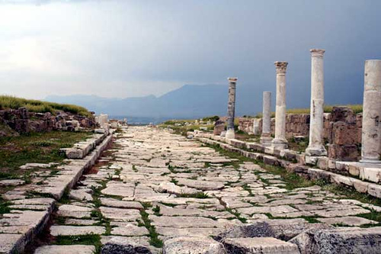
Church at Laodicea
They were lost
Revelation 3:14-22
LUKEWARM
Thought they were saved because they “seemed” religious
Richard Thetford www.thetfordcountry.com

Slide 9
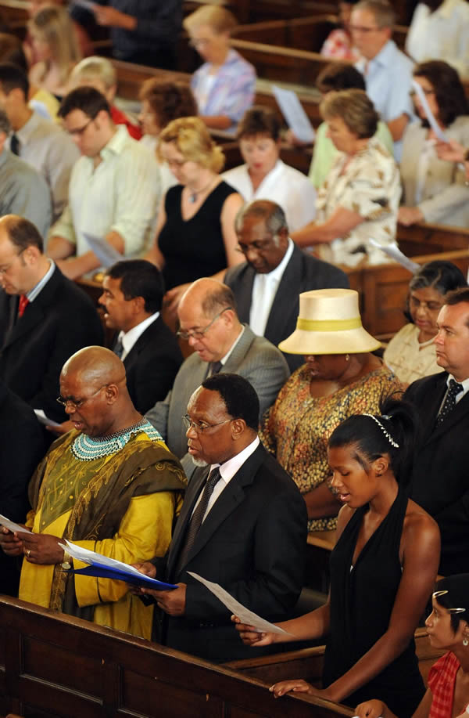
CONCLUSION
Many religious people will be disappointed at the judgment day
Matthew 7:21-23
A religious person is not necessarily a saved person
Only those who obey Jesus will have salvation
Hebrews 5:9
Richard Thetford www.thetfordcountry.com

