Slide 1

The Lord’s Church is Right

Slide 2
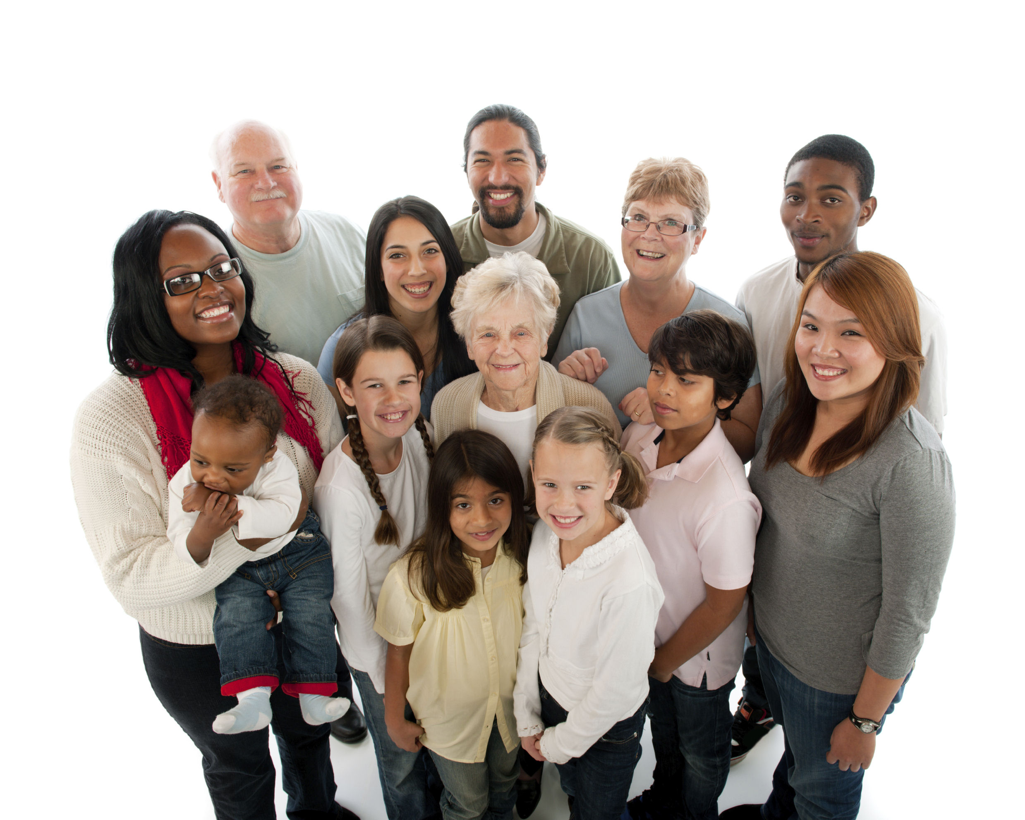
Introduction
The church is the body of Christ
  Ephesians 1:21-23
  Made up of baptized believers
  “church” – Greek word ekklesia
    an assembly; called-out
  “church” is the people
    – not a building

Slide 3
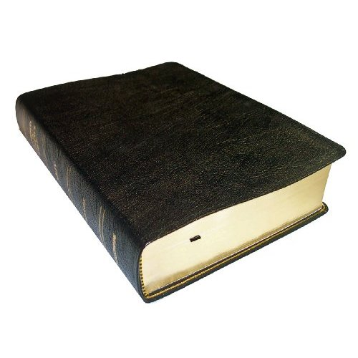
The Foundation is Right
Church built on the foundation of faith
  Matthew 16:13-19
Jesus is that foundation
  1 Corinthians 3:11
  Ephesians 2:20-21
Solid – like a rock
  Matthew 7:24-27

Slide 4
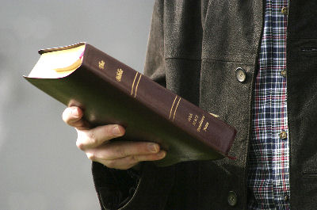
The Faith is Right
The Doctrine of Christ
  “Doctrine” is that which we teach
  The “truth” is what we contend for
    Jude 3
  Church has the right doctrine
  because Jesus IS that doctrine
    Acts 8:35

Slide 5
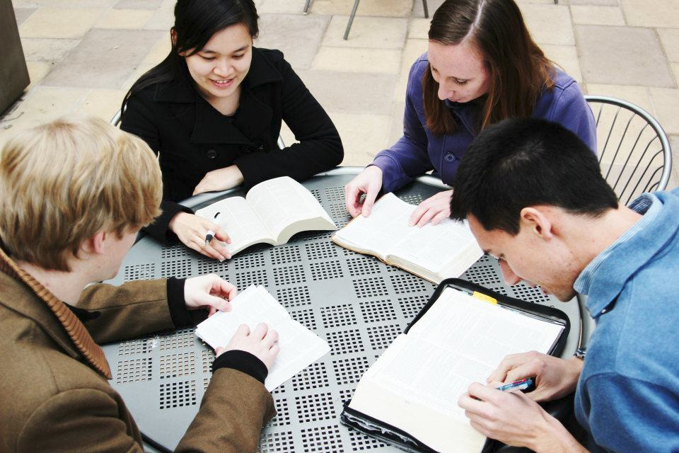
The Fellowship is Right
Fellowship is the life blood of the church
  Philippians 1:3-6
  Acts 2:42
  Early church examples:
    Suffer and rejoice
      1 Corinthians 12:26
    Carry burdens
      Galatians 6:2

Slide 6
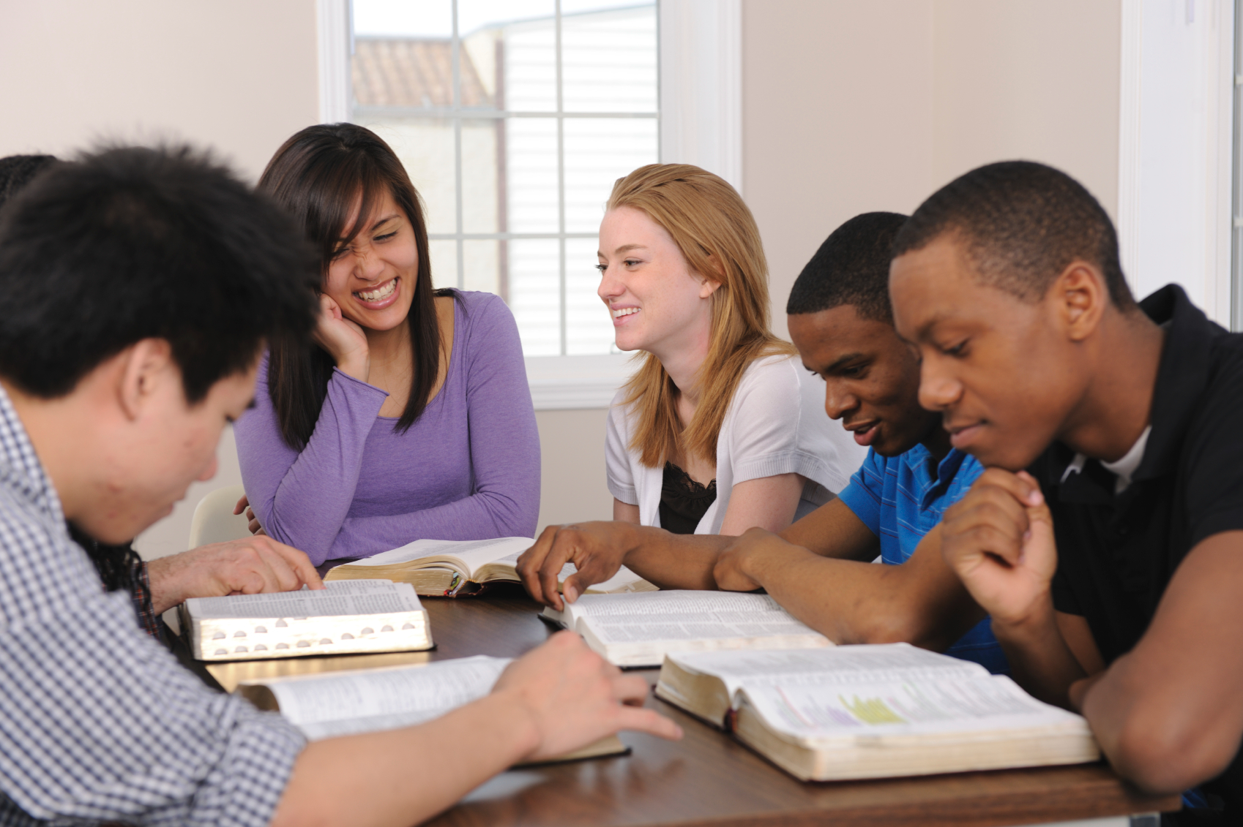
The Fellowship is Right
  Early church examples:
    Restore
      Galatians 6:1
    Pray
      Romans 15:30
    Encourage
      Romans 1:12
    Forgive
      Ephesians 4:32

Slide 7
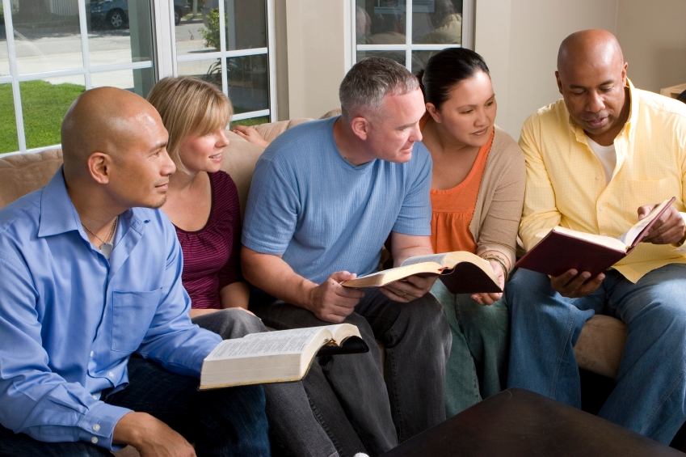
The Fellowship is Right
  Early church examples:
    Confess
      James 5:16
    Be truthful
      Ephesians 4:25
    Spur each other on
      Hebrews 10:24
    Give
      Philippians 4:14-15

Slide 8
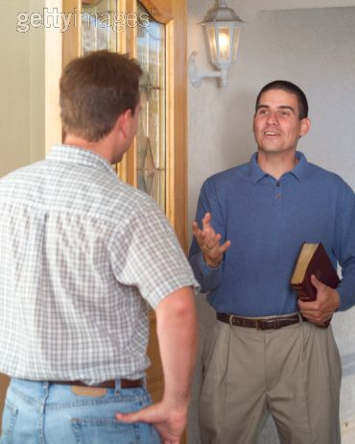
The Focus is Right
Fixated on souls
  Mark 16:15
  Jesus had compassion on lost souls
    Matthew 9:35-36
  Motivated Him to do two things:
    Pray for laborers
      Matthew 9:37-38
    Send out teachers
      Matthew 10:1, 5-7

Slide 9
The Future is Right
Jesus coming for His church
  1 Corinthians 15:24
  The words of Paul:
For the Lord Himself will descend from heaven with a shout, with the voice of an archangel, and with the trumpet of God. And the dead in Christ will rise first. Then we who are alive and remain shall be caught up together with them in the clouds to meet the Lord in the air. And thus we shall always be with the Lord. 1 Thessalonians 4:16-17
Each day we should live for the one who died for us!

Slide 10

Conclusion
The Church is Right!
Beauty of the church
is the glory of Christ!
Jesus always shines!
  Colossians 3:17
  1 John 3:2-3

