Slide 1

The Lord’s Church
“To the church of God which is at Corinth,
to those who are sanctified in Christ Jesus, called to be saints, with all who
in every place call
on the name of
Jesus Christ our Lord, both theirs and ours”
1 Corinthians 1:2
Richie Thetford www.thetfordcountry.com

Slide 2

The Lord’s Church
Jesus prayed for all believers to be “ONE”
“I do not pray for these alone,
but also for those who will
believe in Me through their
word; that they all may be one, as You, Father, are in Me, and
I in You; that they also may be one in Us, that the world may believe that You sent Me.”
John 17:20-21
Richie Thetford www.thetfordcountry.com

Slide 3
The Lord’s Church
Division cannot be pleasing to Jesus
Body
Spirit
Hope
Lord
Faith
Baptism
God
1
“Now I plead with you, brethren,
by the name of our Lord Jesus Christ, that you all speak the
same thing, and that there be
no divisions among you, but
that you be perfectly joined together in the same mind
and in the same judgment.”
1 Corinthians 1:10
Eph 4:1-6
Richie Thetford www.thetfordcountry.com

Slide 4
How Did Denominations or Division Come About?
In the New Testament – not groups of congregations distinguished by differing doctrines and practices
Congregations were simply “churches of Christ”
  Romans 16:16
?
If nothing had been changed would we still have the unity we read about in the New Testament
Richie Thetford www.thetfordcountry.com

Slide 5

How Did Denominations or Division Come About?
Changes did take place!
  Were predicted by the apostles before the New Testament period came to a close
Doctrines
of Teachers?
TRUTH?
1 Tim 4:1-2
2 Tim 4:3-4
Richie Thetford www.thetfordcountry.com

Slide 6
How Can the Unity the
Lord Prayed for be Recovered?
If we get rid of the cause of the division – would we not get rid of the division itself
?
If present division is the result of additions, subtractions and modifications to the LORD’s teaching – would we not be able to have unity
IF these changes were eliminated?
+ / -
Richie Thetford www.thetfordcountry.com

Slide 7
How Can the Unity the
Lord Prayed for be Recovered?
The Word of God is like “seed”
  Luke 8:11
  Seed ALWAYS produces AFTER its kind!
It should not be surprising that if it looks like an acorn, it most likely is an acorn
Richie Thetford www.thetfordcountry.com

Slide 8
How Can the Unity the
Lord Prayed for be Recovered?
Denominational teachings are also like seed – producing after their kind
Catechism = Catholic
Augsburg Confession = Lutheran
Book of Mormon = Mormon
Book of Common Prayer = Episcopalian
Methodist Discipline = Methodist
Baptist Manual = Baptist
The Methodist Discipline will never produce a Baptist,
And the Baptist Manual will never produce a Methodist
Richie Thetford www.thetfordcountry.com

Slide 9
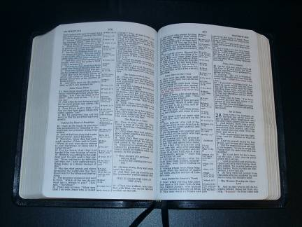
How Can the Unity the
Lord Prayed for be Recovered?
If the only “seed” sown was the New Testament, what would result?
Richie Thetford www.thetfordcountry.com

Slide 10


What is the
“church of Christ?”
NOT a denomination
  A church that “belongs to” Christ, the Lord
“And I also say to you that you are Peter, and on this rock I will build My church, and the gates of Hades shall not prevail against it.”
Matthew 16:18
Romans 16:16
Richie Thetford www.thetfordcountry.com

Slide 11
What is the
“church of Christ?
Members are simply His “disciples” who wear the name Christ (Christian)
  Acts 11:26; 26:28
New Testament Christians were the Lord’s people
  His by having obeyed the gospel and receiving the forgiveness of sins
  1 Corinthians 1:2
  Ephesians 5:25-27
Richie Thetford www.thetfordcountry.com

Slide 12
What is the
“church of Christ?
Jesus warned about adding to His Holy Word
  Revelation 22:18-19
“But He answered and said, "Every plant which My heavenly Father has not planted will be uprooted.”
Matthew 15:13
1 Corinthians 4:6
Colossians 3:17
Richie Thetford www.thetfordcountry.com

Slide 13
Jesus specified what we
MUST do to be saved
Mark 16:16; Acts 2:38; 22:16
Baptized
Matthew 10:32-33; Romans 10:10
Confess
Repent
Luke 13:3; Acts 17:30
Believe
John 3:16; Hebrews 11:6
Hear
Romans 10:17
Richie Thetford www.thetfordcountry.com

Slide 14
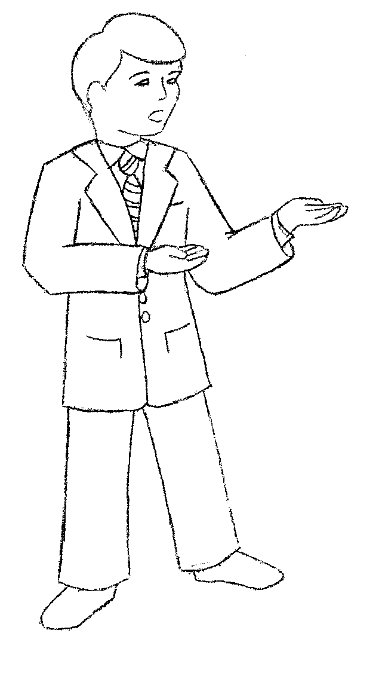
The Lord’s Church
When we do the things Jesus requires to be saved – we are then added by Him to His church
  Acts 2:38, 40-41, 47
As long as we believe AND practice only the Lord’s will, we will be the Lord’s church – and nothing else
Richie Thetford www.thetfordcountry.com

Slide 15
The Lord’s Church
If we get outside the boundaries of the Lord’s will – we will have severed our relationship with Him
  Matthew 7:21; Hebrews 5:9
“Whoever transgresses and does not abide in the doctrine of Christ does not have God. He who abides in the doctrine of Christ has both the Father and the Son.”
2 John 9
Won’t you be a member of the church that belongs to Christ?
Richie Thetford www.thetfordcountry.com

