Slide 1

Longing for Heaven,
My Eternal Home
Richie Thetford www.thetfordcountry.com

Slide 2
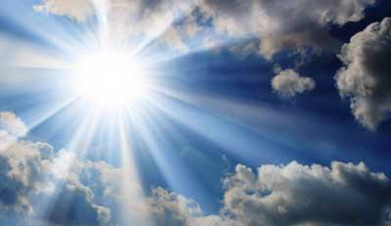
Where Is Heaven?
Bible speaks of three heavens
  Isaiah 55:10
  Psalms 8:3
  2 Corinthians 12:2
Heaven is up
  Matthew 28:2
  John 1:32
Richie Thetford www.thetfordcountry.com

Slide 3
Where Is Heaven?
Heaven is a real place
  Acts 7:55
“When He opened the fifth seal, I saw under the altar the souls of those who had been slain for the word of God and for the testimony which they held. And they cried with a loud voice, saying, "How long, O Lord, holy and true, until You judge and avenge our blood on those who dwell on the earth?”
Revelation 6:9-10
Richie Thetford www.thetfordcountry.com

Slide 4

What Is Heaven Like?
Place of reward
  Matthew 5:12
  Matthew 25:23
Place where God’s will is done
  Matthew 6:10
Place of rejoicing
  Luke 15:7
Richie Thetford www.thetfordcountry.com

Slide 5

What Is Heaven Like?
Place of different roles
  Matthew 22:29-30
No sin
  2 Peter 2:6-8
Place of rest
  Revelation 14:13
Richie Thetford www.thetfordcountry.com

Slide 6

What Is Heaven Like?
Place of beauty and wonder
  Heaven is described in figurative language
Place where there are no more tears
Revelation 7:15-17
Richie Thetford www.thetfordcountry.com

Slide 7

Who Is Going to Heaven?
Not everyone
  Matthew 7:21
Prepared for its citizens
  Philippians 3:20
Those who strive for it
  Mark 9:43-47
Richie Thetford www.thetfordcountry.com

Slide 8
Longing for Heaven,
My Eternal Home
Heaven should be our incentive
to spiritual growth
Richie Thetford www.thetfordcountry.com

