Slide 1
Living for God’s son in 2021
Beginning the New Year!
Richard Thetford www.thetfordcountry.com

Slide 2
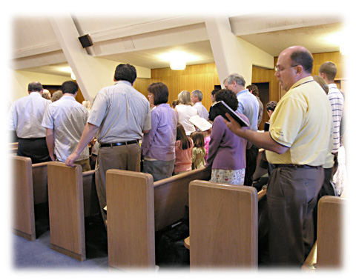
Living for God’s Son in 2021
Hold fast
Hebrews 10:22
1 Corinthians 15:58
Assemble regularly
Hebrews 10:24-25
Richard Thetford www.thetfordcountry.com

Slide 3
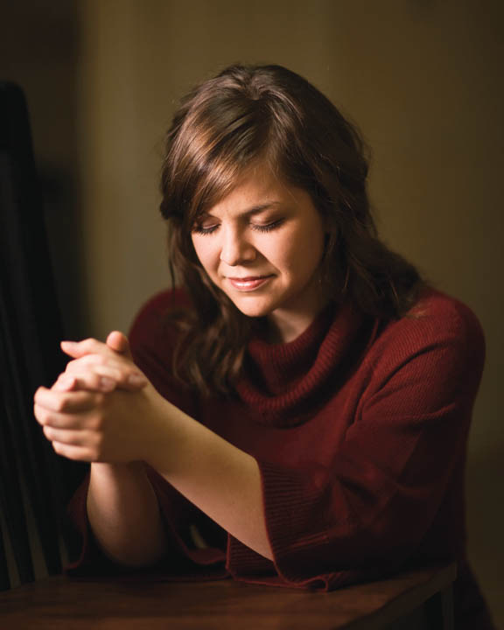
Living for God’s Son in 2021
Pray everyday
James 5:16
1 Thessalonians 5:17
Prepare our heart
Ezra 7:10
Amos 4:12
Richard Thetford www.thetfordcountry.com

Slide 4
Living for God’s Son in 2021
Yield not
Matthew 26:41
Neglect not opportunities
Galatians 6:10
Richard Thetford www.thetfordcountry.com

Slide 5
Living for God’s Son in 2021
Exercise ourselves
1 Timothy 4:7-8
Hebrews 5:12-14
Work diligently
Titus 3:1
Nehemiah 4:6
Richard Thetford www.thetfordcountry.com

Slide 6
Living for God’s Son in 2021
Be instruments of righteousness
Romans 6:13, 16-18
Examine ourselves
2 Corinthians 13:5
Galatians 6:4
2 Corinthians 10:12
Richard Thetford www.thetfordcountry.com

Slide 7
Living for God’s Son in 2021
Aim at perfection
Hebrews 6:1
Colossians 3:14
Matthew 5:48
Redeem the time
Ephesians 5:16
Colossians 4:5
Richard Thetford www.thetfordcountry.com

Slide 8
Live for God’s son in 2021
The best year spiritually!
Richard Thetford www.thetfordcountry.com

