Slide 1

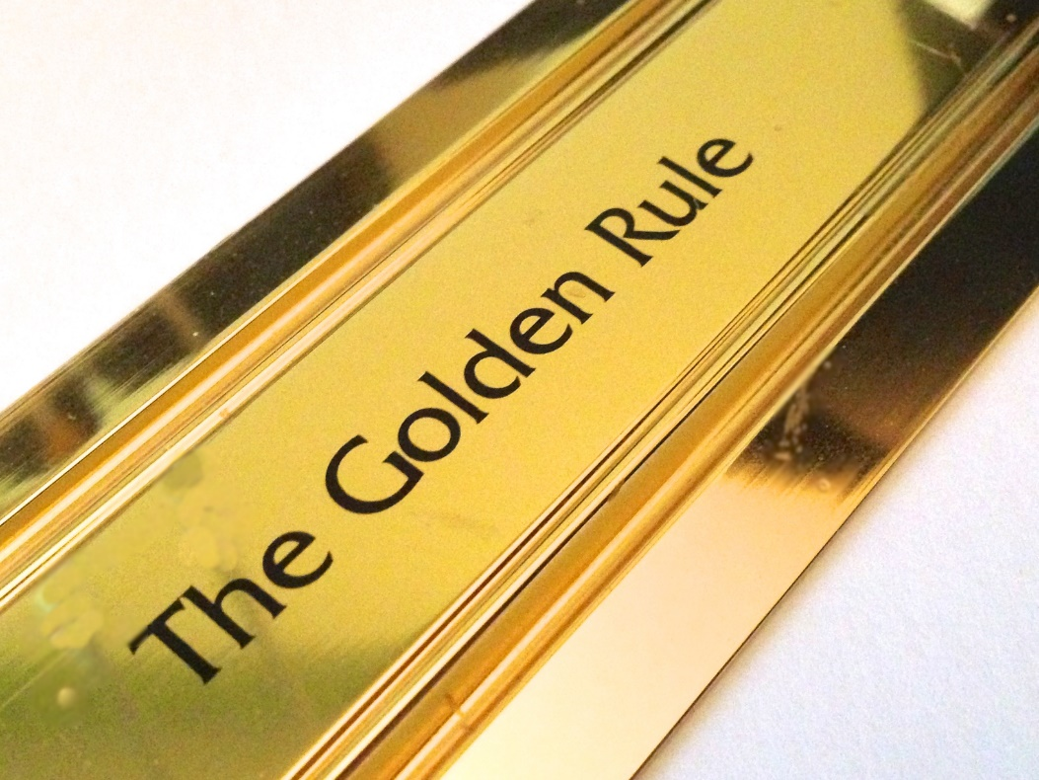
Living By the Golden Rule
“Therefore, whatever you want men to do to you, do also to them, for this is the Law
and the Prophets.”
Matthew 7:12

Slide 2

Obligation Involved in the
Golden Rule
“Let all your dealings with men be conducted in the same spirit in which you would desire them to deal with you”
“golden rule” says do
Responsibility is placed
on my shoulders
An obligation of love
  John 15:12
  John 13:34-35

Slide 3
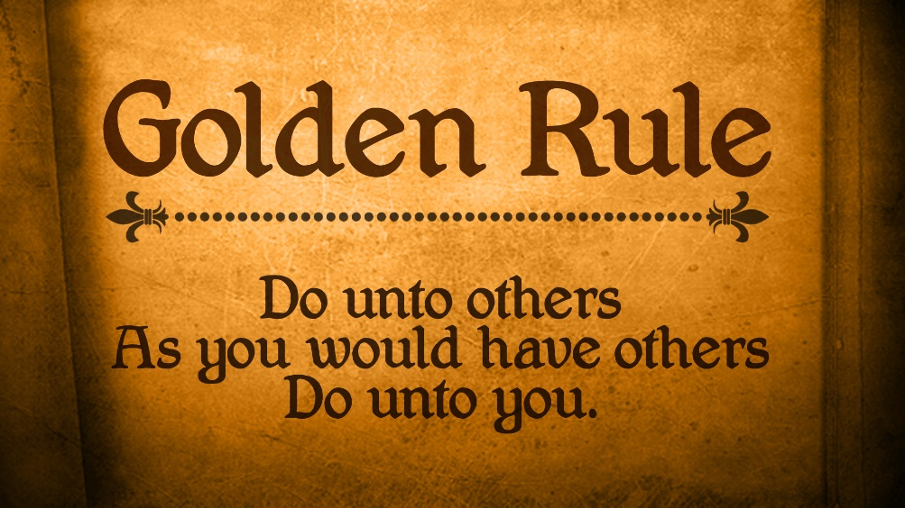
Obligation Involved in the
Golden Rule
An obligation of kindness and forgiveness
  Ephesians 4:32
An obligation of compassion
  1 Peter 3:8
  Matthew 9:36

Slide 4

Golden Rule
Versus Rules of Society
The “vandal” rule
The “pleasure” rule
The “iron” rule
The “it’s legal” rule
The “non-involvement” rule
The “brass” rule
The “silver” rule
  “do not do unto others what you would not want them to do to you”

Slide 5
Golden Rule
Would Make a Difference!
Divorce would be canceled
  Men how to treat their wives:
    Ephesians 5:22-33
    1 Peter 3:7
  Women how to treat their husbands
    1 Peter 3:1-6
    Titus 2:4
Child/Parental abuse would stop
  Ephesians 6:1-4

Slide 6
Golden Rule
Would Make a Difference!
No need for unions or legislation
Jails, etc. would be unnecessary
More unfaithful would be restored
Arguments, etc. no longer a problem
Friendships would remain loyal
Relationship with God would be strong
More people being taught the truth

Slide 7
Golden Rule
Broken in Many Ways
Parents neglect their children
Children neglect their parents
Husbands neglect their wives
Wives neglect their husbands
We neglect to see the needs of others
  Matthew 25:31-46
  Galatians 6:1-2, 10
Often neglect to teach the lost
  Romans 10:1, 13-15

Slide 8
Golden Rule
Broken in Many Ways
By ignoring others because we think we are better than they are
  Luke 14:7-11
By sarcastic remarks
By the use of gossip and slander
  Galatians 5:15
  Tongue must be guarded at all times
    James 3

Slide 9

Why Do We Break the
Golden Rule?
Our own sins cause us to treat others
as we do
Jealousy and envy is often the cause
Ignorance
A lack of love
  John 13:34-35

Slide 10
Conclusion
Matthew
7:12
Nothing could go further in changing life in general for the better than living the “golden rule”

