Slide 1
Human resources slide 1
LIVING BY FAITH
1 Corinthians 1:10
Romans 1:16-17
Galatians 3:11
2 Corinthians 5:7
Hebrews 10:38
Richie Thetford www.thetfordcountry.com

Slide 2

Living by Faith – Requires God’s Word
“So then faith comes by hearing, and hearing by the word of God.”
Romans 10:17
We can’t believe in something without
a word from God
  1 John 1:7
It reveals what is wrong with the
“but the Bible doesn’t say I can’t”
doctrine
If no word from God – then there is no faith
Richie Thetford www.thetfordcountry.com

Slide 3
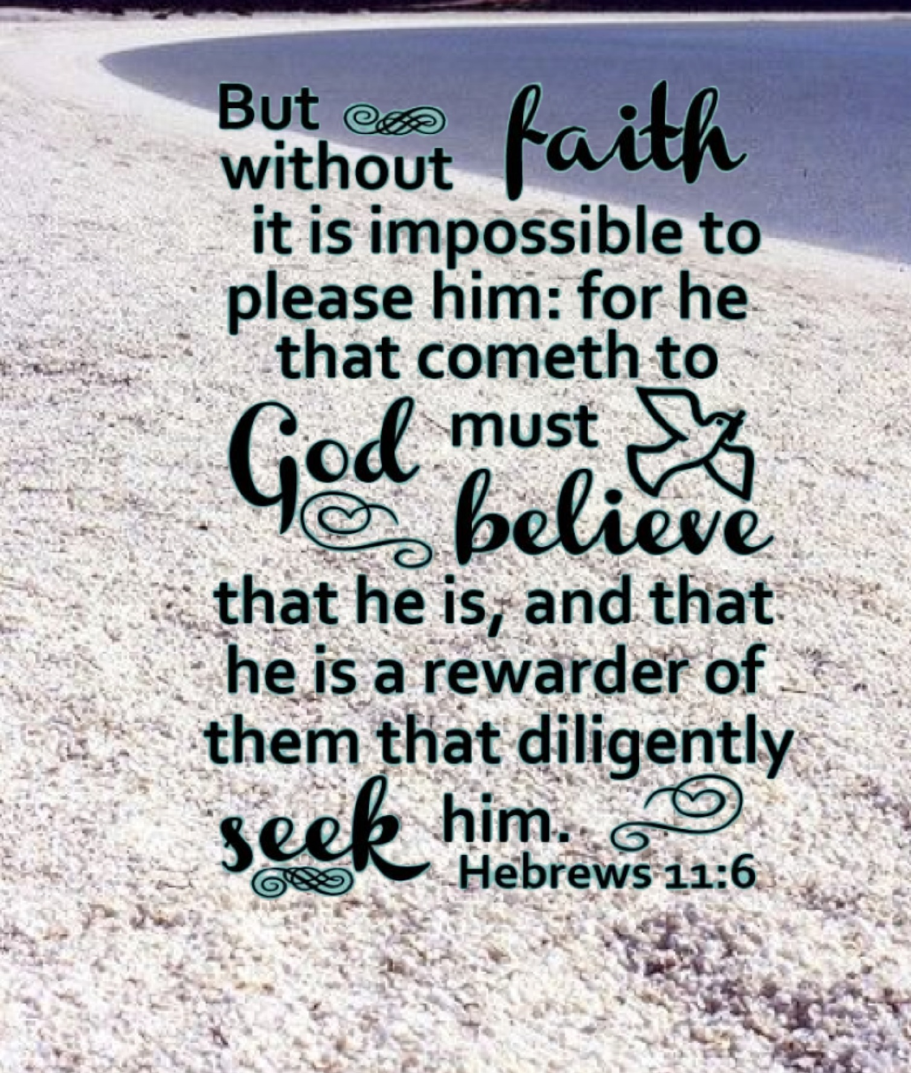
Living by Faith – Illustrated
Hebrews 11 shows us what faith is about
  Noah (v.7)
  Abraham (v.8-10, 17-19)
  Walls of Jericho (v.30)
If God has specified – the rest is excluded
  2 Timothy 4:2
  Mark 16:15
Richie Thetford www.thetfordcountry.com

Slide 4

Living by Faith – In What We Say
“If anyone speaks, let him speak as the oracles of God…”
1 Peter 4:11
Speak what God has spoken
  Colossians 1:18
  Ephesians 4:4
“contend earnestly for the faith…”
“…From heaven or from men?...”
Matthew 21:25
Richie Thetford www.thetfordcountry.com

Slide 5

Living by Faith – In What We Do
“And whatever you do in word or deed, do all in the name of the Lord Jesus…”
Colossians 3:17
By His own authority
If not spoken by the Lord – Presumptuous
  Deuteronomy 18:22
Presumptuous: Failing to observe the limits of what is permitted or appropriate
Richie Thetford www.thetfordcountry.com

Slide 6
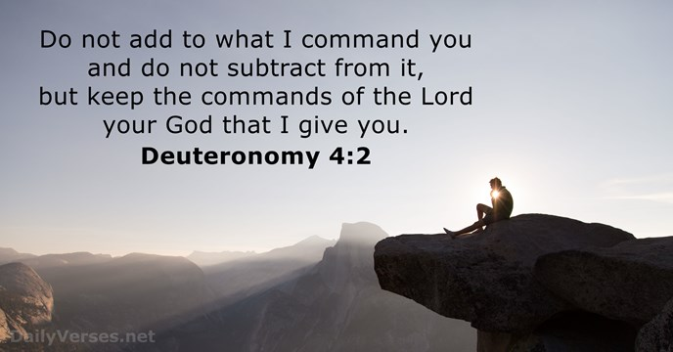
Living by Faith – In What We Do
“And whatever you do in word or deed, do all in the name of the Lord Jesus…”
Colossians 3:17
Not permitted to do anything beyond
what is written by God
  1 Corinthians 4:6
  Deuteronomy 4:2
  Proverbs 30:5-6
  Revelation 22:18-19
Richie Thetford www.thetfordcountry.com

Slide 7
Human resources slide 1
LIVING BY FAITH
If we live by faith, we will know that God is pleased
with how we live
“Is it from heaven
or is it from men?”
Richie Thetford www.thetfordcountry.com

