Slide 1
Letting Go
and
Moving On
Richard Thetford www.thetfordcountry.com

Slide 2
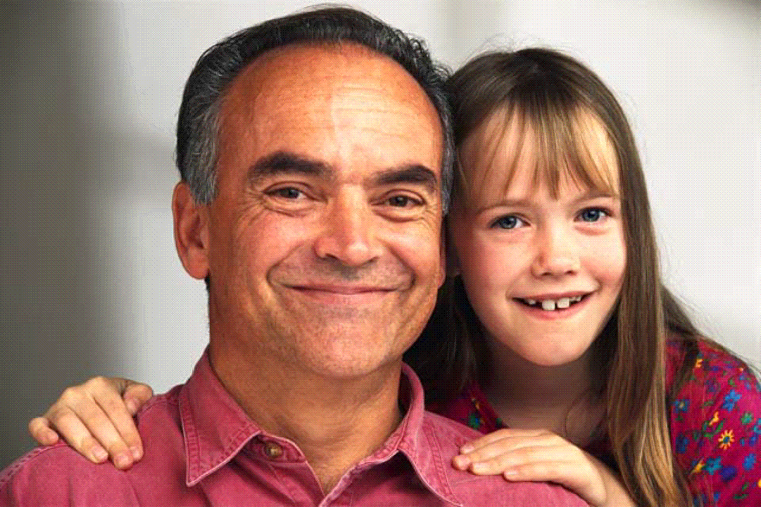
Philippians 3:4-16
Richard Thetford www.thetfordcountry.com

Slide 3
“But what things were gain to me, these I have counted loss for Christ. Yet indeed I also count all things loss for the excellence of the knowledge of Christ Jesus my Lord, for whom I have suffered the loss of all things, and count them as rubbish, that I may gain Christ and be found in Him, not having my own righteousness, which is from the law, but that which is through faith in Christ, the righteousness which is from God by faith; that I may know Him and the power of His resurrection, and the fellowship of His sufferings, being conformed to His death, if, by any means, I may attain to the resurrection from the dead.”
Philippians 3:7-11
Richard Thetford www.thetfordcountry.com

Slide 4
His Loss and Gain
“But what things were gain to me, these I have counted loss for Christ” (Philippians 3:7)
“were gain” and “counted loss”
Weighing one thing over or against another
Paul let other things go for the sake of Christ
“Yet indeed I also count all things loss for the excellence of the knowledge of Christ Jesus my Lord” (Philippians 3:8)
Paul moves from the past to the present
“knowledge” was to KNOW Christ
Richard Thetford www.thetfordcountry.com

Slide 5
His Loss and Gain
“that I may know Him and the power of His resurrection” (Philippians 3:10)
To “know” – to be fully incorporated in Him
To think as He would think, to love as He would love, to serve as He would serve
It means “I have been crucified with Christ; it is no longer I who live, but Christ lives in me” (Galatians 2:20)
Also to know the power of His resurrection
That is exemplified in the life of the Christian
End of an old life – beginning of a new
Romans 6:3-7
Richard Thetford www.thetfordcountry.com

Slide 6
“Not that I have already attained, or am already perfected; but I press on, that I may lay hold of that for which Christ Jesus has also laid hold of me. Brethren, I do not count myself to have apprehended; but one thing I do, forgetting those things which are behind and reaching forward to those things which are ahead, I press toward the goal for the prize of the upward call of God in Christ Jesus.”
Philippians 3:12-14
Richard Thetford www.thetfordcountry.com

Slide 7
Pressing Toward the Mark
“Not that I have already attained, or am already perfected; but I press on…” (Philippians 3:12)
Always room for progress
The prize is available at the end of the race
“Or am already perfected” – Paul never claimed to have been perfect
“I press on” – Paul knew he had to continue to press forward
In order to obtain the prize!
Richard Thetford www.thetfordcountry.com

Slide 8
Pressing Toward the Mark
“Brethren, I do not count myself to have apprehended; but one thing I do, forgetting those things which are behind and reaching forward to those things which are ahead” (Philippians 3:13)
Constant effort required to obtain the prize
Forgot about those things which he once thought of as gain (v7)
Eager to receive that which was before him
Richard Thetford www.thetfordcountry.com

Slide 9
Pressing Toward the Mark
“I press toward the goal for the prize of the upward call of God in Christ Jesus” (Philippians 3:14)
His eyes are fixed on the goal of heaven
He presses through every difficulty to reach it
At the conclusion of his life he said:
“I have fought the good fight, I have finished the race, I have kept the faith. Finally, there is laid up for me the crown of righteousness, which the Lord, the righteous Judge, will give to me on that Day, And not to me only but also to all who have loved His appearing.” 2 Timothy 4:7-8
Richard Thetford www.thetfordcountry.com

Slide 10
“Therefore let us, as many as are mature, have this mind; and if in anything you think otherwise, God will reveal even this to you. Nevertheless, to the degree that we have already attained, let us walk by the same rule, let us be of the same mind.”
Philippians 3:15-16
Richard Thetford www.thetfordcountry.com

Slide 11
Encouragement to the Mature
“…to the degree that we have already attained…” (Philippians 3:16)
Paul encourages all who are mature
To have the mind or spirit indicated in Vs 7-14
Richard Thetford www.thetfordcountry.com

Slide 12
Let Go
Richard Thetford www.thetfordcountry.com

Slide 13
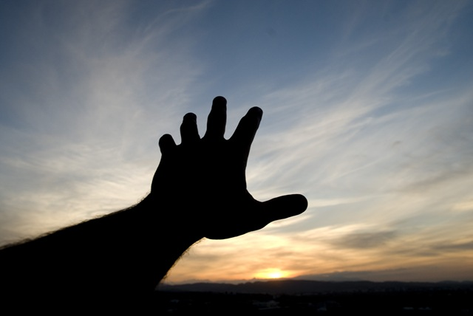
Reach
Forward!
Richard Thetford www.thetfordcountry.com

