Slide 1
LET US NOT GROW WEARY WHILE DOING GOOD
And let us not grow weary while doing good, for in due season we shall reap if we do not lose heart.
Galatians 6:9

Slide 2
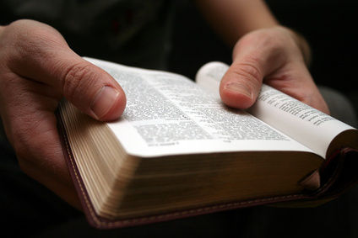
An Admonition Not to Grow Weary
To grow weary is to be selfish
Galatians 2:20
Philippians 3:13-14
Doubt causes weariness
Philippians 4:13

Slide 3
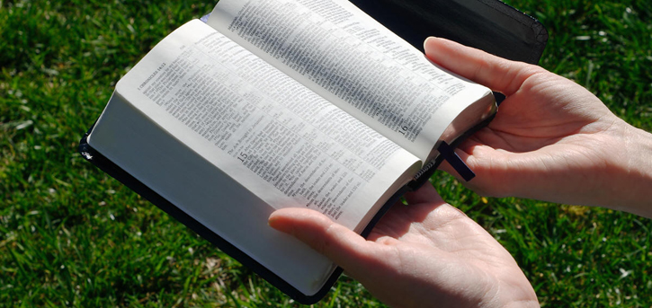
An Admonition Not to Grow Weary
Those who grow weary are concerned with the earthly
Matthew 7:13-14
Colossians 3:1-7
Isaiah 55:9-11
The word:
John 1:1-2,14
To grow weary may indicate fear
Matthew 10:28; 5:11-12; 1 Peter 3:14-15

Slide 4
A Reminder That There Will Be a Harvest
Harvest according to that sown
Galatians 6:7
2 Corinthians 5:10
Reward is reserved in heaven
1 Peter 1:3-5
Hebrews 9:28

Slide 5
A Reminder That There Will Be a Harvest
For those who love the Lord’s appearing
We will be denied if we deny the Lord
Matthew 10:32-33
I have fought the good fight, I have finished the race, I have kept the faith. Finally, there is laid up for me the crown of righteousness, which the Lord, the righteous Judge, will give to me on that Day, and not to me only but also to all who have loved His appearing. (2 Timothy 4:7-8)

Slide 6
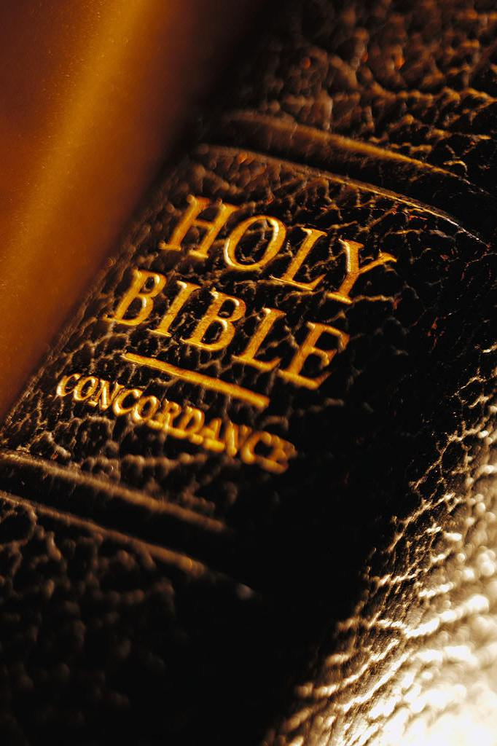
The Fact That Salvation is Conditioned Upon Faithfulness
If we do not grow weary
Galatians 6:9
Must continue to be steadfast
1 Corinthians 15:58
Must fight the good fight of faith
1 Timothy 6:12
Ephesians 6:12
2 Timothy 2:3-4

Slide 7
The Fact That Salvation is Conditioned Upon Faithfulness
It is possible to grow weary
Hebrews 6:4-6
Must abide in Christ
John 15:1-10
Must add Christian Characteristics
2 Peter 1:5-11
2 Corinthians 8:7
Can fall – must remain faithful
1 Corinthians 10:12; Rev 2:10

Slide 8
Conclusion
When we grow weary – we begin to sink
Belief in the Lord will prevent weariness
The good harvest follows the good life
Hebrews 12:2-3
Consider all that Jesus has done for us and when we do, we won’t grow weary while doing good!

