Slide 1
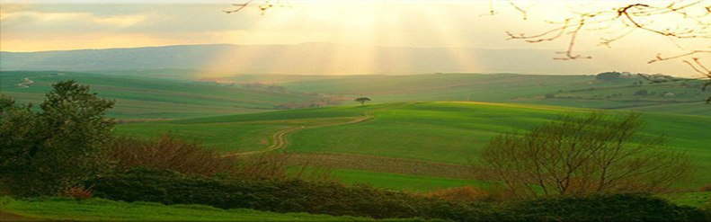
Let Us Draw Near to God
“Draw near to God and He will draw near to you….”
James 4:8
6
Things that we should do to draw near to God
Richie Thetford www.thetfordcountry.com

Slide 2

Divorce Ourselves From The World
The groundwork that we must understand
  James 4:4
  Matthew 6:24
  1 John 2:15-17
  2 Corinthians 6:14-7:1
Christians who “love the world”
are adulterers
  Ephesians 5:22-33
Richie Thetford www.thetfordcountry.com

Slide 3

Divorce Ourselves From The World
The Lord is a jealous God
  James 4:5
  Likened to a jealous husband who takes offense when his bride is with another man
“For I am jealous for you with godly jealousy. For I have betrothed you to one husband, that I may present you as a chaste virgin to Christ.”
2 Corinthians 11:2
Richie Thetford www.thetfordcountry.com

Slide 4
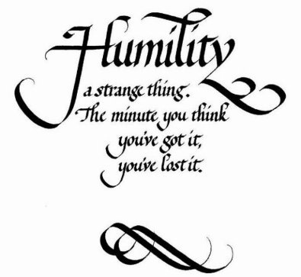
Exalted Through Humility
We must be humble
  James 4:6
  Proverbs 3:34
    Man’s arrogance and pride will drive him away, not near to God
Humility does not mean thinking less of yourself than of other people,
nor does it mean having a low opinion of your own gifts. It means freedom from thinking about yourself one way or the other at all (William Temple)
Richie Thetford www.thetfordcountry.com

Slide 5
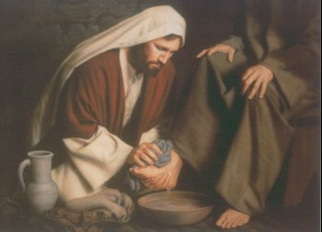

Exalted Through Humility
When we become humble then we
will be exalted
  James 4:10
  Proverbs 15:33; 18:12
  Jesus was exalted AFTER he gave his life a ransom
    Matthew 20:26-28
Richie Thetford www.thetfordcountry.com

Slide 6


Submit to God
Must be submissive to Him
  James 4:7
    To “submit” means to “put oneself under”
Power can’t force submission – Love can earn submission
Have you submitted to God?
  The plan of salvation
  The law of God
  His providence
Richie Thetford www.thetfordcountry.com

Slide 7

Resist the Devil
Be set to “resist the Devil”
  James 4:7
  Must be prepared to resist the Devil in order to draw near to God
    1 Peter 5:8
  God gives Christians the resources necessary to resist
    1 Corinthians 10:13
Richie Thetford www.thetfordcountry.com

Slide 8
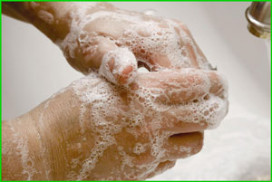
Cleanse Your Hands and
Purify Your Hearts
Follow God’s instructions
  James 4:8
    Cleansing of hands is a figurative way to emphasize the purity of life
    1 Peter 1:22
  Think on clean things
    Philippians 4:8
We cannot draw near to God
with a heart that continues to
be filled with moral filth!
Richie Thetford www.thetfordcountry.com

Slide 9

Be Afflicted, Mourn and Weep
Lament, mourn and weep
  James 4:9
    We are to mourn over our sins and forsake them
    We must have a godly sorrow for sin we have committed
A disposition that laughs
at sin must be broken
Richie Thetford www.thetfordcountry.com

Slide 10
Conclusion
In order to draw near to God, one must do the things in which James taught
DO WE WISH TO BE NEAR TO GOD?
  If so – we must be determined to be!
“Draw near to God and He will draw near to you….”
James 4:8
Richie Thetford www.thetfordcountry.com

