Slide 1
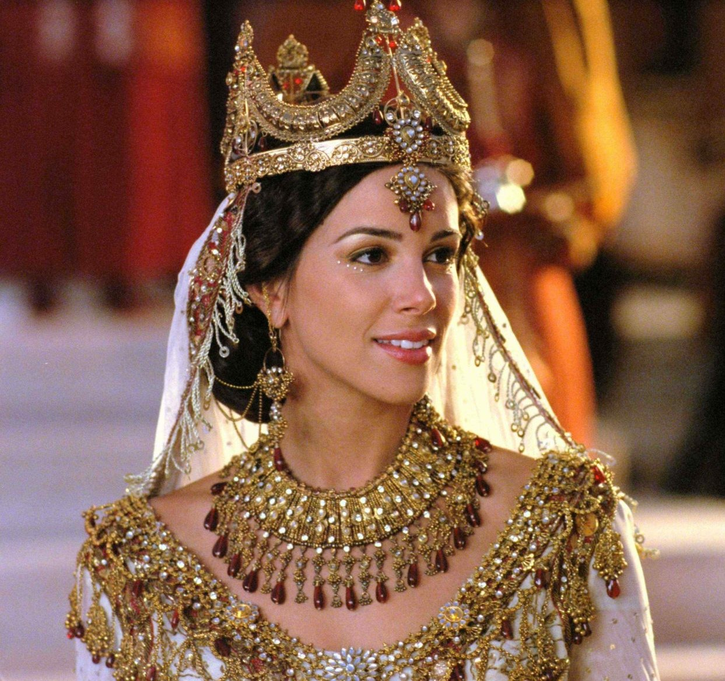
Lessons Learned from
Esther
Esther 2:5-9
Richie Thetford www.thetfordcountry.com

Slide 2
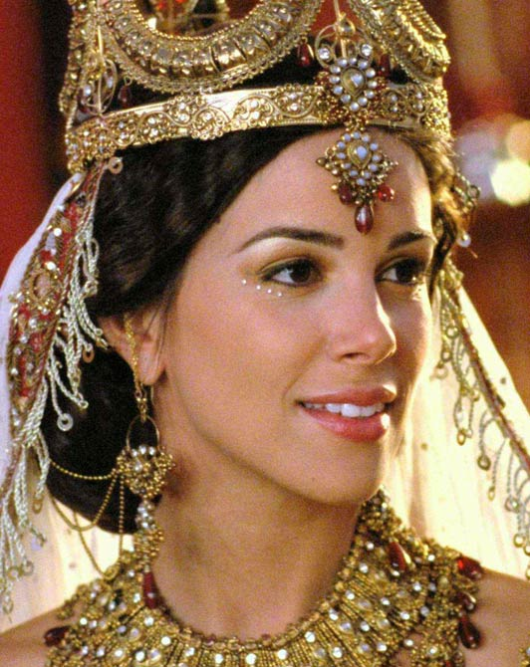
Key Verse
And Mordecai told them to answer Esther: “Do not think in your heart that you will escape in the king’s palace any more than all the other Jews. For if you remain completely silent at this time, relief and deliverance will arise for the Jews from another place, but you and your father’s house will perish. Yet who knows whether you have come to the kingdom for
such a time as this?”
Esther 4:13-14
Richie Thetford www.thetfordcountry.com

Slide 3
Story of the Book of Esther
Vashti’s downfall
  (chapter 1)
Esther’s selection and marriage
  (2:1-20)
Mordecai’s service to the king
  (2:21-23)
Haman’s promotion and plot
  (chapter 3)
Richie Thetford www.thetfordcountry.com

Slide 4
Story of the Book of Esther
Proclamation of destruction
  (4:1-14)
Esther’s plan begun
  (4:15-5:8)
Haman’s plan against Mordecai
  (5:9-14)
Honor of Mordecai
  (6:1-14)
Richie Thetford www.thetfordcountry.com

Slide 5
Story of the Book of Esther
Esther’s plan completed
  (7:1-10)
Salvation of Mordecai and the Jewish people
  (8:1-17)
Jewish victory over their enemies
  (9:1-16)
Richie Thetford www.thetfordcountry.com

Slide 6
Story of the Book of Esther
Celebration of their victories
  (9:17-32)
Mordecai’s notoriety
  (10:1-3)
Richie Thetford www.thetfordcountry.com

Slide 7
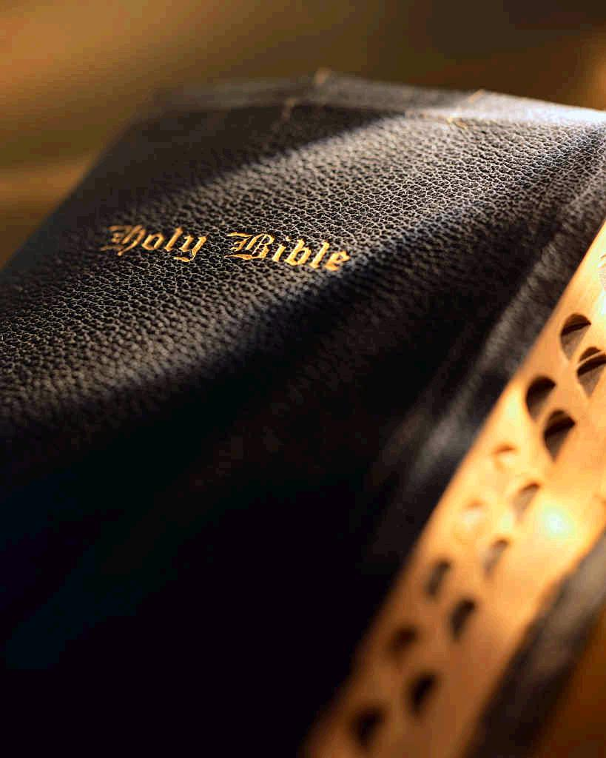
Lessons Learned from the book of
Esther
God can use evil men to accomplish good things for His people
  Romans 8:28
Courage is a virtue worth rewarding
  2 Timothy 1:7-8
Richie Thetford www.thetfordcountry.com

Slide 8
Lessons Learned from the book of
Esther
Pride goes before destruction
  Proverbs 16:18
Anger does nothing but build our own gallows
  Ephesians 4:31
Richie Thetford www.thetfordcountry.com

Slide 9
Lessons Learned from the book of
Esther
God takes care of His people
  Hebrews 13:5-6
Practical lessons noted from
the book of Esther
God always takes care of His people
– we are God’s people today!
Richie Thetford www.thetfordcountry.com

