Slide 1
Acts 19:1-7
Lessons Learned From Twelve Disciples

Slide 2
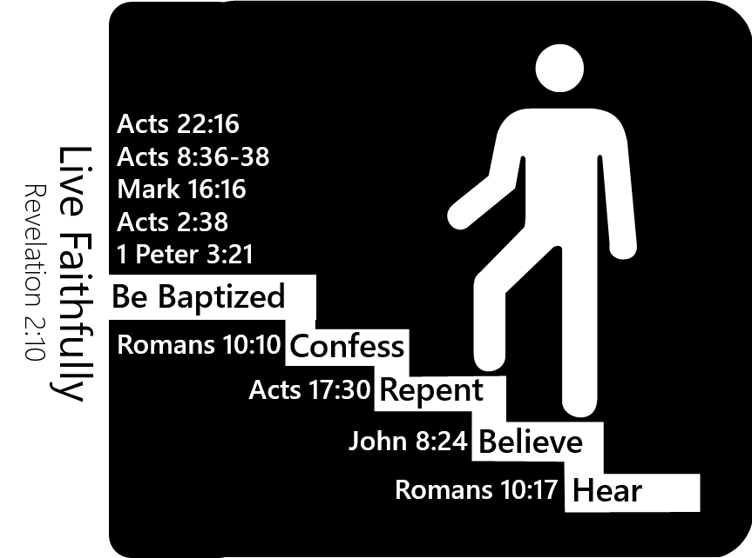
Lessons Learned From Twelve Disciples
Cannot be taught wrong and do right
John 8:32
Matthew 7:21-23
Are things which we must be right
Plan of salvation
Church
Worship
Etc.

Slide 3
Lessons Learned From Twelve Disciples
Salvation can’t be had without Christ
John 14:6
Acts 4:12
Matthew 28:18
All must be done in Jesus’ name
Acts 2:38
Colossians 3:17

Slide 4
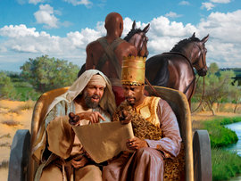
Lessons Learned From Twelve Disciples
Must be honest and change when shown to be wrong
Day of Pentecost
Acts 2
Eunuch
Acts 8:29-39
Cornelius
Acts 10

Slide 5
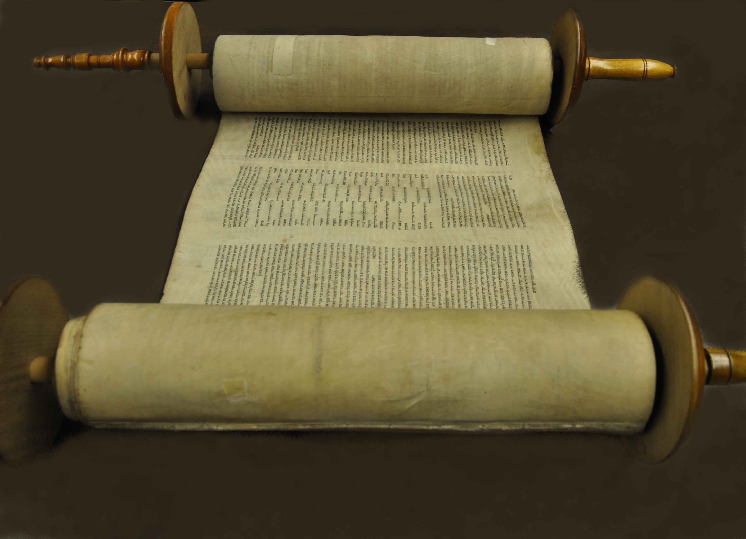
Lessons Learned From Twelve Disciples
Past authorizations may not be authorized today
John 4:1-4
Luke 3:3
Old Testament was once authorized
Sabbath Day
Instrumental Music
Animal Sacrifices

Slide 6
Lessons Learned From Twelve Disciples
Can be a disciple and not have learned enough
2 Timothy 3:7
Can be a believer without being saved
John 12:42-43
James 2:19

Slide 7
Lessons Learned From Twelve Disciples
A thing CAN be wrong without it stated as being wrong
John’s baptism
Sincerity in what one believes to be right is not enough
Proverbs 14:12
Proverbs 28:26

Slide 8
Lessons Learned From Twelve Disciples
We may need help from others to learn the truth
Day of Pentecost
Eunuch
Cornelius
Twelve disciples

